Slide 1
Welcome to
PayPath Actions
Please locate and open the
Cisco AnyConnect VPN Client while waiting for class to start.
Notes:
Welcome to PayPath Actions training. This course outlines the process required to manage incumbents hired into positions in UCPath.

Slide 2
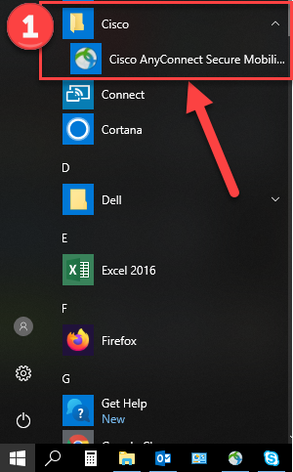
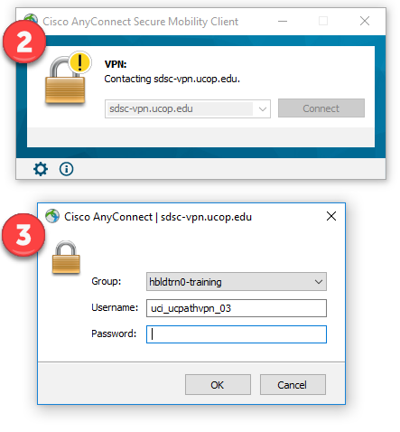
Steps to Log Into VPN
Locate and open the Cisco AnyConnect VPN client.
Enter sdsc-vpn.ucop.edu and click the Connect button.
Enter the following:
  Select Group: hbldtrn0-training
  Enter 1 of these 3 Usernames:
    uci_ucpathvpn_01
    uci_ucpathvpn_02
    uci_ucpathvpn_03
  Enter this week’s Password:
    Down-Hole

Slide 3


Introductions
Instructor
Name
UCI role
UCPath role
Functional experience

Slide 4
Course Agenda
PayPath Actions Part 1
1: PayPath Transactions Overview
2: Position Data Changes
3: Job Data Changes
4: Additional Pay

Slide 5
Course Agenda
PayPath Actions Part 2
Combination Changes
Retroactive PayPath Adjustments

Slide 6

Course Objectives
By the end of this course, you should be able to:
Understand the PayPath Transaction system process.
Describe the PayPath Actions entry pages.
Describe the PayPath transaction action and reason codes.
Enter position data change PayPath transactions.
Initiate job data change PayPath transactions.
Create additional pay PayPath transactions.

Slide 7
Key Concepts & Vocabulary
UCPath Term | Definitions
Action/Action Reason: | A data field on the PayPath Actions page, used to describe the type of job/position data recorded in UCPath via the P.
Additional Pay: | Any amount paid to an employee which is in addition to the employee’s regular, base compensation. Can also be used to pay student employees who ONLY receive additional pay; however, not to CWR employees.
Approval Workflow Engine (AWE): | UCPath functionality that routes transactions in UCPath to designated roles (e.g., Initiator or Approver). Upon approval, transactions are either routed to the UCPath Center (UCPC) for finalization or are finalized in UCPath.
Effective Date: | The date the transaction is supposed to take place. This date is to used to maintain and view a complete chronological record of historical, current and future data. PayPath Actions can be future or retro effective dated depending on the action and other job data.
Incumbent: | An employee assigned/hired to a Position. Also known as an “Employee”.
One Time Pay: | One-time Payments that apply to a single pay cycle (e.g., not recurring and non-consecutive pay cycles.)

Slide 8
Key Concepts & Vocabulary (cont.)
UCPath Term | Definitions
Position: | A position must exist in order to hire an incumbent. Job data is created when an employee is hired into a position, the position details are then managed via PayPath Actions.
Recurring Pay: | Consecutive, recurring pay in addition to an Employees’ base compensation, including: recurring stipends, By-Agreement Payments.
Retroactive Effective Date: | Date prior to the current pay period begin date.
Short Work Break (SWB): | A status that temporarily takes an employee off of pay status when a leave action is not appropriate, where permitted by policy or collective bargaining agreement. (see Short Work Break Matrix job aid.)
Workforce Administration (WFA): | Workforce Administration is a moduel in UCPath where personal data, job data, reporting and tracking for Employees, and Contingent Workers are administered, managed and stored. This is similar to the Employee Data Base (EDB) in PPS today.

Slide 9
Payroll Processing Calendar
All PayPath Actions are subject to the UCPC Payroll Processing Calendar deadlines.
https://www.ucop.edu/ucpath-center/_files/mypath/calendar/payroll-processing-schedule-2019.pdf

Slide 10
Lesson 1
PayPath Transactions Overview

Slide 11

Lesson Objectives
PayPath Transactions Overview
3: Job Data Changes
4: Additional Pay
2: Position Data Changes
In this lesson you will learn how to:
Identify the transactions performed using PayPath Actions.
Describe the PayPath Transaction system process.
Identify the PayPath transaction action and reason codes.
Describe the PayPath Actions entry pages.

Slide 12
PayPath Actions – Overview
PayPath Actions is a custom component designed to streamline updates to employee data in UCPath.
Once an employee is hired into a Position, the employee and their job details are managed using PayPath Actions.
The PayPath Actions component provides intuitive, compliant functionality that is designed to meet UC's academic and staff requirements. This component offers a one-stop-shop for processing various types of transactions and the flexibility to submit multiple actions in a single transaction.
PayPath integrates changes to position data, job data and additional pay, providing a tight integration between HR actions and funding requirements.
Notes:
Integration between HR actions and funding: After a PayPath transaction that affects compensation is processed, UCPath reallocates funding to ensure that all components of pay are allocated to the correct fund source, and to ensure that the salary cap and other funding compliance requirements are followed. The designated role at Locations updates funding using the Funding Entry page if necessary upon notification of a job change.

Slide 13
PayPath Actions – Important Notes
ALL PayPath transactions have to be submitted and approved at UCI prior to the Payroll Processing deadline.
If a PayPath transaction affects compensation, funding reallocates to ensure that all components of pay are allocated to the correct fund source after the transaction is processed. PayPath also ensures that the salary cap and other funding compliance requirements are followed. If necessary, employees with certain roles can update funding via Funding Entry page upon notification of a job change.
Only active employee records (Active, Paid Leave, Unpaid Leave or Short Work Break, including future hires) will be accessed through PayPath.
PayPath will be accessed by employee record. Therefore, if an employee has more than one job, each record will have to be updated separately. If multiple records exist, this may require coordination with another department or location.
When the transactions are submitted and approved, the information is updated based on the effective date entered.
Notes:
PayPath Actions are written to the system upon completion of the AWE process. However, information will not be available in Reports until the next ODS update (usually overnight).

Slide 14
Transactions Processed in PayPath Actions
The following types of transactions are processed for staff and academic employees using PayPath Actions.
Position data changes can be entered only for positions that have a single active incumbent.
  New or vacant positions must be created/updated using a Position Control Request.
PayPath Actions are not used to hire, terminate, transfer employees to a new position, or place employees on a leave of absence.
PayPath Actions Transactions
Position Data Changes Job Data Changes Additional Pay
Notes:
Smart HR Templates are used to Hire, Terminate and Transfer to new position (among other actions).
Extended Leaves are used to place employees on leave of absence.
Refer to the Web-based Training course WFA110 – WFA Overview for more information.

Slide 15
PayPath Actions – Examples
Examples of changes requested through PayPath Actions:
Academic Merit, Promotion or Change in Series
Retro Academic Merits, Promotions, Series Changes
Position and/or Job Data FTE Changes
Salary Only Changes / Pay Rate Changes
Short Work Break / Return from Short Work Break
Abeyance / Return from Abeyance
Recurring Additional Pay Payments
Employee Reduction In Time (ERIT)
Probationary Status and Trial Employment Changes
Notes:
Use of Abeyance: Position on hold while employee takes another position (ex: faculty member becomes medical center director and then returns to faculty position). This transaction is available via “Short Work Break”. The Action/Action Reason codes are available for the appropriate job code.
Many of these examples are covered throughout this training course.

Slide 16
PayPath Actions – Components
There are two PayPath Actions components, one for academic and one for staff. Data and transaction options displayed are based on the type of employee selected.
Some examples of the differences between Academic and Staff components:
Some fields display values as applicable for staff or academic. For example: position data and job data Action/Action Reason fields and valid Comp Rate Codes.
The Employee Class field is display-only for academic employees (derived from Job Code), versus editable for staff employees.
Job Data page, under UC Job Data section, different fields are visible as relevant to staff or academic. For example, staff employees have fields related to Probation and Probation Date, while academic employees have dates such as Post Docs Anniversary Date and Academic Duration of Appt.
Notes:
The display of the PayPath Actions component is based on the type of employee selected from the search page. The component title and page titles do not change. Some of the content within the component changes as needed based on the selection of the employee.
There are several demonstration and exercise simulations provided in this course that demonstrate Staff or Academic transactions. Sometimes the simulation demonstrates both Staff and Academic because the steps to perform certain transactions are the same.

Slide 17
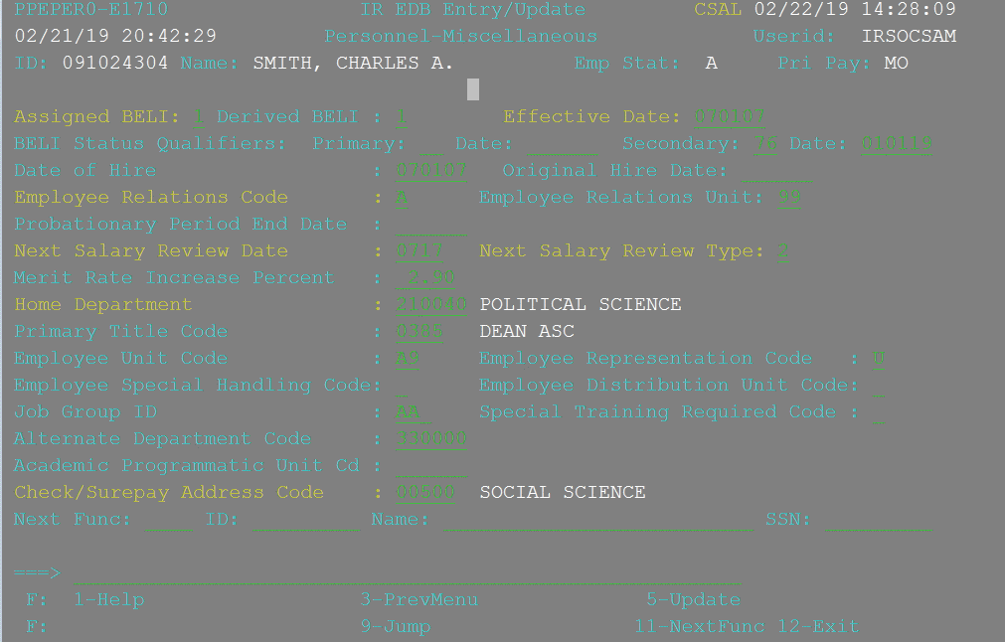
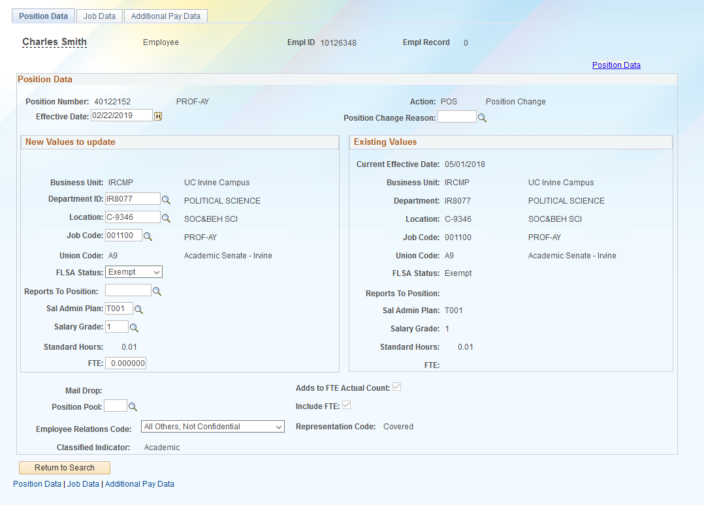
PPS and PayPath
In UCPath, Initiators will use PayPath to update job information for existing employees. In comparison, PPS Processers used the CSAL bundle in PPS to make similar changes.
PPS - CSAL (Classic View)
UCPath - PayPath
Notes:
This is a slide to show the PPS vs. UCPath comparison for the screens that are used to make changes to an existing employee. The CSAL bundle contains the appropriate data entry screens that were needed to make updates such as promotions, reclassifications, rate changes, or appointment renewals

Slide 18
Person Organizational Summary Overview
Always use the Person Org Summary page to view a summary of an employee’s current organizational relationships, including HR and payroll status, primary job assignment and other current job assignment details.
This page displays current employee information for all organizational relationships: Employee & Contingent Worker (CWR).
  An employee may have more than one organizational relationship concurrently. For example, the person may be an employee at one UC Location and a CWR at another.
This page does not have row-level security. If you have access to this page, you can view job assignment information for all employee records across all locations.
This page does not display historical or future-dated employment details. Please use Workforce Job Summary page to view current and historical employee job data information.
Notes:
The PayPath Initiator reviews the Person Org Summary page before initiating a PayPath transaction. This page provides the status of the employee’s current assignments. If you are initiating a change to an employee’s job information, you should use this page to validate the current employment status in UCPath. You can also use the Workforce Job Summary page. If you don’t know the employee’s ID you can use the Search Match page to find the ID.
Workforce Job Summary Navigation: PeopleSoft Menu > Workforce Administration > Job Information > Review Job Information > Workforce Job Summary

Slide 19
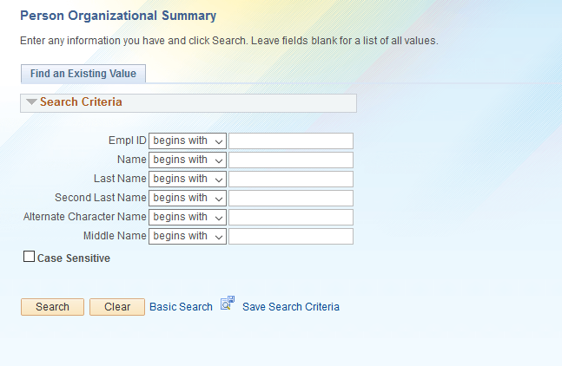
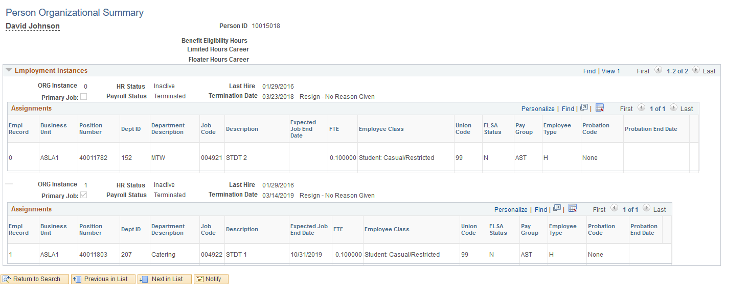
Person Organization Summary
Navigation: PeopleSoft Menu > Workforce Administration > Personal Information > Person Organizational Summary
If there is more than one row of data, click the View All link to view all current information.
Notes:
This is a slide to show Person Org Summary. This page is used to view the summary of an employee’s current organizational relationships across all of the University of California locations.
For detailed

Slide 20



PayPath Transaction – System Process
Enter and Submit PayPath Transaction
Review / Approve PayPath Transaction
View Employee Data
Navigate to PayPath Actions component
PayPath Initiator
PayPath Initiator
PayPath Approver
All
AWE
Notes:
The High-level steps involved in the PayPath Transaction process.
The first step is for the Location PayPath Initiator to navigate to the PayPath Actions component, search for the employee and review the current employee information. You also can access the Workforce Job Summary or Person Org Summary pages directly from PayPath Actions to gain an understanding of the employee’s assignments.
Next, the Location PayPath Initiator enters the PayPath transaction. After the Initiator saves and submits the transaction, it is automatically routed for approval using Approval Workflow Engine (AWE).
Then, a designated Location PayPath Approver reviews and, if applicable, approves the transaction. After approval of PayPath transactions, the system saves the information directly to the appropriate UCPath tables. There may be multiple Approvers depending on your Location’s business process,.
After the information is saved to the UCPath tables, the employee data can be viewed in UCPath; typically using the PayPath Actions component and the Workforce Job Summary or Job Data pages.

Slide 21
PayPath Actions AWE
All PayPath Actions transactions are routed for approval using the Approval Workflow Engine (AWE).
The AWE approval routing for a PayPath Actions transaction is based on:
Security role tied to the PayPath Initiator (for example: Central vs. Department).
Approval routing configuration by Location (Business Unit). For example, number of approval levels required.
AWE security role assignment and approval routing configuration is determined by each Location’s business process.
AWE will only be triggered once when a PayPath transaction is submitted, even if all 3 tabs have updated data.
Upon final approval, the transaction changes are visible in the system. Additional Pay updates are in a staging process for processing by UCPC.
Currently, there is no functionality available to review PayPath transaction status in UCPath
Notes:
The AWE Approver(s) have the ability to edit non-compensation fields. If changes are made by the Approver, then the Initiator of the transaction is notified after the transaction is saved.
AWE Approvers cannot edit the following data fields during the approval process:
EFFDT
Position Data FTE
Job Data FTE
Compensation Frequency
All fields in Job Data Pay Components Section (for example: CompRate Code, etc.)
All fields in Job Data Job Earnings Distribution Section (for example: ERNCDs, Earns Dist Type, etc.)

Slide 22
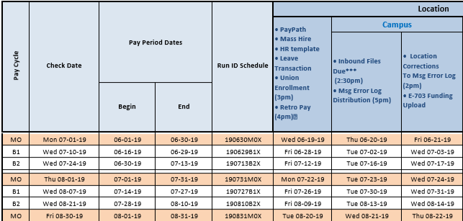
Payroll Processing Calendar
All pay impacting PayPath Actions have to be submitted and approved by the payroll deadline.
The UCPath Payroll Processing Schedule is stored on UCPath online. To access it, navigate to:
Quick links -> Payroll Calendars for MO or BW and Schedules
Notes:
Example: If you submit a reclassification, or a pay adjustment, and it isn’t approved prior to the processing deadline, those changes will not be included in the upcoming on-cycle paycheck. Failure to meet the paypath actions deadline may result in an employee being over, or underpaid.

Slide 23
Transaction Deadlines
PayPath Actions that are submitted after the processing deadline will continue to flow through AWE for processing, however, may not be reflected in the upcoming on-cycle paycheck.
If the transaction meets Off-Cycle pay criteria, a Payroll Request may be submitted to correct employee pay. (Please refer to Payroll Request course).
If the transaction does NOT meet Off-Cycle criteria, the changes will reflect in the next on-cycle paycheck.

Slide 24
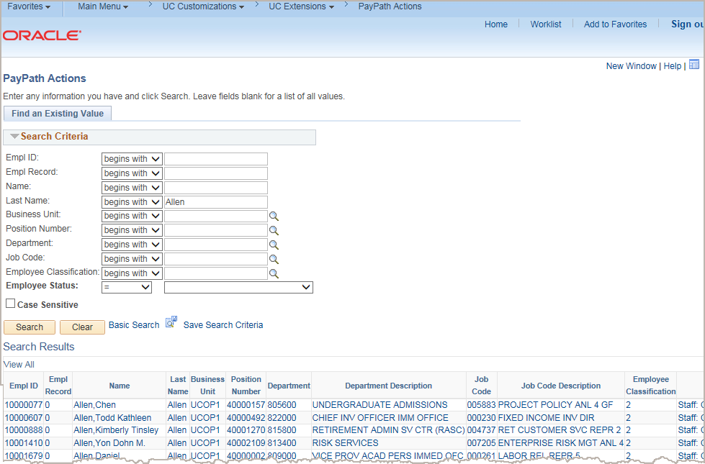
Initiating PayPath Actions
Navigation: PeopleSoft Menu > UC Customizations > UC Extensions > PayPath Actions
Enter search criteria to locate the employee.
In this example, a search was performed on the Last Name: Allen.
If only one employee matches the search criteria entered, the PayPath Actions component opens and displays the employee.
If multiple employees match the search criteria entered, those employees display in the Search Results.
Notes:
PayPath is accessed by employee record. Therefore, if an employee has more than one job, each record will have to be updated separately. Select the relevant job using Employee Record field.

Slide 25
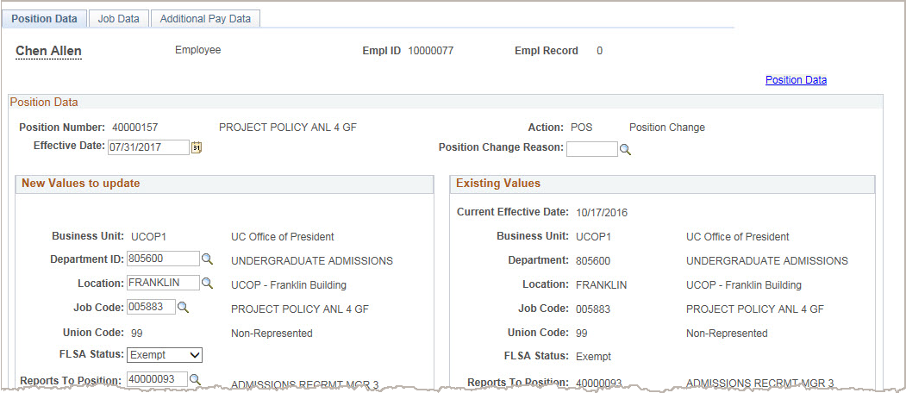
PayPath Actions Component
The PayPath Actions component is comprised of three pages: Position Data, Job Data and Additional Pay Data.
Navigate to the appropriate page to enter the related update.
Notes:
Unlike in the hire templates, you don’t have to navigate through all the tabs to make changes to the appropriate tab. You can skip tabs and go directly to the page you want to make a change to. In order to Save and Submit you will need to navigate to the Additional Pay page.

Slide 26
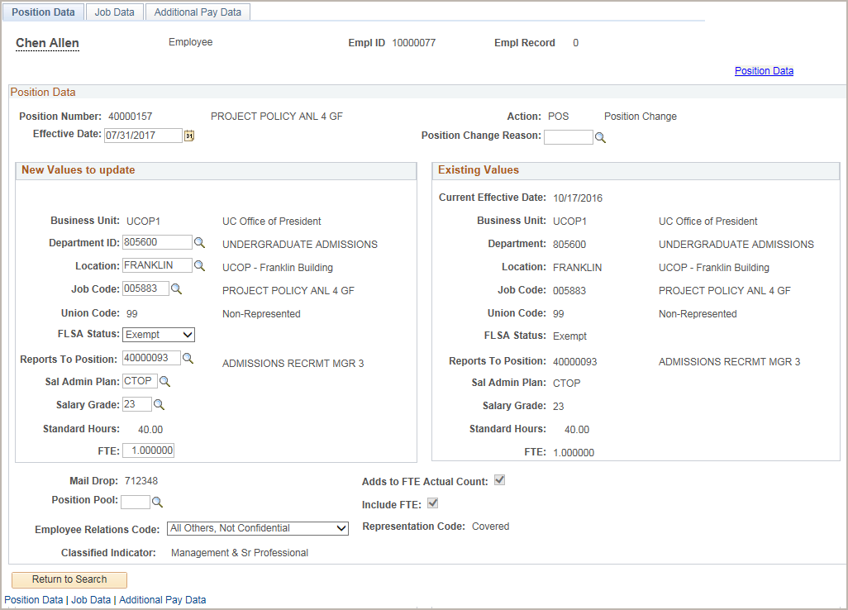
PayPath Actions – Position Data Page
Use the Position Data page to enter changes to position data.
The Position Data page provides two areas:
New Values to Update and Existing Values to update.
This allows you to compare the existing position information while you enter the updated information.
If the employee is in a multi-headcount position the fields on the Position Data page are view-only and you cannot enter changes; however, you can still enter Job Data changes.
Remember that in UCPath FTE means Full Time Equivalent, it is not related to permanent budget.
Notes:
This is an overview of the Position Data page. The detailed steps for entering an update are covered later in this training.

Slide 27
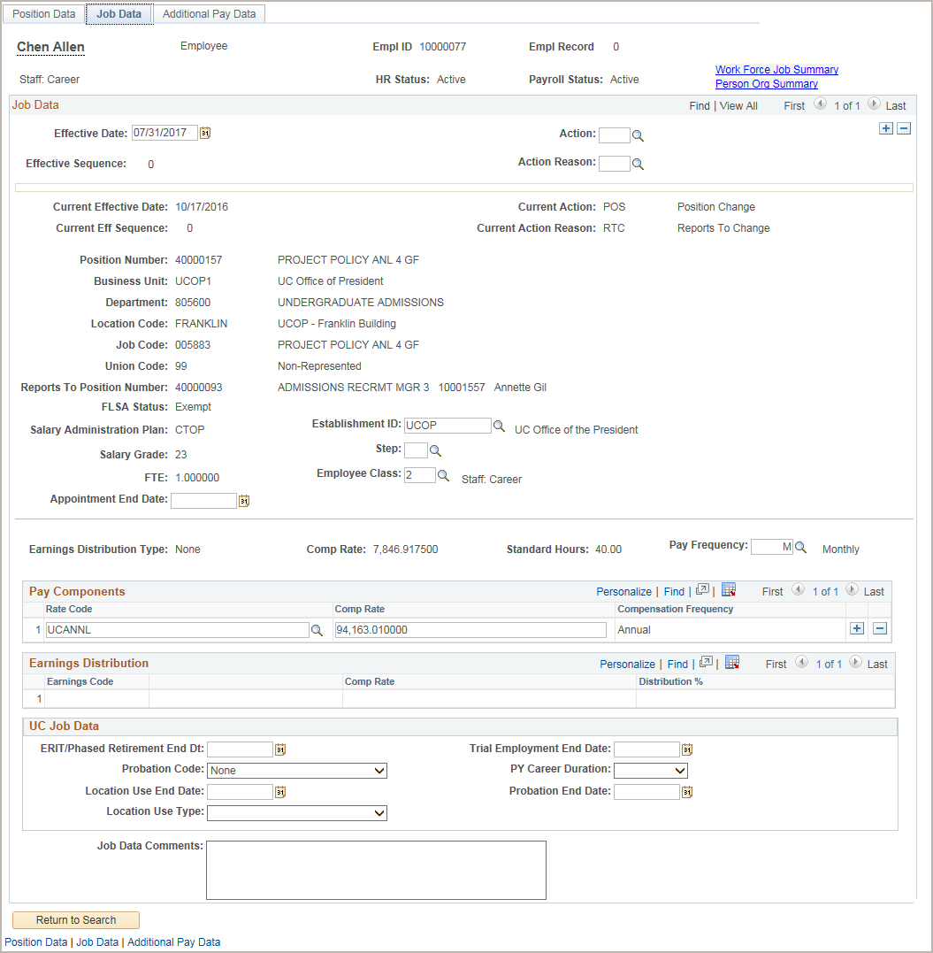

PayPath Actions – Job Data Page
Use the Job Data page for various job data changes. The fields and values available on the Job Data page change depending on whether the employee selected from the search is an academic or staff employee.
Click on the Funding Entry Page, Workforce Job Summary and Person Org Summary links on this page to access additional information for reference, such as compensation, FLSA data and FTE data.
Use the Job Data Comments to record details about the position and/or job changes that are entered. This note is stored directly in the employee’s Job Data for reference.
Notes:
When displayed in Slide Show mode, this slide includes animation for the yellow caption. Click to the caption as you describe the objects on the Job Data page.
This is an overview of the Job Data page. The detailed steps for entering an update are covered later in this training.
If the employee is in a multi-headcount position the fields on the Position Data page are view-only and you cannot enter changes; however, you can still enter Job Data changes.

Slide 28
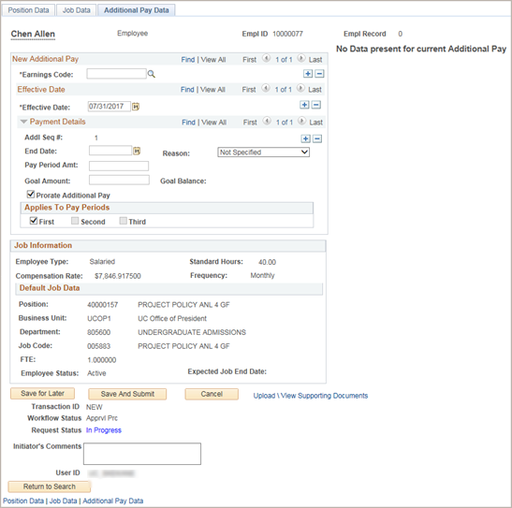
PayPath Actions – Additional Pay Data Page
Use the top portion of the Additional Pay Data page to enter one-time or recurring additional pay information for an employee. If the employee has current additional pay information, it appears on the right side of the page.
The middle section provides details about the employee’s current Job Information.
Use the bottom portion of this page to:
Upload or view supporting documents.
Enter comments to the Approver.
View the Transaction ID, Workflow Status and Request Status.
The buttons allow you to save the transaction for later processing, submit the transaction for approval or cancel the transaction.
Note that Additional Pay data is not loaded directly to UCPath after approval, as is the case for Position and Job Data. Additional Pay data is loaded to the Additional Pay Staging table and reviewed and loaded by UCPath Payroll.
Notes:
When displayed in Slide Show mode, this slide includes animation for two objects. Click to display each object as you talk through the points on the teal caption.
This is an overview of the Additional Data page. The detailed steps for entering an Additional Data update are covered later in this course.

Slide 29
PayPath Actions – Effective Dates
When used together in a transaction, Position Data and Job Data transaction must have the same Effective Date.
  UCPath prevents the entry of multiple effective dates on these tabs.
    After you enter the Effective Date in one of the tabs, the field becomes view-only on the other tabs and for new rows.
  If you have changes that fall on different effective dates, you must enter a separate PayPath transaction for each effective date. Also, you must wait until the first PayPath transaction has completed the approval process before entering the next transaction.
Additional Pay Data
  You can enter multiple Effective Dates for Additional Pay Data transactions.

Slide 30
Retroactive Changes
Changes can be entered retroactively for Position Data and Job Data.
  If the date is prior to the UCPath conversion date, a case must be submitted to UCPath Center.
    Contact Campus Payroll by submitting a case through EEC – Employee Experience Center
After the change is approved, it is saved to UCPath and the update is applied to the appropriate component in the appropriate row according to the Effective Date entered.
For job data updates, all rows of data after the retro change are also updated.
The PayPath Actions pages display the latest effective dated row. Keep in mind that this could be a future dated row.
  To view all rows of employee data, including historical data, access the Workforce Job Summary page link directly from the PayPath Actions Job Data page.

Slide 31
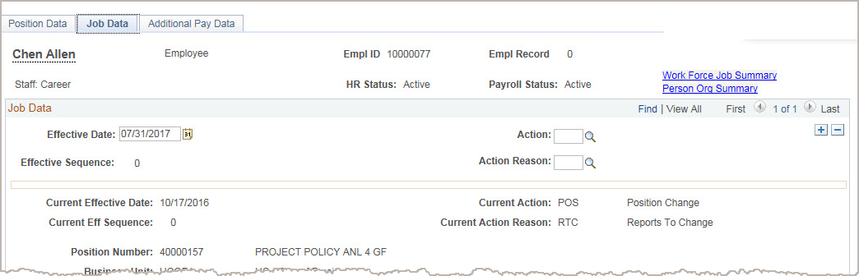

PayPath Transactions –
Action/Action Reason Codes
Action and Action Reason codes further define the purpose of position data change and job data change transactions.
You must specify the appropriate Action and Action Reason codes when a PayPath transaction is initiated.
For Position Data there is only one Action: POS.
Notes:
For Position Data changes, you only need to complete the Position Change Reason. The action code POS will appear as a default.
For Job Data changes, you must complete both the Action and Action Reason. The options that display in the Action Reason are dependent on the selected Action. On the next slide, you will access the PayPath Transactions Action Codes, Reason Codes and Descriptions job aid to review a full listing of codes.

Slide 32
PayPath Action Codes – Examples
This chart lists some examples of Action codes that can be used to identify changes made in each PayPath tab.
PayPath Transactions | Examples
Position Data Tab | POS – Position Data (Only Action available, auto defaults
Job Data Tab | DTA – Data Change JED – Earnings Distribution Changes PAY – Pay Rate/Data Change POS – Position Change RES – Reserve/Faculty Abeyance SWB- Short Work Break
Additional Pay Tab (one-time or recurring) | Action Codes are not required on the Additional Pay tab, only a Reason is required.
Notes:
Reports To is an attribute of the position, which determines who, the position in question reports to. Changes to Reports To for filled positions can be made via PayPath.
Action Reason Codes are explained later in the course.

Slide 33
PayPath Action Reason Codes – Examples
This chart lists some examples of Action Reason codes that can be used to identify changes made in each PayPath tab.
PayPath Transactions | Examples
Position Data Tab | COR– Position Data Correction RTC – Reports-To Change PIT – Permanent Increase in Time (FTE)
Job Data Tab | COR- Correction – Non Pay Related CPR – Correction to Pay Rate EXT- Add/Extend appointment end date JRU – Job Reclass Upward MER - Merit
Additional Pay Tab (one-time or recurring) | New Additional Pay Retroactive Change Range Adjustment
Notes:
All PayPath Actions are managed and approved locally at UCI. Use of the Action/Action reason codes should BEST/CLOSELY reflect the type of change associated with the transaction being submitted. Your initiator comments should include details to further explain.

Slide 34
PayPath Action/Action Reason Code – Use Cases
Position Data Updates
Example 1:
  Employee’s FTE is being increased from .70 to 1.0
    Where to apply update: Position Data tab (FTE is a position attribute)
    Action: POS
    Position Change Reason: PIT (Permanent Increase in Time)
Notes:
Keep in Mind, POS is the only Action code available on the Position Data tab and therefore is auto defaulted onto the page.

Slide 35
PayPath Actions/Action Reason Code – Use Cases
Job Data Updates
Example 2:
  Employee’s current appointment needs to be extended.
    Where to apply update: Job Data tab (Expected Job End Date is a “Job” attribute)
    Action: DTA
    Actions Reason: EXT (Add/Extend Appointment)

Slide 36
PayPath Actions/Action Reason Code – Use Cases
Additional Pay
Example 3:
  Employee received Star Award, Additional Pay request needs to be submitted.
    Where to apply update: Additional Pay tab
    Reason: New Additional Pay
Notes:
Additional Pay tab does not require a “Action” code to be identified. There is also no data field available to identify this,
No, effective dates do no need to be entered on position or job data tab when only submitting additional pay data.

Slide 37

Job Aid
PayPath Transactions – Action Codes, Reason Codes and Descriptions
This is your opportunity to review the job aid.
  Academic: Open the UCPath Help site and refer to the PayPath Transactions – Action Codes, Reason Codes and Descriptions (Academic) topic.
  Staff: Open the UCPath Help site and refer to the PayPath Transactions – Action Codes, Reason Codes and Descriptions (Staff) topic.
If you need help, Ask your instructor for assistance.
Notes:
For UPK job aids, instruct the users to open the job aid and review the online PDF version.
Note there are separate job aids specific to Academics and Staff.
This job aid is referred to throughout this training.

Slide 38

PayPath Overview – Key Takeaways
PayPath is a set of online pages in UCPath that streamlines employee data updates.
PayPath Actions transactions consist of position data changes, job data changes, and additional pay.
ALL PayPath Actions have to be submitted and approved at UCI prior to the payroll processing deadline.
All PayPath Actions transactions route through AWE in pending status. No additional PayPath Actions transactions can be entered for the employee until the pending transaction is processed by the designated approvers.
If an employee has more than one job, each record must be updated with a separate PayPath transaction.
PayPath allows historic, current or future updates for position data, job data and additional pay.
Action and action/reason codes further define position and job data transactions. For position data there is only one action: POS.

Slide 39

Lesson Objectives Review
Having completed this lesson, you should now be able to:
Identify the transactions performed using PayPath Actions.
Describe the PayPath transaction system process.
Identify the PayPath transaction action and reason codes.
Describe the PayPath Actions entry pages.
Notes:
Having completed this Lesson, you should be able to:
Identify the transactions performed using PayPath Actions.
Describe the PayPath Transaction system process.
Identify the PayPath transaction action and reason codes.
Describe the PayPath Actions entry pages.

Slide 40

Knowledge Check
You now have the opportunity to assess your knowledge of the information presented in this lesson.
The questions and answers presented in this review help you to determine whether you remember and understand the important points.

Slide 41
Multiple Choice
Transactions that are initiated using the PayPath Actions component include:
A. Position Data Changes
B. New Hires
C. Job Data Changes
D. All of the above
E. A and C
Notes:
Transactions that are initiated using the PayPath Actions component include:
The answer is E. A and C.

Slide 42
True or False
All PayPath Actions transaction are routed for approval using the Approval Workflow Engine (AWE).
TRUE
FALSE
Next
Notes:
All PayPath Actions transaction are routed for approval using the Approval Workflow Engine (AWE).
The answer is: True

Slide 43
True or False
An Action and Action Reason code is needed only for pay rate changes.
TRUE
FALSE
Next
Notes:
An Action and Action Reason code is needed only for pay rate job data changes.
The answer is: False. An Action and an Action Reason code must be entered for every Job Data change transaction.

Slide 44
Lesson 2
Position Data Changes

Slide 45
Lesson Objectives
1: PayPath Transactions Overview
3: Job Changes
4: Additional Pay
Position Data Changes
In this lesson you will learn how to:
Describe the key system steps to complete a position data change PayPath transaction.
Initiate position data change PayPath transactions
Understand when to submit a Position Data Change form to UCPath Center.

Slide 46


What is a Position in UCPath?
In UCPath a position is required to hire or rehire an employee.
A position is like a chair. Like chairs, positions can be filled or vacant and can have different people sitting in them at different times.
UCI employees are assigned to a single headcount position (one-to-one) where a unique position number is assigned to a single employee.
Multi-headcount positions (one-to-many) will only be used for in some instances when cross training of a new employee is conducted by the current employee in the position.
Notes:
Before we move on to how Position Data can be managed in PayPath let’s start with a refresher on the concept of Position Management.
Multi-headcount positions will only be used for transitional staff positions (for training purposes).

Slide 47
Position Management Overview
Position Management coordinates 3 components Position, Person and Job.
When an employee is hired into a position, a job is created.
Position
Person
Job
Administrative Assistant
Employee - John Jones
John Jones - Administrative Assistant

Slide 48
Position vs Job
Position
Job
Position is independent of an employee.
It has a set of attributes, which are preserved even as incumbents come and go, for example:
Department
Job code
FTE
Salary Plan & Grade
When the employee is hired their jobs inherits the attributes of the Position. During the hire additional information, unique to the person, is added to complete an employee’s Job Record, for example:
Employee Class
Compensation Rate
Additional compensation

Slide 49
Position Data Changes – Overview
Position Data changes in PayPath can be initiated for filled positions only, and where only one employee is assigned to the position.
The PayPath Actions search page restricts you from accessing a position that is vacant. The system displays an error message:
“No matching values. You have entered a position number that is vacant.”
*Initiators can access the Position Control Request page to update to vacant positions.

Slide 50
Position Data Changes
Position Data is not sequenced. Therefore, multiple position data changes cannot occur using the same effective date.
Position Changes that need to be updated using a previously used effective date require submission of a Position Update Request form to the UCPath Center.
  Other Position Related attributes may only be updated with the use of the Position Update Request form or a request to the Position Administrator. (I.e.; Salary Admin Plan & Grade, Headcount,)
All Job Data fields that are controlled by Position Data appear as display-only.
If needed, you can add additional Job Data rows (with the same effective date) to add job-related updates.
For example:
  Position Data change: Employee promoted to a new job code.
  Job Data change: Employee receives a pay rate increase.
Notes:
Position Initiators can initiate a position control request for updates to a vacant position or a multi-head count position.

Slide 51

Position Data Changes – Examples
Position FTE changes
FLSA Status changes
Reports To Change
Series Change
Job code changes
Position Location changes
Union Codes
UC Employee Relations Code
Notes:
Note: Prior to making FLSA Status changes, please consult with your CPO, HR Business Partner or Academic Personnel Coordinator.

Slide 52
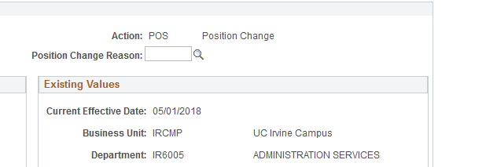
Position Data Change – Position Change Reason
Action and Action Reason codes further define the purpose of PayPath transactions.
For position data changes, the Action is always the same, POS. You only need to complete the Position Change Reason.

Slide 53
Position Data Change – Key System Steps
Navigate to the Person Org Summary and review employee information
Review Employee Information
Update Position Data
Save and Submit
Notes:
Key system steps for entering a position data change transaction:
First, navigate to the PayPath Actions component and locate the employee to update.
Next, review the existing position information on the Position Data page. Also access the Funding Entry Page, Person Org Summary page and the Workforce Job Summary page directly from the Job Data tab, to gain an understanding of the employee’s current assignments.
Next, enter the position update on the Position Data page. Enter other updates as needed, for example, a Job Data update.
Then, navigate to the Additional Pay Data page where you can add attachments and enter comments to the Approver. When the transaction is complete, select the Save and Submit button.
After the initiator saves the transaction, it is automatically routed for approval using AWE. A designated Location PayPath Approver reviews and, if applicable, approves the transaction. After approval, the system saves the information directly to the appropriate UCPath component. Depending on your location’s business process, there may be multiple Approvers.
The Location/department that initiates the transaction also approves the transaction.

Slide 54
Position Data Page
Enter the Effective Date for the position update.
Enter the Position Change Reason for the position update.
Click the Position Data link to access the position information component to view details for the position. For example, you can see the position Effective Dates and also if the position has multiple incumbents.
Use the Position Data page to enter changes to position data.
You must enter the Effective Date and the Position Change Reason fields before entering the update.
The Effective Date cannot be the same date as any existing effective date for the employee in the Position Information component. This is because there is no effective date sequencing for position information. Use the Position Data (Include History) link to review employee position information including existing effective dates.
Position information updated on this page also updates the Job Data page.
Notes:
When displayed in Slide Show mode, this slide includes animation for the yellow captions. Click to individually display each caption (and hide the previous caption) as you describe the objects on the Position Data page. To see all of the position actions for an incumbent you must click on the “Include History” button on the bottom of the page.
See the next slide for more information on the use of effective date on position data.

Slide 55
Position Changes & Job Data Impacts
Certain Positon Data changes may require Job data to be updated as well.
  Examples:
    Position Reclassification – may require pay rate changes in job data tab.
    Expected Job End Date – this field may need to be updated on the job data tab before entering a position data change. Data changes and additional pay are not allowed beyond the identified job end date.
    Position FTE - Changes entered on the position tab will automatically update & reflect on the Job FTE field on Job Data tab.

Slide 56
Position Data Effective Date
Position Data is not sequenced
    Only one position row can exist on a specific effective date
    Select the Position Data link when making historical changes to ensure that a position data row does not already exist for that date
    Only UC Path Center (UCPC) can make changes to an existing effective dated position data row.
      A request can be submitted using the Position Update Request form found in the Forms Library. Initiate a case by clicking on the “AskUCPath” link.
Notes:
It’s important to note that Position Data is not sequenced
Only one position row can exist on a specific effective date.
Select the Position Data link when making historical changes to ensure that a position data row does not already exist for that date – be sure to click on the “Include History” button.
Only the UC Path Center can make changes to an existing effective dated position data row
Effective dates should be before or after the current date, however it cannot prior to the original effective date of the position.

Slide 57
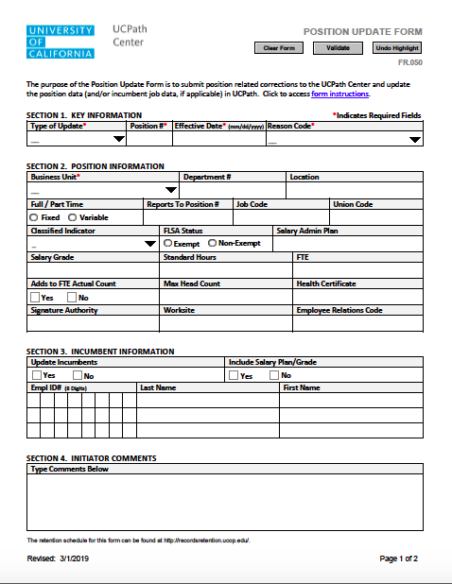
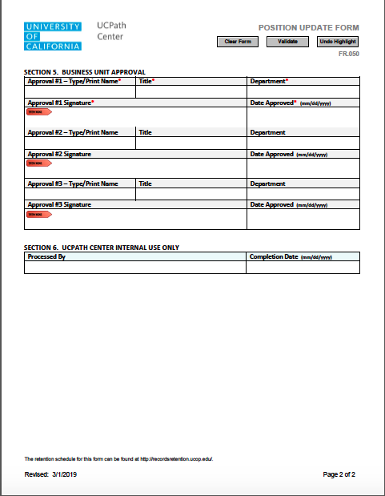
Position Update Form
Navigation: Forms Library > Access Forms: Human Resources – Position Update

Slide 58
Changes to Position and Job FTE
FTE can be either changed at Position or at a Job level.
Changing Position FTE
  Vacant positon – changes to FTE for vacant positions can be done via the Position Control Form (PeopleSoft Menu > UC Customizations > UC Extensions > Position Control Request).
  Filled position – changes to FTE for filled positions can be done via PayPath. Please see the UPK ‘Initiate Position Data Change PayPath Transaction (Acad FTE Change)’ or ‘Initiate Position Data Change PayPath Transaction (Staff FTE Change)’ for step by step instructions.
Changing Job FTE
  You can also keep the position FTE as 1.00 and only change the job FTE. This will require you to first decouple the position and job FTE so they are independent. Once decoupled the job FTE can be adjusted as needed. Please see the UPK ‘Initiate Job Data FTE Override PayPath Transaction (Staff/Acad) for step by step instruction.
Notes:
Please note that you can only override the FTE in PayPath, when a position is filled.

Slide 59


Instructor Demo
Initiate Position Data Change PayPath Transaction (Staff/Acad)
Watch as your instructor demonstrates how to initiate a position data change PayPath transaction.
Follow along using the UPK topic.
  Open the UCPath Help site and refer to the Initiate Position Data Change PayPath Transaction (Staff/Acad) topic.
Launch the See It version of the topic.
At the end of the demonstration, you will have the opportunity to practice this task.
Notes:
For UPK simulation-based demonstrations, open the Try It view and walk through the activity while providing details and explaining the task. The users should follow along with the Print It version of the UPK.
Explain that some UPK topics are specific to Academics or Staff noted by () at the end of a topic title.
Some UPK topics apply to both Staff and Academics and are noted by (Staff/Acad) at the end of a topic title.

Slide 60

Exercise 1
Initiate Position Data Change PayPath Transaction
This is your opportunity to practice this task on your own.
  Use your workbook to complete the Initiate Position Data Change PayPath Transaction – Initiate Data Change.
Ask your instructor for assistance, if needed.
Navigation:
PeopleSoft Menu
> UC Customization
> UC Extensions
> PayPath Actions

Slide 61
Instructor Demo
Initiate Position Data Change PayPath Transaction (Promotion/Reclassification)
Watch as your instructor demonstrates how to initiate a position data change PayPath transaction for a promotion in UCPath.
Follow along using the UPK topic.
  Academic: Open the UCPath Help site and refer to the Initiate Position Data Change PayPath Transaction (Acad Promotion) topic.
  Staff: Open the UCPath Help site and refer to the Initiate Position Data Change PayPath Transaction (Staff Promotion) topic.
Launch the Print It version of the topic.
At the end of the demonstration, you will have the opportunity to practice this task.
Notes:
For UPK simulation-based demonstrations, open the Try It view and walk through the activity while providing details and explaining the task. The users should follow along with the Print It version of the UPK.
Explain that some UPK topics are specific to Academics or Staff noted by () at the end of a topic title.
Some UPK topics apply to both Staff and Academics and are noted by (Staff/Acad) at the end of a topic title.

Slide 62
Exercise 2
Initiate Position Data Change PayPath Transaction (Promotion/Reclassification)
This is your opportunity to practice this task on your own.
  Use your workbook to complete the Initiate Position Data Change PayPath Transaction (Acad Promotion).
  Use your workbook to complete the Initiate Position Data Change PayPath Transaction (Staff Promotion).
Ask your instructor for assistance, if needed.
Navigation:
PeopleSoft Menu
> UC Customization
> UC Extensions
> PayPath Actions

Slide 63
Instructor Demo
Initiate Position Data Change PayPath Transaction (FTE Change)
Watch as your instructor demonstrates how to initiate a position data change PayPath transaction for an FTE change in UCPath.
Follow along using the UPK topic.
  Academic: Open the UCPath Help site and refer to the Initiate Position Data Change PayPath Transaction (Acad FTE Change) topic.
  Staff: Open the UCPath Help site and refer to the Initiate Position Data Change PayPath Transaction (Staff FTE Change) topic.
Launch the Print It version of the topic.
At the end of the demonstration, you will have the opportunity to practice this task.
Notes:
For UPK simulation-based demonstrations, open the Try It view and walk through the activity while providing details and explaining the task. The users should follow along with the Print It version of the UPK.
Explain that some UPK topics are specific to Academics or Staff noted by () at the end of a topic title.
Some UPK topics apply to both Staff and Academics and are noted by (Staff/Acad) at the end of a topic title.

Slide 64
Exercise 2
Initiate Position Data Change PayPath Transaction
This is your opportunity to practice this task on your own.
  Use your workbook to Initiate Position Data Change PayPath Transaction (Acad FTE Change).
  Use your workbook to Initiate Position Data Change PayPath Transaction (Staff FTE Change).
  Ask your instructor for assistance, if needed.
Navigation:
PeopleSoft Menu
> UC Customization
> UC Extensions
> PayPath Actions

Slide 65

Lesson Objectives Review
Having completed this lesson, you should be able to:
Describe the key system steps to complete a position data change PayPath transaction.
Initiate position data change PayPath transactions.

Slide 66

Knowledge Check
Position Data
You now have the opportunity to assess your knowledge of the information presented in this lesson.
The questions and answers presented in this review help you to determine whether you remember and understand the important points.

Slide 67
True or False
Position data changes in PayPath Actions can be initiated for vacant positions (positions not filled).
TRUE
FALSE
Next

Slide 68
Fill-In-The-Blank
Position information that is updated on the Position Data page also updates the position-related information on the ___________ page.
Job Data

Slide 69
Multiple Choice
You must enter the following field(s) on every position data change transaction:
A. Department ID
B. Position Action Reason
C. Position Action
D. All of the above
E. None of the Above

Slide 70

BREAK TIME
Lunch Break

Slide 71
Welcome to
PayPath Actions
Please locate and open the
Cisco AnyConnect VPN Client while waiting for class to start.
Notes:
Welcome to PayPath Actions training. This course outlines the process required to manage incumbents hired into positions in UCPath.

Slide 72
Steps to Log Into VPN
Locate and open the Cisco AnyConnect VPN client.
Enter sdsc-vpn.ucop.edu and click the Connect button.
Enter the following:
  Select Group: hbldtrn0-training
  Enter 1 of these 3 Usernames:
    uci_ucpathvpn_01
    uci_ucpathvpn_02
    uci_ucpathvpn_03
  Enter this week’s Password:
    Down-Hole

Slide 73
Course Agenda
PayPath Actions Part 1, cont.
3: Job Data Changes
4: Additional Pay

Slide 74
Lesson 3
Job Data Changes

Slide 75
Lesson Objectives
1: PayPath Transactions Overview
Job Changes
4: Additional Pay
2: Position Data Changes
In this lesson you will learn how to:
Describe the key system steps to complete a job data change PayPath transaction.
Initiate a multi-row job data change PayPath transaction.
Initiate a pay rate change PayPath transaction.
Initiate job earnings distribution PayPath transactions.
Initiate short work break PayPath transactions.

Slide 76
Job Data Changes – Overview
The Job Data page is used for many types of employee job, and compensation related updates, which can be made independent of a position change.
  However, if a position change is made, PayPath automatically updates the Job Data page to display the new position data.
Some of the Job Data page fields and values display differently for academics than they do for staff. For example:
  The End Job Automatically flag, Academic Duration Appointment, and Post Doctoral Anniversary Date fields are applicable only to academics.
  Probation Code, Probation End Date, Trial Employment End Date, Partial Year Career Duration are applicable only to staff.
Notes:
When a position change is executed in PayPath, the effective date is auto-created and unable to be edited on the Job Data tab. However, the effective date can be changed on the Additional Pay tab.

Slide 77
Job Data Page – Staff Example
This is an example of the staff version of the Job Data page. The staff and academic versions are very similar; however, each version includes some fields and data that is relevant to either academic or staff employees.
For example, for staff:
The data values available in the Action and Action Reason fields are specific to staff.
The Employee Class field can be edited.
All UC Job Data fields are specific to Staff.
If the employment is a short-term assignment or temporary hire, the date the position ends appears in the Appointment End Date field.
Non-Academic employees are automatically terminated in UCPath on this date.
Locations monitor expected job/appointment end dates and, if needed, update/extend the Appointment End Date to ensure the termination does not occur.

Slide 78
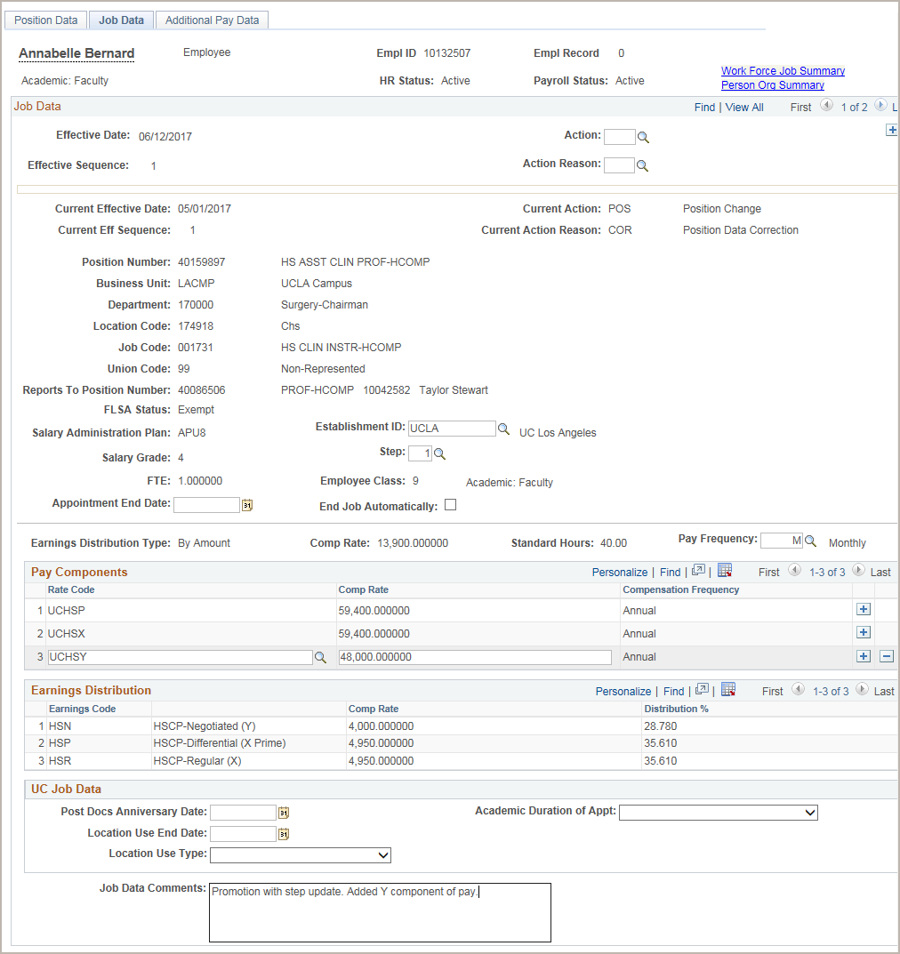
Job Data Page – Academic Example
The academic version of the Job Data page is similar to the staff version, but there are some differences.
For example, for academics:
The data values available in the Action and Action Reason fields are specific to academics.
The Employee Class defaults and cannot be edited.
The functionality of Pay Components and Earnings Distribution supports academic pay calculations.
The fields in the UC Job Data section are specific to academics.
For Academic employees, the End Job Automatically check box also appears. This check box must be selected to automatically terminate the academic employee on the Expected Job End Date.

Slide 79

Appointment End Date
There are important factors to consider about appointment end dates.
Academic appointment end dates will not stop payroll.
  An employee will continue to get paid after their appointment end date and will continue to do so until they are terminated, the End Job Automatically box in Job Data is checked, or the employee is placed on a Short Work Break.
Staff appointments with end dates will auto-terminate. A final pay transaction may need to be processed to pay out any accruals.
Changes cannot be made on appointments with expired end dates.
  Any changes will require a reinstatement of their job first. (Reinstatement = SmartHR Template)
Notes:
There are important factors to consider about appointment end dates.
Appointment End Dates Will Not Stop Payroll
An employee will continue to get paid after their appointment end date and will continue to do so until they are terminated or placed on a Short Work Break. Use the End Job Automatically checkbox to ensure that an appointment will terminate on the end date.
Changes Cannot be Made on Appointments with Expired End Dates
Any changes will require a reinstatement of their job.
Reports are being developed to help monitor appointment end dates. Refer to these reports to assure that the appropriate action is taken before appointment end date.

Slide 80
Multiple Job Data Changes
PayPath can accommodate multiple job data changes in a single transaction:
The multiple job data changes must be the same effective date.
Enter the rows in sequential order, or the order in which they occur.
  Seq. 0 is the first update, then add a row.
  Seq. 1 is the next update, then add a row.
  Seq. 2 is the next update, and so forth.
  The sequence number is automatically populated when you add a row in PayPath Actions.
  Effective date sequencing is especially important when compensation is involved.
Action | Effective Date | Effective Seq. | Notes
Position Promotion | 3/1/2016 | 0 | Position Data change automatically inserts the first row in Job Data.
Pay Rate Change / Promotion | 3/1/2016 | 1 | Second row added by user.
Pay Rate Change / Equity | 3/1/2016 | 2 | Third row added by user.
Notes:
PayPath can accommodate multiple job data changes in a single transaction. In order to make multiple job data changes in a single transaction:
Ensure the changes have the same effective date
Enter the rows in the order in which they occur. The Effective Sequence 0 row is an update entered by the user on Positon Data, which automatically updates Job Data by adding the first row. For example: Effective Sequence 0 is the first update, then add a row.
Effective Sequence 1 is the next update, then add a row.
Effective Sequence 2 is the next updated, then add a row, and so forth.
The sequence number is automatically populated when you add a row in PayPath Actions.

Slide 81
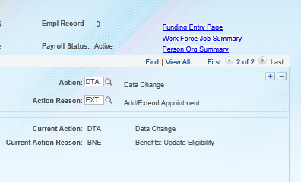
Adding a Row – PayPath Actions
When entering multiple job data changes in UCPath. Click the [+] box to insert a new row.
The [+] button will add a new row to the same transaction creating a sequence.
The job data page view will indicate how many rows exist. You can toggle between rows.

Slide 82
Instructor Demo
Initiate Multi-Row Job Data Change PayPath Transaction
Watch as your instructor demonstrates how to initiate multiple job data changes in a single PayPath transaction in UCPath.
Follow along using the UPK topic.
  Open the UCPath Help site and refer to the Initiate Multi-Row Job Data Change PayPath Transaction (Staff/Acad) topic.
Launch the Print It version of the topic.
Access the UCPath Help site for an opportunity to practice this task.
Notes:
For UPK simulation-based demonstrations, open the Try It view and walk through the activity while providing details and explaining the task. The users should follow along with the Print It version of the UPK.

Slide 83
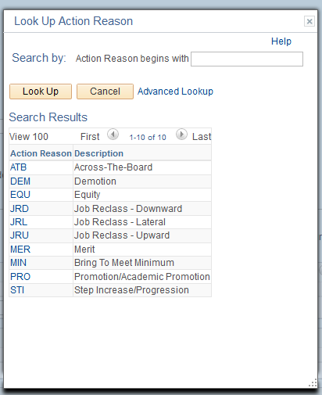
Job Data Change – Action Reason Codes
Action and Action Reason codes further define the purpose of job data change transactions.
The Action and the Action Reason fields are required.
The values available in the Action Reason field are dependent on the selection made in the Action field.
Examples of Action/Action Reason include:
Action: PAY
Action Reasons:
Notes:
In this example the Action is “Pay”. Listed are the Action Reasons that are associated with selecting the Action “Pay”

Slide 84
Job Aid
PayPath Transactions – Action Codes, Reason Codes and Descriptions
This is your opportunity to review the job aid.
  Academic: Open the UCPath Help site and refer to the PayPath Transactions – Action Codes, Reason Codes and Descriptions (Academic) topic.
  Staff: Open the UCPath Help site and refer to the PayPath Transactions – Action Codes, Reason Codes and Descriptions (Staff) topic.
Ask your instructor for assistance.
Notes:
For UPK job aids, instruct the users to open the job aid and review the online PDF version.
Note there are separate job aids specific to Academics and Staff.
Review the Job Data Actions, Action Reasons and Descriptions.

Slide 85
Job Data Change – Key System Steps
Navigate to the PayPath Actions Page
Review Employee Information
Enter Job Data update
Save and Submit
Notes:
Key system steps for entering a Job Data Change transaction:
First, navigate to the PayPath Actions component and locate the employee to update.
Next, review the existing position information and job information. You also can access the Person Org Summary page and the Workforce Job Summary page directly from the Job Data tab, to gain an understanding of the employee’s current assignments.
Next, enter the job data update(s) on the Job Data page.
Then, navigate to the Additional Pay Data page where you can add attachments and enter comments to the Approver. When the transaction is complete, select the Save and Submit button.
After the initiator saves the transaction, it is automatically routed for approval using AWE. A designated Location PayPath Approver reviews and, if applicable, approves the transaction. After approval, the system saves the information directly to the appropriate UCPath component. Depending on your location’s business process, there may be multiple Approvers.

Slide 86
Job Data Page – Data Entry
Enter the Effective Date for the job data update.
To review all job data rows for the employee (single employee assignment), click the Work Force Job Summary link. To review all current assignments (multiple employee assignments), click the Person Org Summary link. Review the current funding using the Funding Entry Page .
Click + to add multiple job data changes in the same transaction. Multiple changes can be entered only for the same Effective Date.
Enter the Action and Action Reason for the job data update.
Use the Job Data page to enter updates to job-related data such as pay, earnings distribution and short work break.
You must enter the Effective Date and the Action and Action Reason fields before entering an update.
Use the PayPath Job Data Comments to record details about the position and/or job changes. This note is stored directly in the notes feature of the Job Data component for the employee.
Notes:
Use the Job Data page to enter updates to job-related data such as pay, earnings distribution and short work break.
You must enter the Effective Date and the Action and Action Reason fields before entering an update.
If you’d like to add multiple job data changes in the same transaction, click the plus button in the top right corner. Remember, multiple changes can only be entered for the same effective date.
To review all job data rows for the employee, click the Work Force Summary link. To review all current assignments, click the Person Org Summary link. To view the current funding for this position, access the Funding Entry Page.
Also note that Job Data Comments are copied and stored in the Job Data component at the bottom of the Job Data page.

Slide 87
Job Data – Change Types
There are many types of Job Data changes, most of which fall into the first three categories.
Data
Pay Rate
Job Earnings Distribution (JED)
Short Work Break
Notes:
Examples and simulations are provided for each of these Change Types on the following slides.

Slide 88
Change Type – Data
Data
Examples of data changes requested through PayPath include:
Extension of Appointment End Date
Extension of Location Use End Date
Academic Reappointment
Change from Limited to Career Status and
Change of Employee Class (Staff Only)
Update to Probation Code and/or Probation Date (Staff Only)

Slide 89
Change Type – Pay Change
Pay Rate
Pay Rate changes update the rate of pay for Staff or Academic employees.
Examples of pay changes requested through PayPath include:
Change to rate of pay for staff or academic
  Merit
  Equity increases
  Changes to negotiated salaries
  Adjustments to off-scale salary amounts
  Step increase progression
Pay components (i.e.; Pay Frequency, or Compensation Codes, Pay Components) automatically populate
based on selection of a salary step.

Slide 90
Change Type – Job Earnings Distribution
Job Earnings Distribution (JED)
The Job Earnings Distribution (JED) is primarily used to distribute earnings by earn codes either by percentage or by amount for Exempt employees as it controls how much they are paid when an adjustment to their FTE is not applicable.
Non-Exempt employees’ pay is generated based on their hours submitted in Time and Attendance.
Examples of JED changes requested through PayPath include:
Employee Reduction in Time (ERIT)
HSCP-related automated JED by Earn Code
NSTP-Negotiated Salary Trial Program
Notes:
A simulation Demo and Exercise is provided for HSCP later in this training.

Slide 91
Instructor Demo
Initiate Pay Rate Change PayPath Transaction
Watch as your instructor demonstrates how to initiate a pay rate change PayPath transaction in UCPath.
Follow along using the UPK topic.
  Academic: Open the UCPath Help site and refer to the Initiate Pay Rate Change PayPath Transaction (Acad) topic.
  Staff: Open the UCPath Help site and refer to the Initiate Pay Rate Change PayPath Transaction (Staff) topic.
Launch the Print It version of the topic.
At the end of the demonstration, you will have the opportunity to practice this task.
Notes:
For UPK simulation-based demonstrations, open the Try It view and walk through the activity while providing details and explaining the task. The users should follow along with the Print It version of the UPK.
Explain that some UPK topics are specific to Academics or Staff noted by () at the end of a topic title.
Some UPK topics apply to both Staff and Academics and are noted by (Staff/Acad) at the end of a topic title.

Slide 92
Exercise 3
Initiate Pay Rate Change PayPath Transaction
This is your opportunity to practice this task on your own.
  Academic: Use your workbook to complete the Initiate Pay Rate Change PayPath Transaction (Acad).
  Staff: Use your workbook to complete the Initiate Pay Rate Change PayPath Transaction (Staff) topic
Ask your instructor for assistance.
Notes:
For UPK simulation-based exercises, instruct the users to open the Try It view and complete the task.

Slide 93
Instructor Demo
Initiate Job Earnings Distribution PayPath Transaction
Watch as your instructor demonstrates how to initiate a job earnings distribution PayPath transaction in UCPath.
Follow along using the UPK topic.
  Academic: Open the UCPath Help site and refer to the Initiate Job Earnings Distribution PayPath Transaction (Acad) topic.
  Staff: Open the UCPath Help site and refer to the Initiate Job Earnings Distribution PayPath Transaction (Staff) topic.
Launch the Print It version of the topic.
Access the UCPath Help site for an opportunity to practice this task.
Notes:
For UPK simulation-based demonstrations, open the Try It view and walk through the activity while providing details and explaining the task. The users should follow along with the Print It version of the UPK.
Explain that some UPK topics are specific to Academics or Staff noted by () at the end of a topic title.
Some UPK topics apply to both Staff and Academics and are noted by (Staff/Acad) at the end of a topic title.

Slide 94
Instructor Demo
Initiate Return to Normal (JED) Distribution PayPath Transaction
Watch as your instructor demonstrates how to initiate a return to normal (JED) distribution PayPath transaction in UCPath.
Follow along using the UPK topic.
  Open the UCPath Help site and refer to the Initiate Return to Normal (JED) Distribution PayPath Transaction (Staff/Acad) topic.
Launch the Print It version of the topic.
Access the UCPath Help site for an opportunity to practice this task.
Notes:
For UPK simulation-based demonstrations, open the Try It view and walk through the activity while providing details and explaining the task. The users should follow along with the Print It version of the UPK.
Explain that some UPK topics are specific to Academics or Staff noted by () at the end of a topic title.
Some UPK topics apply to both Staff and Academics and are noted by (Staff/Acad) at the end of a topic title.

Slide 95
Change Type – Short Work Break
Short Work Break
The UCPath Short Work Break (SWB) process refers to placing an employee on, or returning them from, a short work break. Refer to the Short Work Break Matrix Job Aid for durations allowed.
The action of SWB can be used to stop pay for an employee in the system for a temporary period of time and moves them to a ‘work break’ status.
It avoids the process and time involved in terminating and rehiring someone who will be gone for a short period of time
This process applies to both staff and academic employees.
While on SWB, the employee may not receive any pay for the job on SWB, however they may be eligible to continue certain benefits. It will also trigger Benefits Billing, if necessary. See UCI Business Process Guide (WFA.13) for more information.
Notes:
Locations are responsible for monitoring employees on SWB. You must return the employee from SWB, extend the SWB or terminate the job upon the end date of the SWB.
AWE approver(s) must confirm proper local procedures, documentation, consultations and communications have taken place prior to final approval of the SWB request.
Locations are responsible for notifying employees of the need to return from SWB and for confirming that the employee has/will return as expected.
For those academic employees who receive additional compensation while on Short Work Break, locations must request additional payment via Payroll Requests (E-353/I-618). Refer to your Location payroll department for additional assistance.
In the event of an employee’s death while on Short Work Break, the employee’s death benefits (UCRP & OME (One Month Equivalent Salary) are not impacted unless the terms of the short work break result in a break in service. One example that would constitute a break in service for the OME Salary would be a short work break greater than 4 months. A break in service might occur for UCRP death benefits if the employee receives pay during the short work break that is not covered compensation. These examples and are not intended to capture all possible breaks in service; refer to BN.03 Death Benefits Administration for more information.
E-353: One Time Pay – Self Service Transactions Links Page
I-618: Flat Dollar Interface upload (Excel Spreadsheet)

Slide 96
Change Type – Short Work Break (cont.)
Short Work Break
Employee’s on SWB are monitored at locations on a regular basis. The UCPath Center is responsible for monitoring the Short Work Break Audit Report and works with Locations to confirm the appropriate course of action regarding the employee on SWB.
The length of time allowed for a short work break depends on the type of position/ employee class. See the next two slides for more information and examples.
SWB is assigned per job. It is possible for an employee to be on SWB for one job but not for other job or jobs.
Notes:
Locations are responsible for monitoring employees on SWB. You must return the employee from SWB, extend the SWB or terminate the job upon the end date of the SWB.
AWE approver(s) must confirm proper local procedures, documentation, consultations and communications have taken place prior to final approval of the SWB request.
Locations are responsible for notifying employees of the need to return from SWB and for confirming that the employee has/will return as expected.
For those academic employees who receive additional compensation while on Short Work Break, locations must request additional payment via E-353/I-618. Refer to your Location payroll department.
In the event of an employee’s death while on Short Work Break, the employee’s death benefits (UCRP & OME Salary) are not impacted unless the terms of the short work break result in a break in service. One example that would constitute a break in service for the OME Salary would be a short work break greater than 4 months. A break in service might occur for UCRP death benefits if the employee receives pay during the short work break that is not covered compensation. These examples and are not intended to capture all possible breaks in service; refer to BN.03 Death Benefits Administration for more information.
E-353: One Time Pay – Self Service Transactions Links Page
I-618: Flat Dollar Interface upload (Excel Spreadsheet)

Slide 97
Short Work Break – Academic Examples
Type | Description
Academic Students | Used to put academic students off pay status over the summer or in between quarters/semesters. Limited to 4 consecutive months.
Unit 18- Benefits Bridge Eligible | Used to put a Unit 18 employee off pay status in between quarters/ semesters of active employment. The employee is eligible to request a Benefits Bridge. Limited to 3 consecutive months.
Unit 18- Benefits Bridge Not Eligible | Used to put a Unit 18 employee off pay status in between quarters/ semesters of active employment. The employee is not eligible to request a Benefits Bridge. Limited to 12 consecutive months.
University Extension (UNEX) | Used to put a UNEX Teacher off pay status in between periods of active employment. Limited to 6 consecutive months.
Variable Appointment | Used to put an exempt academic employee with a highly variable schedule off pay status in between periods of active employment. Limited to 12 consecutive months.
Research Funding Bridge | Used to place an employee that is awaiting research funding on SWB. Limited to 4 consecutive months.

Slide 98
Short Work Break – Staff Examples
Type | Description
Partial-Year Career Furlough | Used to place a partial-year career employee on furlough. Action Reason selection is based on the number of working months the partial-year career employee is scheduled to work: 9, 10 or 11 months. See Job Aid: Short Work Break Matrix for more detail.
Floaters | Used for floater employees during periods of inactivity. See Job Aid: Short Work Break Matrix for more detail.
Limited Employees | Used for limited employees off pay status. Limited to 4 consecutive months.
Undergraduate Students | Used to put undergraduate students (covered under PPSM) off pay status over the summer or in between quarters/ semesters. Limited to 4 consecutive months.
Notes:
Please note: SWB changes an employees’ payroll status to “Inactive” while keeping their HR status “Active”. For Furlough employees whose pay is spread over 12 months (10/12, 11/12), if put on a short work break the employee will not get paid during the time on SWB.

Slide 99
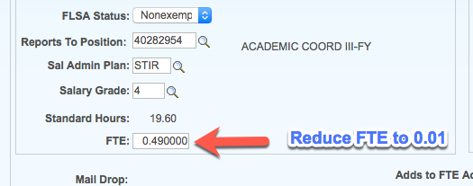
Short Work Break - Benefits
UCPath includes the FTE for all jobs when establishing benefits eligibility – this includes jobs on Short Work Break.
When processing a SWB transaction, reduce the FTE to 0.01 to avoid inclusion in benefits eligibility.

Slide 100
Job Aid
Short Work Break Matrix
Open the UCPath Help site and refer to the Short Work Break Matrix topic.
This matrix provides guidance for when and how to use a Short Work Break.
Notes:
For UPK job aids, instruct the users to open the job aid and review the online PDF version.
The Short Work Break types were reviewed by systemwide Benefits, RASC, systemwide Labor Relations, Academic Personnel and UCOP HR Policy for confirmation.
While on SWB, the employee may be eligible to continue certain benefits. Depending on the type of the SWB, the employee may be required to pay both the employee and employer portions to continue medical, dental and/or vision coverage. Refer to the Short Work Break Matrix job aid for details.

Slide 101
Instructor Demo
Initiate Short Work Break PayPath Transaction
Watch as your instructor demonstrates how to initiate a short work break PayPath transaction in UCPath.
Follow along using the UPK topic.
  Open the UCPath Help site and refer to the Initiate Short Work Break PayPath Transaction (Staff/Acad) topic.
Launch the Print It version of the topic.
Access the UCPath Help site for an opportunity to practice this task.
Notes:
For UPK simulation-based demonstrations, open the Try It view and walk through the activity while providing details and explaining the task. The users should follow along with the Print It version of the UPK.
Explain that some UPK topics are specific to Academics or Staff noted by () at the end of a topic title.
Some UPK topics apply to both Staff and Academics and are noted by (Staff/Acad) at the end of a topic title.

Slide 102
Instructor Demo
Initiate Return from Short Work Break PayPath Transaction
Watch as your instructor demonstrates how to initiate a return from short work break PayPath transaction in UCPath.
Follow along using the UPK topic.
  Open the UCPath Help site and refer to the Initiate Return from Short Work Break PayPath Transaction (Staff/Acad) topic.
Launch the Print It version of the topic.
Access the UCPath Help site for an opportunity to practice this task.
Notes:
For UPK simulation-based demonstrations, open the Try It view and walk through the activity while providing details and explaining the task. The users should follow along with the Print It version of the UPK.
Explain that some UPK topics are specific to Academics or Staff noted by () at the end of a topic title.
Some UPK topics apply to both Staff and Academics and are noted by (Staff/Acad) at the end of a topic title.

Slide 103
Lesson Objectives Review
Having completed this lesson, you should now be able to:
Describe the key system steps to complete a job data change PayPath transaction.
Initiate a multi-row job data change PayPath transaction.
Initiate a pay rate change PayPath transaction.
Initiate job earnings distribution PayPath transactions.
Initiate short work break PayPath transactions.

Slide 104

Knowledge Check
Introduction
You now have the opportunity to assess your knowledge of the information presented in this esson.
The questions and answers presented in this review help you to determine whether you remember and understand the important points.

Slide 105
True or False
For multiple Job Data updates, enter the rows of data in sequential order, or the order in which they should occur.
TRUE
FALSE
Next

Slide 106
Multiple Choice
Types of Job Data changes that can be initiated in PayPath Actions include:
A. FTE, Short Work Break, Salary Step
B. Pay Rate, Expected Job End Date
C. FTE, Pay Frequency, Job Earnings Distribution
D. All of the Above
Notes:
Answer: D

Slide 107
Fill-In-The-Blank
You must enter values in the _____________, Action and Action Reason fields before entering a Job Data update.
Effective Date

Slide 108
Lesson 4
Additional Pay

Slide 109
Lesson Objectives
1: PayPath Transactions Overview
3: Job Changes
Additional Pay
2: Position Data Changes
In this lesson you will learn how to:
Describe the key systems steps to complete an additional pay PayPath transaction.
Initiate additional pay PayPath transaction.
Initiate update to additional pay PayPath transaction.
Initiate retroactive additional pay PayPath transaction.

Slide 110
Additional Pay – Overview
  One-time – applies to a single pay cycle or non-consecutive pay cycles.
  .
Additional Pay is any compensation above a University employee’s regular, base compensation.
There are two types of additional pay transactions:
+1
One-time – applies to a single pay cycle or non-consecutive pay cycles. | Recurring – payments are paid over multiple, consecutive pay periods
Additional pay transactions entered in PayPath are routed for approvals and then transferred to a Payroll staging table to be processed automatically by UCPC Payroll.
Notes:
Additional Pay Data transactions can be entered independently of Position Data and/or Job Data changes.

Slide 111
Additional Pay – Overview (cont’d)
Additional pay must be entered as a flat per pay period amount (monthly or bi-weekly)
  All prorated payments should be calculated prior to entering the flat amount.
  The Prorate check box is checked by default. If you do NOT want to prorate your additional pay you must uncheck the box. Confirmation of functionality is pending
During the hire process, when the SmartHR Hire Template transaction has been submitted for approval, the employee is not available in PayPath until the Hire Template has been approved and processed by UCPC WFA Production Team.
  After the employee is available in PayPath, the employee’s additional pay data cannot be updated until the Payroll nightly process has assigned the employee’s pay group.

Slide 112
Additional Pay Files
Additional pay files are processed during on-cycle payrolls only.
  Refer to the UCPath Production Processing Schedule for deadlines.
  When additional pay transactions are entered into UCPath, the AWE approval process must be completed before UCPath sends the files to payroll processing.
  Allow sufficient time to get the transactions through the approval process so they can be processed in the next on-cycle.
  Submitted transactions are attached to a specific run ID. If the approved transaction is past the due date, the request will be cancelled and must be resubmitted by the Location.
Additional Pay transactions can be continuously submitted. The UCPath Center batches these transactions every morning so they are available to view in staging the next day.
  This means that the Locations can see the status of a transaction one business day after submission, even if it is days or weeks before the specific payroll begins.
Notes:
The assumption of additional pay is that the employee has already received a regular pay check therefore UCPC is only scheduling additional pay during on-cycle payrolls only.
All Additional Pay will be processed using PayPath Actions page.
Off-cycle pay processing will be addressed in the Payroll Requests course.

Slide 113
Payroll Processing Calendar
All pay impacting PayPath Actions have to be submitted and approved by the payroll deadline.
The UCPath Payroll Processing Schedule is stored on UCPath online. To access it, navigate to:
Quick links -> Payroll Calendars for MO or BW and Schedules
Notes:
Example: If you submit a reclassification, or a pay adjustment, and it isn’t approved prior to the processing deadline, those changes will not be included in the upcoming on-cycle paycheck. Failure to meet the paypath actions deadline may result in an employee being over, or underpaid.

Slide 114
UCPath Process Overview – Additional Pay
EMPLOYEE
LOCATION
1
2
4
Submits
Additional Pay (E-330) and/or
One-Time Payment
(E-353)*
Approves transaction through AWE process and submits
Makes corrections and resubmits by 2pm the day before payroll confirmation
UCPATH CENTER
Yes
Errors identified?
3
5
Files are processed automatically and loaded into pay sheets and employee’s record
Begins payroll processing
No
6
PY Production
Employee
Location
UCPath Center
UCPath
Notes:
This is an overview of how additional pay flows through the UCPath Center and the responsibilities assigned to the Employee, Location and UCPC.
*E-330 and E-353 are the additional pay pages which can be accessed through the Self Service Transaction Links. UCI is not using the E-353 (One-Time Payment) due to limited reporting and transaction visibility prior to transaction payment.

Slide 115
Additional Pay – Key System Steps
Navigate to the PayPath Actions Page
Review Employee Information
Enter Additional Pay
Save and Submit
Notes:
Key system steps for entering an Additional Pay transaction:
First, navigate to the PayPath Actions component and locate the employee to update.
Next, review the existing additional pay information on the Additional Pay Data page.
Next, enter the additional pay on the Additional Pay Data page.
Then, if needed, add attachments and enter comments to the Approver. When the transaction is complete, select the Save and Submit button.
After the initiator saves the transaction, it is automatically routed for approval using AWE. A designated Location PayPath Approver reviews and, if applicable, approves the transaction. After approval, for additional pay transactions, the system saves the information to a staging table to be picked up in the nightly payroll process.
Depending on your location’s business process, there may be multiple Approvers.

Slide 116
Additional Pay Earn Codes
There are several earn codes available to identify the type of additional pay. The list of additional pay earn codes available is based on the earnings program tied to the employee’s paygroup.
Staff Examples
Former PPS DOS Code | UCPath Earn Code | Description
AWD, PAA, SMA, IA8 | AWD | Incentive Award
BON | BON | Bonus
CPC, CPG, CDF, FFO, SPC | CRT | Certification Pay
SAS, STI, SUP | SAS | Stipend-Admin-Staff
XSL, SPT, SPA, LAP, LEA, NDL, SAL | XSL | Star Award Local
XUI, MPP, BOP | XUI | UC Incentive Program
Academic Examples
Former PPS DOS Code | UCPath Earn Code | Description
FAP, LAA | AAP | Academic Award Program
AWD, PAA, SMA, IA8 | AWD | Incentive Award
DIF, SMD, SMR | DIF | Summer Differential
FHA, AHA | FRA | Faculty Recruitment Allowance
HON | HON | Honorarium
AWD, BNX, IAP, EIA, LSI, MIA, TIA, TIL, BWP UIA, NRP | ICP | Incentive Pay
PTP, PTH, PIT | PTP | Post Doc PTO Adjustment
Notes:
There are several earn codes available to identify the type of additional pay. The list of additional pay earn codes available is based on the earnings program tied to the employee’s paygroup.
Take a moment to review these lists of common Staff and Academic Earn Codes used to identify the type of Additional Pay.

Slide 117
Additional Pay Data Page
Use the PayPath Actions Additional Pay Data page to enter specific information about the payment.
Enter the Earnings Code, Effective Date and Pay Period Amount. Enter the Goal Amount and End Date. Whichever is reached first will stop the further payments.
If the employee has existing additional pay, it displays in the Current Additional Pay section. In this example, the employee does not have existing additional pay set up.
The options available are based on the employee's pay cycle (for example, monthly or biweekly). For biweekly employees, you may select in which pay periods the amount should be paid.
This section displays a summary of the employee’s current job data.
Enter comments you want the approver to see during the review of this request.
Notes:
When displayed in Slide Show mode, this slide includes animation for the gray captions. Click to individually display each caption (and hide the previous caption) as you describe the objects on the Additional Pay Data page.
The system steps for initiating an additional pay transaction are covered in more detail during the instructor demonstration and participant exercise.
Page / field notes:
Earnings Code: Enter the appropriate earnings code value. If you know the value, you can type it in or you can search for and select it from the lookup.
Effective Date: Defaults to the system date (today’s date). Enter the date on which the additional payment is effective.
End Date: Enter the date on which payments should end.
Pay Period Amount: Enter the amount for each payment. All prorated payments should be calculated prior to entering a flat amount.
Goal Amount: Use this field to specify a maximum amount to pay out. This amount must be entered. UCPath issues the Pay Period Amount until the goal amount entered has been reached.
The Applies to Pay Periods values default based on the employee’s pay group. Additional pay is received based upon the employee’s regular pay cycle.
*The functionality of the Prorate Additional Pay check box has proven to be working in production. At this time, keep the box checked, however any proration related to Additional Pay will need to be processed as a separate transaction.
[The Prorate Additional Pay is based on the employee's JOB record. If the employee has a mid-period, effective-dated change on their JOB record, the system prorates the additional pay. The system does not prorate the additional pay based on the Effective Date of the Additional Pay record. It is encouraged to keep this check box selected. The next slide provides an example of this page for an employee who has existing additional pay set up.]

Slide 118
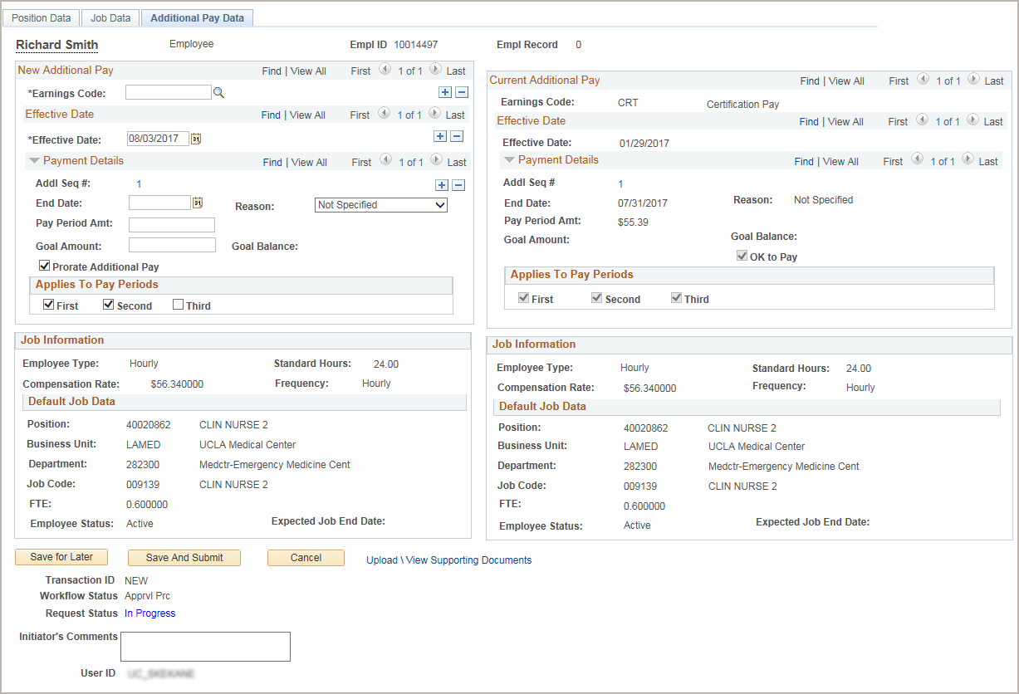
View Current Additional Pay
In this example, the employee has existing additional pay, which displays in the Current Additional Pay section.

Slide 119
Instructor Demo
Initiate Additional Pay PayPath Transaction (Staff/Acad)
Watch as your instructor demonstrates how to initiate an additional pay PayPath transaction in UCPath.
Follow along using the UCPath topic.
  Open the UCPath Help site and refer to the Initiate Additional Pay PayPath Transaction (Staff/Acad) topic.
Launch the Print It version of the topic.
At the end of the demonstration, you will have the opportunity to practice this task.
Notes:
For UPK simulation-based demonstrations, open the Try It view and walk through the activity while providing details and explaining the task. The users should follow along with the Print It version of the UPK.
Explain that some UPK topics are specific to Academics or Staff noted by () at the end of a topic title.
Some UPK topics apply to both Staff and Academics and are noted by (Staff/Acad) at the end of a topic title.

Slide 120
Exercise 4
Initiate Additional Pay PayPath Transaction (Staff/Acad)
This is your opportunity to practice this task on your own.
  Use your workbook to complete the Initiate Additional Pay PayPath Transaction (Staff/Acad)
Ask your instructor for assistance..
Notes:
For UPK simulation-based exercises, instruct the users to open the Try It view and complete the task.

Slide 121
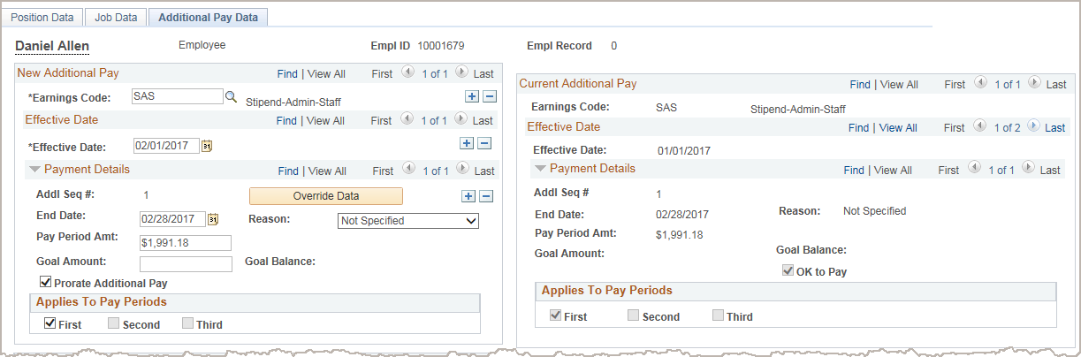
Update Additional Pay
Updates can be made to existing recurring additional pay transactions.
The update must be for the same Earnings Code.
The update must have an Effective Date that is within the existing recurring pay Effective Date (start date) and End Date.
After you enter the Earnings Code and the new Effective Date, the current recurring information populates and the Override Data button appears.
Click the Override Data button to open the recurring information fields for edit.
Notes:
When displayed in Slide Show mode, this slide includes animation for the gray captions. Click to individually display each caption (and hide the previous caption) as you describe the objects on the Additional Pay Data page.
To modify an employee’s existing additional pay earnings, the initiator enters the same Earnings Code as displayed on the existing side and also enters the appropriate Effective Date.
When the initiator tabs out of the date field, the system populates the Payment Details and Job Information sections from the existing data.
An Override Data button appears allowing the initiator to have access to the fields necessary to update the existing additional pay.
Clarification on when it is appropriate to correct the current AP verses create a new AP request. Cite examples for both overpayment and underpayment.

Slide 122
Instructor Demo
Initiate Update to Additional Pay PayPath Transaction (Staff/Acad)
Watch as your instructor demonstrates how to update an existing recurring additional pay PayPath transaction in UCPath.
Follow along using the UCPath Help topic.
  Open the UCPath Help site and refer to the Initiate Update to Additional Pay PayPath Transaction (Staff/Acad) topic.
Launch the Print It version of the topic.
Access the UCPath Help site for an opportunity to practice this task.
Notes:
For UPK simulation-based demonstrations, open the Try It view and walk through the activity while providing details and explaining the task. The users should follow along with the Print It version of the UPK.
Explain that some UPK topics are specific to Academics or Staff noted by () at the end of a topic title.
Some UPK topics apply to both Staff and Academics and are noted by (Staff/Acad) at the end of a topic title.

Slide 123
Retroactive Additional Pay
Retroactive dating is available for additional pay.
The steps for entering a retroactive additional pay transaction are similar to any other additional pay, with the exception of the Effective Date.
In the Effective Date field, enter the previous pay period date that the additional pay should have started.
Enter the Earnings Code, historical Effective Date and Pay Period Amount.
Notes:
Retro pay is initiated by any additional pay change with an effective date that is earlier than or equal to the latest pay end date of a confirmed check that has already been paid to the employee.

Slide 124
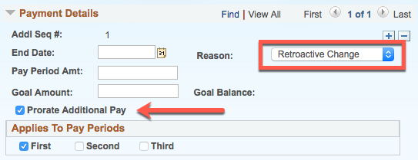
Retroactive Additional Pay, cont.
When processing retroactive dated additional pay, use the reason code : Retroactive Change.
Be sure to uncheck the Prorate Additional Pay box if you do not want the transaction prorated.
Notes:
Retro pay is initiated by any additional pay change with an effective date that is earlier than or equal to the latest pay end date of a confirmed check that has already been paid to the employee.

Slide 125
Instructor Demo
Initiate Retroactive Additional Pay PayPath Transaction (Staff/Acad)
Watch as your instructor demonstrates how to initiate a retroactive additional pay PayPath transaction in UCPath.
Follow along using the UCPath Help topic.
  Open the UCPath Help site and refer to the Initiate Retroactive Additional Pay PayPath Transaction (Staff/Acad) topic.
Launch the Print It version of the topic.
Access the UCPath Help site for an opportunity to practice this task.
Notes:
For UPK simulation-based demonstrations, open the Try It view and walk through the activity while providing details and explaining the task. The users should follow along with the Print It version of the UPK.
Explain that some UPK topics are specific to Academics or Staff noted by () at the end of a topic title.
Some UPK topics apply to both Staff and Academics and are noted by (Staff/Acad) at the end of a topic title.

Slide 126
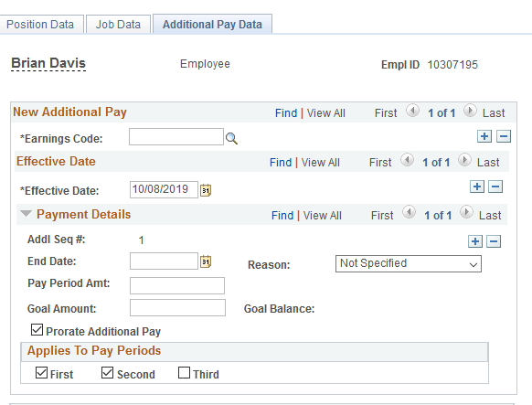
Multiple Additional Pay Actions
You can process multiple Additional Pay actions in the same transaction provided that the Earnings Code, Effective Date and Payment Details follow the appropriate sequence.
In the Earnings Code section, you can add a row to enter another type of additional pay with a different Earnings Code, Effective Date and Payment Details.
In the Effective Date section, you can add a row to enter another additional pay for the same Earnings Code but a different Effective Date and Payment Details.
In the Payment Details section, you can add a row to enter another additional pay for the same Earnings Code on the same Effective Date but different Payment Details.
Notes:
Retro pay is initiated by any additional pay change with an effective date that is earlier than or equal to the latest pay end date of a confirmed check that has already been paid to the employee.

Slide 127
Lesson Objectives Review
Having completed this lesson, you should now be able to:
Describe the key systems steps to complete an additional pay PayPath transaction.
Initiate additional pay PayPath transaction.
Initiate update to additional pay PayPath transaction.
Initiate retroactive additional pay PayPath transaction.

Slide 128
Lesson Assessment
Introduction
You now have the opportunity to assess your knowledge of the information presented in this lesson.
The questions and answers presented in this review help you to determine whether you remember and understand the important points.

Slide 129
Fill-In-The-Blank
All additional pay must be entered as a _______________ amount.
flat per pay period

Slide 130
True or False
Updates can be made to existing recurring additional pay transactions.
TRUE
FALSE
Next

Slide 131
Multiple Choice
The steps for entering a retroactive additional pay transaction are similar to any other additional pay, with the exception of the ___________.
A. Pay Period Amount
B. Effective Date
C. End Date
D. All of the Above
E. A and B

Slide 132
UCPC Update Forms
Submit to via case to UCPC when changes cannot be made using a module transaction.
  Position Update Form – To make changes to a position when the effective date has already been used or data is not writing to the system correctly.
  Job Data Update Form – To make changes to job data when a module transaction is not available or unable to process correctly.
  Recurring Additional Pay Change Form – Request from UCPC via case to make changes to an existing recurring additional pay.

Slide 133
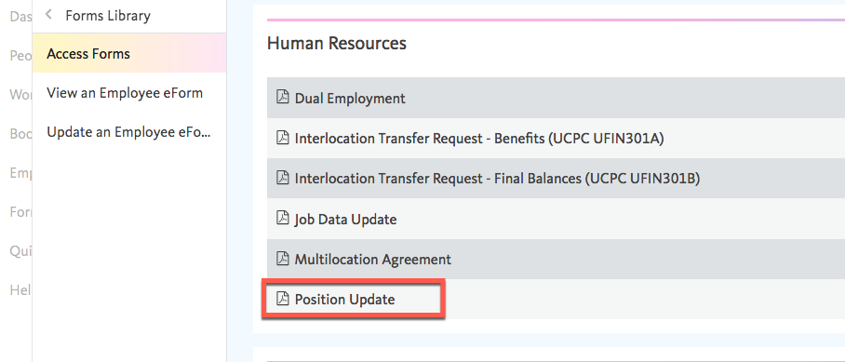
UCPC Update Forms – Position Data
Navigation – From UCPath Dashboard
  Forms Library > Access Forms
    In Forms Library under Human Resources

Slide 134
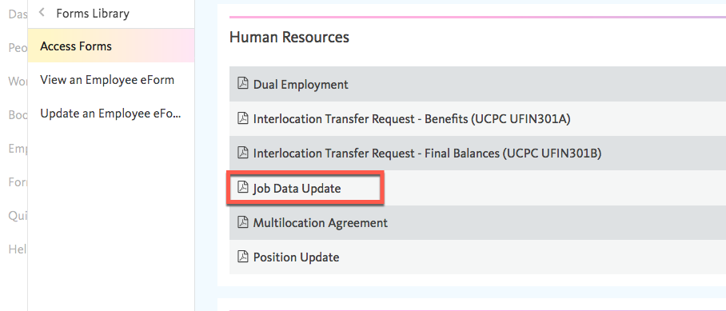
UCPC Update Forms – Job Data
Navigation – From UCPath Dashboard
  Forms Library > Access Forms
    In Forms Library under Human Resources

Slide 135
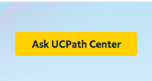
UCPC Update Forms – Additional Pay
The Recurring Additional Pay Form FR.021 will need to be requested via case from UCPC.
Click on the Ask UCPath Center which is located in the upper right corner in UCPath Production. The form will be sent to you via the case response.

Slide 136

Putting It All Together
As the Location PayPath Initiator, you initiate position data change, job data change and additional pay transactions, which are workflowed to Location PayPath Approver(s) for approval.
PayPath Actions allows historic, current or future updates in Position Data and Job Data.
The position data change Effective Date cannot be the same date as any existing effective date for the employee in the Position Information component because there is no sequence field for same-date actions.
Job Data changes can be made independent of a position data change. However, if a position data change is made, PayPath automatically updates the Job Data page to display the new position information.
Refer to the PayPath Transactions – Action Codes, Reason Codes and Descriptions job aid for a description of all Action and Action Reason code combinations.

Slide 137

Parking Lot
Review parking lot
UCPATH CENTER

Slide 138

Reference Material

Slide 139
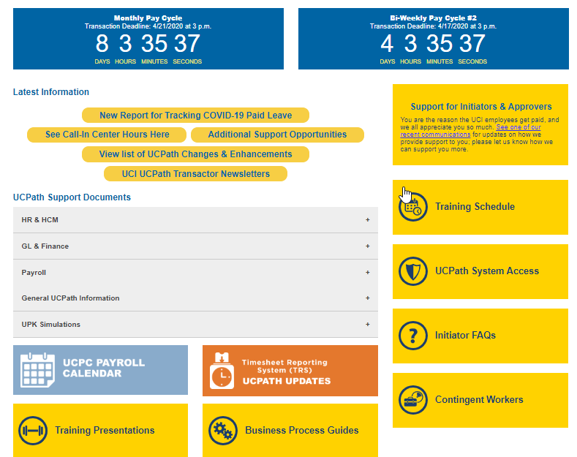
Reference Material for Review
The UCPath Help site is available for your support. Search for conceptual content, job aids or step-by-step instructions for UCPath tasks.

Slide 140
Thank You!
Training End

Slide 141
Welcome to
PayPath Actions
Please locate and open the
Cisco AnyConnect VPN Client while waiting for class to start.
Notes:
Welcome to PayPath Actions training. This course outlines the process required to manage incumbents hired into positions in UCPath.

Slide 142
Steps to Log Into VPN
Locate and open the Cisco AnyConnect VPN client.
Enter sdsc-vpn.ucop.edu and click the Connect button.
Enter the following:
  Select Group: hbldtrn0-training
  Enter 1 of these 3 Usernames:
    uci_ucpathvpn_01
    uci_ucpathvpn_02
    uci_ucpathvpn_03
  Enter this week’s Password:
    Down-Hole

Slide 143
Introductions
Instructor
Name
UCI role
UCPath role
Functional experience

Slide 144
PayPath Actions Pt. 2
1: Combination Changes
2. Retroactive PayPath Transactions

Slide 145
Course Objectives
By the end of this part of the course, you should be able to:
Initiate Various PayPath Combination Transactions
Understand How To Process Retroactive Transactions using PayPath

Slide 146

PayPath Transactions Part 1 - Review
As a recap from Part 1 of this course, PayPath is a set of online pages in UCPath designed to streamline updates to employee data (position, job and additional pay).
PayPath provides intuitive, compliant functionality that is designed to meet UC's academic and staff requirements. These pages offer a one-stop-shop for processing various types of transactions and the flexibility to submit multiple actions in a single transaction.
PayPath integrates changes to positions, jobs and additional pay, providing a tight integration between Human Resources (HR) actions and funding requirements.
  PayPath cannot be used to hire, terminate, transfer or place employees on a leave of absence.

Slide 147
Transactions Processed in PayPath Actions
The following types of transactions are processed for staff and academic employees using PayPath Actions.
Position data changes can be made only for positions that have a single active incumbent.
  New or vacant positions must be created/updated using a Position Control Request.
PayPath Actions is not used to hire, terminate, transfer to a new position or place employees on a leave of absence.
PayPath Actions Transactions
Position Data Changes Job Data Changes Additional Pay
Notes:
Smart HR Templates are used to Hire, Terminate and Transfer to new position (among other actions).
Extended Leaves are used to place employees on leave of absence.
UCI is not using the multi-headcount functionality in UCPath. All positions will have a one-to-one relationship. Exception: Transitional appointments for training purposes.

Slide 148
PayPath Actions AWE
All PayPath Actions transactions are routed for approval using the Approval Workflow Engine (AWE).
The AWE approval routing for a PayPath Actions transaction is based on:
Security role tied to the PayPath Initiator (for example: Central vs. Department).
Approval routing configuration by Location (Business Unit). For example, number of approval levels required.
Note that AWE will only be triggered once when a PayPath transaction is submitted, even if all 3 pages have updated data.
As soon as the transaction has been approved the changes are visible in the system (except for Additional Pay which needs to be processed by UCPC)
Notes:
The AWE Approver(s) have the ability to edit non-compensation fields. If changes are made by the Approver, then the Initiator of the transaction is notified after the transaction is saved.
AWE Approvers cannot edit the following data fields during the approval process:
EFFDT
Position Data FTE
Job Data FTE
Compensation Frequency
All fields in Job Data Pay Components Section (for example: CompRate Code, etc.)
All fields in Job Data Job Earnings Distribution Section (for example: ERNCDs, Earns Dist Type, etc.)

Slide 149
Payroll Processing Calendar
All pay impacting PayPath Actions have to be submitted and approved by the payroll deadline.
The UCPath Payroll Processing Schedule is stored on UCPath online. To access it, navigate to:
Quick links -> Payroll Calendars for MO or BW and Schedules
Notes:
Example: If you submit a reclassification, or a pay adjustment, and it isn’t approved prior to the processing deadline, those changes will not be included in the upcoming on-cycle paycheck. Failure to meet the paypath actions deadline may result in an employee being over, or underpaid.

Slide 150
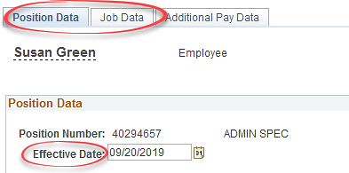
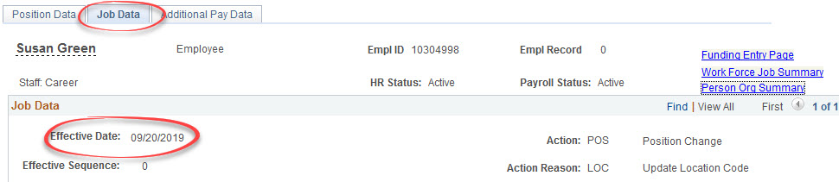
Things to Remember …
Position Data and Job Data changes can be entered in a single PayPath transaction; however, they must have the same Effective Date.
Notes:
[Click to view job data flow through] The Effective Date used when making Position Data changes will flow through to the Job Data page and you will not be able to change the date.

Slide 151
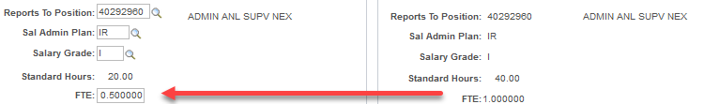
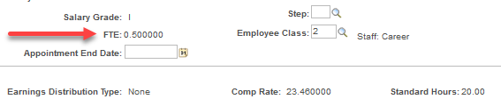
Things to Remember …
When a position data change is entered, a new row is automatically inserted in the Job Data page and displays the updated position data fields.
Position Data Change
Job Data Change
Notes:
Position Data that flows through to Job Data is not able to be edited. Additional Job Data information can be added on the same transaction as long as the effective date of the action is the same. [Click to show Job Data Change]

Slide 152
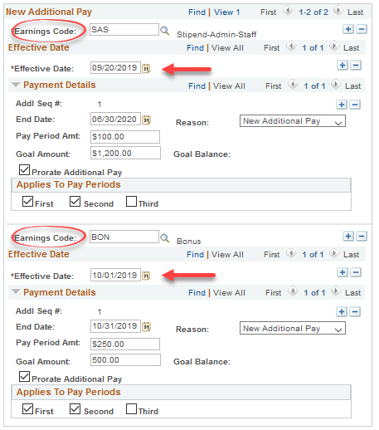
Things to Remember …
You can enter multiple Additional Pay entries with different details in the same transaction.
Certain details in the Earnings Code, Effective Date and Payment Details will have specified criteria when stacking transactions.
Notes:
Refer to PayPath Transactions Part 1 for multiple Additional Pay transactions stacking details or view the UPK on the help site.

Slide 153

Please locate your workbooks to complete this lesson

Slide 154
Lesson Objectives
In this lesson you will learn how to:
Describe when combination changes are required.
Initiate multiple combination changes.
1: Combination Changes
Retroactive PayPath Transactions

Slide 155

Combination Changes – Overview
There are many circumstances where a combination of changes are needed between position, job data and additional pay.
The following slides provide direction for additional practice on some of the common combination changes.
Notes:
There are many circumstances where a combination of changes are needed between position, job data and additional pay.
The following slides provide direction for additional practice on some of the common combination changes.

Slide 156
Combination Changes
Some examples of PayPath Actions that require updates on multiple tabs are:
Staff Reclassification + Pay Raise
Promotion/Reclass + Additional Pay
Appointment Extension + Additional Pay
Reclass + Appointment Extension + Pay Raise

Slide 157
Instructor Demo
Initiate Position Data + Job Data Change PayPath Transaction
Watch as your instructor demonstrates how to initiate a combination change PayPath transaction in UCPath.
Follow along using the UCPath Help topic.
  Academic: Open the UCPath Help site and refer to the Initiate Position Data + Job Data Change PayPath Transaction (Acad) topic.
  Academic Health Sciences Compensation Plan (HSCP): Open the UCPath Help site and refer to the Initiate Position Data + Job Data Change PayPath Transaction (Acad HSCP) topic.
  Staff: Open the UCPath Help site and refer to the Initiate Position Data + Job Data Change PayPath Transaction (Staff) topic.
Launch the See It version of the topic.
At the end of the demonstration, you will have the opportunity to practice this task.
Notes:
Easy examples to demo:
Change Department & Extend Appointment End Date
Change FLSA Status & Change Pay Frequency
Change FTE & Increase Pay

Slide 158
Exercise 1
Initiate Position Data Change PayPath Transaction
This is your opportunity to practice this task on your own.
  Academic: Select the Initiate Position + Job Data Change PayPath Transaction (Acad) topic.
  Academic (HSCP): Select the Initiate Position + Job Data Change PayPath Transaction (Acad HSCP) topic.
  Staff: Select the Initiate Position + Job Data Change PayPath Transaction (Staff) topic.
Ask your instructor for assistance, if needed.
Navigation:
PeopleSoft Menu
> UC Customization
> UC Extensions
> PayPath Actions

Slide 159
Instructor Demo
Initiate Job Data Change + Additional Pay PayPath Transaction
Watch as your instructor demonstrates how to initiate a combination change PayPath transaction in UCPath.
Follow along using the UCPath Help topic.
  Academic: Open the UCPath Help site and refer to the Initiate Job Data Change + Additional Pay PayPath Transaction (Acad) topic.
  Staff: Open the UCPath Help site and refer to the Initiate Job Data Change + Additional Pay PayPath Transaction (Staff) topic.
Launch the Print It version of the topic.
At the end of the demonstration, you will have the opportunity to practice this task.

Slide 160
Exercise 2
Initiate Job Data Change + Additional Pay PayPath Transaction
This is your opportunity to practice this task on your own.
  Academic: Select the Initiate Job Data Change + Additional Pay PayPath Transaction (Acad) topic.
  Staff: Select the Initiate Job Data Change + Additional Pay PayPath Transaction (Staff) topic.
Ask your instructor for assistance, if needed.
Navigation:
PeopleSoft Menu
> UC Customization
> UC Extensions
> PayPath Actions

Slide 161
Instructor Demo
Initiate Position Data + Job Data + Additional Pay Change PayPath Transaction
Watch as your instructor demonstrates how to initiate a combination change PayPath transaction in UCPath.
Follow along using the UCPath Help topic.
  Academic: Open the UCPath Help site and refer to the Initiate Position Data + Job Data + Additional Pay Change PayPath Transaction (Acad) topic.
  Staff: Open the UCPath Help site and refer to the Initiate Position Data + Job Data + Additional Pay Change PayPath Transaction (Staff) topic.
Launch the Print It version of the topic.
At the end of the demonstration, you will have the opportunity to practice this task.

Slide 162
Exercise 3
Initiate Position Data + Job Data Change (2) + Additional Pay PayPath Transaction
This is your opportunity to practice this task on your own.
  Academic: Select the Initiate Job Data Change + Additional Pay PayPath Transaction (Acad) topic.
  Staff: Select the Initiate Job Data Change + Additional Pay PayPath Transaction (Staff) topic.
Ask your instructor for assistance, if needed.
Navigation:
PeopleSoft Menu
> UC Customization
> UC Extensions
> PayPath Actions

Slide 163
Instructor Demo
Initiate Job Data FTE Override PayPath Transaction
Watch as your instructor demonstrates how to initiate a job data FTE override PayPath transaction in UCPath.
Follow along using the UCPath Help topic.
  Open the UCPath Help site and refer to the Initiate Job Data FTE Override PayPath Transaction (Staff/Acad) topic.
Launch the Print It version of the topic.
At the end of the demonstration, you will have the opportunity to practice this task.

Slide 164
Exercise 4
Initiate Job Data FTE Override PayPath Transation
This is your opportunity to practice this task on your own.
  Academic or Staff: Initiate Job Data FTE Override PayPath Transaction.
  Ask your instructor for assistance, if needed.
Navigation:
PeopleSoft Menu
> UC Customization
> UC Extensions
> PayPath Actions

Slide 165
BREAK TIME
Break

Slide 166
Lesson Objectives
In this lesson you will learn how to:
Initiate a Retroactive Data Change
Impacts of Effective Date
1: Combination Changes
Retroactive PayPath Transactions

Slide 167
Retroactive Transactions
Overview
Retroactive transactions are used to initiate an action or to correct a previous action. The Effective Date of a retroactive transaction is prior to the current Effective Date of the transaction.
Retroactive transaction may result in the need for a pay adjustment. The UCPC will evaluate the transaction and process the pay adjustment, if necessary.
Retroactive pay adjustments are processed on the employee’s regular on-cycle pay period.
Retroactive PayPath actions are also subject to payroll processing schedule.

Slide 168
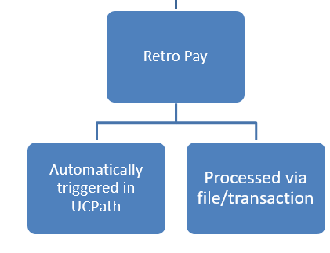
Process Overview – Retro Pay
Retro pay adjustments and overpayments are processed at the UCPath Center.
Retro pay is not considered missed pay and is processed on-cycle
Transactions that result in overpayment are processed via Payroll Requests. More details provided in the Payroll Requests course.
The UCPath Center defines these types of transactions as follows:
Adjustment Type | Overview | Example
Retro Pay | A pay adjustment that occurs as a result of a retro transaction that impacts prior earnings. | A retro pay increase is entered for an employee. A retro pay adjustment is triggered in UCPath to pay the difference in rates from what was paid and what should have been paid.
Overpayment (reviewed in Payroll Requests) | A pay adjustment that occurs as a result of an employee receiving more earnings than he/she was entitled to. An overpayment can also be the result of a retroactive transaction. | A retroactive unpaid leave of absence effective date is entered for an employee, and they have already been paid for the period after the effective date. The result is an overpayment and has to be recovered from the employee.
Notes:
Overpayments will be further discussed in the Payroll Requests course.

Slide 169
Process Overview
Responsibilities by party in the Retro Pay process:
Employee
UCI
UCPath Center WFA
UCPath Center Benefits
UCPath Center Payroll
Monitors his/her pay regularly to identify any issues
Initiates Inquiries for pay issues
Submits Job Data and/or Additional Pay transaction via PayPath or Smart HR template
Reviews retro reports and reaches out to the UCPath Center with any issues
Approves Job Data and Additional Pay Requests submitted via Smart HR Template* and commits them to UCPath
*Changes submitted via PayPath are not reviewed by WFA.
Ensures that eligibility and enrollments are updated if retro transaction results in changes
Makes premium adjustments based on enrollment changes
Manually manages vendor interface submissions for retro enrollment dates
Retro transactions to Job Data trigger a retro transaction for accruals
Reviews pay requests in Retro module for validity and provides the Loaded Retro Results report to locations
Processes inbound files via on-cycle and off-cycle payrolls
Manages the overpayment recovery process
Notes:
This slide identifies the responsibilities as it relates to retro pay. As stated, UCPC does not review PayPath Action transactions. However, there UCPC Retro Team does review transactions that result in retro payments and processes for payment.

Slide 170
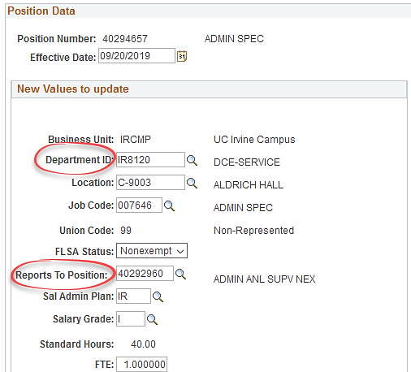
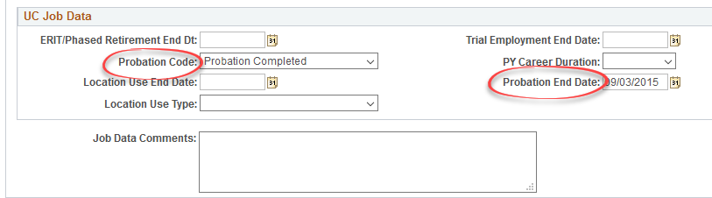
Retroactive Transaction – No Impact to Pay
Here are some examples of PayPath Actions that do not result in a retroactive pay:
Reports To
(Position Data)
Department Location
(Position Data)
Probation Code/Probation End Date (Job Data
Notes:
These retroactive changes can be completed in PayPath with no impact to pay.

Slide 171
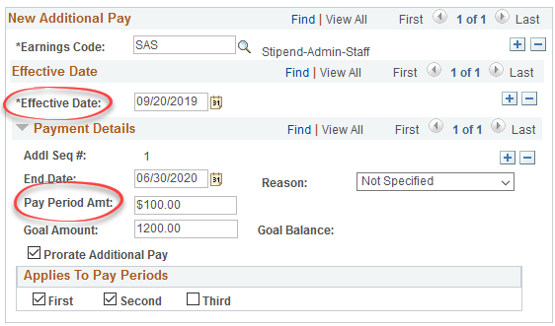
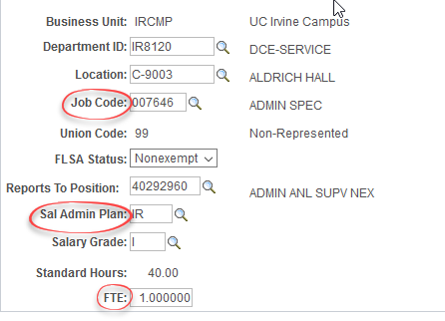
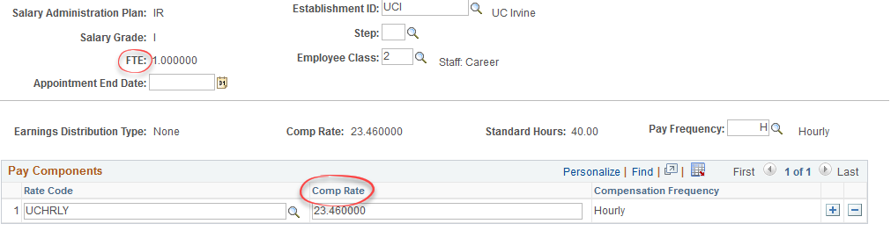
Retroactive Transaction – Impact to Pay
Here are some examples of PayPath Actions that result in a retroactive pay:
Job Code – Promotion/Reclassification (Position Data)
Salary Admin Plan
(Position Data)
FTE
(Position or Job Data)
Compensation Rate
(Job Data)
Change of Effective Date or Pay Period Amount
(Additional Pay)
Additional Pay Data tab
Position Data tab
Job Data tab

Slide 172
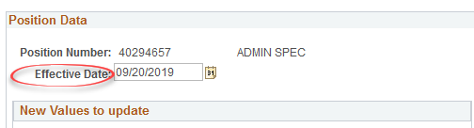
Additional Info on Retroactive Transactions
The effective date for a change on the Position Data page cannot be the same as the original effective date or a previously used effective date. This change can only be made by UCPC via Position Update Request Form.

Slide 173
Instructor Demo
Initiate Retroactive PayPathTransaction
Watch as your instructor demonstrates how to initiate a retroactive additional pay transaction in UCPath.
Follow along using the UCPath Help topic.
  Open the UCPath Help site and refer to the Initiate Retroactive Additional Pay PayPath Transaction (Staff/Acad) topic.
Launch the Print It version of the topic.
At the end of the demonstration, you will have the opportunity to practice this task.

Slide 174
Exercise 5 A/B
Initiate Retroactive PayPath Transation
This is your opportunity to practice this task on your own.
  Use your PayPath Workbook to compete the following tasks:
    (A) Initiate retroactive PayPath transaction with no impact to pay
    (B) Initiate retroactive PayPath transaction with impact to pay.
  Ask your instructor for assistance, if needed.
Navigation:
PeopleSoft Menu
> UC Customization
> UC Extensions
> PayPath Actions

Slide 175
Lesson Objectives Review
Having completed this lesson, you should now be able to:
Initiate various PayPath combination transactions.
Process Retroactive Transactions in PayPath.
1: Combination Changes
2: Retroactive PayPath Transactions
Notes:
Let’s review the objectives that were presented at the beginning of this lesson. Having completed the Combination Changes lesson, you should be able to:
Initiate various PayPath combination transactions.

Slide 176
Putting It All Together
As the Location PayPath Initiator, you initiate position data change, job data change and additional pay transactions, which are workflowed to Location PayPath Approver(s) for approval.
PayPath Actions allows historic, current or future updates in Position Data and Job Data.
ALL PayPath Actions that impact pay are required to be submitted and approved by the published deadline on the UCPC Payroll Processing Calendar.
The position data change Effective Date cannot be the same date as any existing effective date for the employee in the Position Information component because there is no sequence field for same-date actions.
Job Data changes can be made independent of a position data change. However, if a position data change is made, PayPath automatically updates the Job Data page to display the new position information.
Retroactive transaction may result in the need for a pay adjustment. The UCPC will evaluate the transaction and process the pay adjustment, if necessary.
Refer to the PayPath Transactions – Action Codes, Reason Codes and Descriptions job aid for a description of all Action and Action Reason code combinations.
Notes:
As a reminder, Position Data does not have effective sequencing. Making historical changes may affect the current effective dated information row. If a historical change needs to be made that will overwrite the current information row, this transaction will need to be submitted to UCPC via Case Management.

Slide 177
Reference Material

Slide 178

Where to Get Help
The UCPath Help site is your first level of support. Search for conceptual content, job aids or step-by-step instructions for UCPath tasks.
  From the UCPath portal homepage, expand the Help / FAQ section on the left side of the page and then click the appropriate link to open the site. An Adobe PDF version is available for users with screen readers.
  From any UCPath page or component, click the Help link in the upper right corner of the page to find help topics specific to the page/component.
UCPATH CENTER

Slide 179

Where to Get Help
The UCPath Help site is your first level of support. Search for conceptual content, job aids or step-by-step instructions for UCPath tasks.
  From the UCPath portal homepage, expand the Help / FAQ section on the left side of the page and then click the “Location Users” link to open the site. *An Adobe PDF version is available for users with screen readers.
If you’re experiencing issues, or have questions about transactions, please contact the Employee Experience Center at (949) 825- 0500, or submit a ticket by visiting UCPath.UCI.Edu

Slide 180
Additional Resources
Links to helpful reference material:
http://www.hr.uci.edu/ - UCI HR Website
https://ap.uci.edu/ - UCI Academic Personnel Website
http://www.uclc.uci.edu/ - UC Learning Center Website
https://ucpath.uci.edu/training/index.php - UCI UCPath Training Website

Slide 181
Thank You!
Training End

Slide 182
Course Resources

Slide 183
Parking Lot
Review parking lot
UCPATH CENTER

Slide 184
Reference Material for Review
The UCPath Help site is available for your support. Search for conceptual content, job aids or step-by-step instructions for UCPath tasks.

Slide 185
Where to Get Help
The UCPath Help site is available in UCPath for your support. Search for conceptual content, job aids or step-by-step instructions for UCPath tasks.
  From the Transactional Users website, expand the UPK Simulation section in the middle of page and then click the “Location Users” link to open the site. *An Adobe PDF version is available for users with screen readers.
If you’re experiencing issues, or have questions about transactions, please contact the Employee Experience Center at (949) 824-0500, or submit a ticket by visiting ucpath.uci.edu

Slide 186
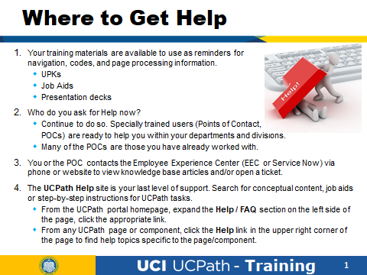

Slide 187
Thank You!
Training End

