Slide 1
Training Tips February 22, 2022

Slide 2
Quick Announcements I
Upcoming Deadlines
BW Transaction deadline: Tuesday March 3 at 3pm (for templates, extended absences, etc.)
BW PayPath deadline: Today 2/22 5pm – blackout through Friday 2/25 6am
MO Transaction deadline: Wednesday March 18 at 3pm (for templates, extended absences leaves, etc.)
MO PayPath deadline: Tues. 2/22 (5pm) - blackout until Thursday 2/24 6am
***Mass PayPath Deadline***
Please open a EEC case by 9am Monday Feb. 28th with SWB changes needed for Grad Students to meet fee remission deadline.

Slide 3
Quick Announcements II
Retroactive Changes
Not necessary to enter retro dates for non-pay impacting data changes.
Location Changes / Dept Id
Reports – to
Employee Relations Code
Please use current dates.
There still exists a problem with overpayments due to non-pay related data changes.
Report Update
The report in Cognos showing employees who work limited hours now reflects hours worked across all jobs, not just the hours worked within your department.
If you have questions, please contact Matthew Levin

Slide 4
Quick Announcements III
PFCB & Holidays in TRS
Please use “Family Care” reason in TRS if on PFCB during the holidays.
Do not use a holidays/vacation code.
Positions with “REMOTE100%” location
Defect has been fixed

Slide 5
Future Training Tips Meetings
March 8
March 22
April 5
April 19
May 3

Slide 6
Agenda
Direct Retros w/ Bundled Checks
Creating New Employee Records
Extended Absences: Cancellations & Retro reminders
Impacts to Future Dated Transactions

Slide 7
Direct Retro Transactions w/ Bundled Checks

Slide 8
Bundling Paychecks for Direct Retros
Direct Retro transactions can be submitted with multiple paychecks selected except for when:
One of the selected paychecks uses funding that involves the Salary Cap / MCOP Worksheet.
Any type of error is received.
If either of the above occur, the paychecks should be submitted one at a time to isolate the problem the paycheck.
Please do not enter an EEC ticket, call the Drop-In Center or email for assistance until you have unbundled the paychecks and tried to submit them one at a time.
That is the first thing we will have you do before troubleshooting further.

Slide 9
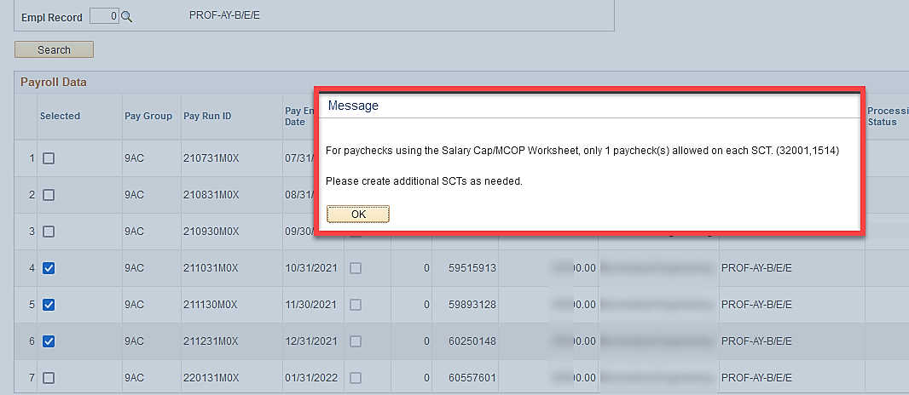
New Warning Message for MCOP
Whenever more than one paycheck is selected and one of the paychecks utilized the MCOP Worksheet, the message below appears.

Slide 10
Creating New Employee Records when Hiring

Slide 11
When to Create a New Employee Record
Scenario | New Employee Record?
CWR to EMP or vice versa | Yes
Staff to Academic (and vice versa) | Yes
One division/school to another (within UCI) | Yes
Inter-Location Transfers (one UC location to another) | Yes
Transfer within same school/department | No
Change in job w/ different FLSA | No
Different Pay Group | No
Promotion in same department | No
Reclassifications | No

Slide 12
Extended Absences Entries, Adjustments, & Cancellations

Slide 13
Entering a New Extended Absence
If an employee will be out of the office for longer than 5 days and the leave is NOT related to vacation or sick time off, you must enter an extended absence in UCPath for that employee.
Employee absences related to sick/vacation, or are less than 5 days long, can be recorded in TRS.
You can enter multiple rows in one transaction for Extended Absences if the dates are consecutive and do not contain any gaps.
For Example: An employee on Medical Leave for 2 weeks. First row shows 1 week as a paid-block and the second row shows as an unpaid-block.
Rows can be for different leave types during initial entry.

Slide 14
Editing Ext. Absence Transactions
If an employee will be transitioning from one leave type to another (i.e., Medical Leave to Personal Leave), you must enter a new row with the new leave type.
If the leave will be continuous, you do not need to enter an “actual return” date on the previous/existing leave row in order to change the leave type.
You are not able to edit and add more rows to an existing and approved extended absence request.
If you need to make changes or adjustments to an employees’ existing absence, other than extending the expected return date or correcting the Paid/Unpaid block values, you must enter a new extended absence transaction in UCPath to record the change.
For example: If an employee notifies the dept. 2 days before their expected return date that they will be out longer than anticipated, but they would like to be on an unpaid leave for those days, a new absence transaction must be entered.

Slide 15
What Happens when EA is Edited?
Once an edit has been entered, UCPath will revert the employee to their previous HR status until edits have been approved at the UCPath Center.
When absences are modified and submitted in UCPath, the employee’s HR Status will revert to the previous status they were in prior to the entry being modified.
If the employee was in active or a different status prior to EA entry, that is what will reflect until edits are processed at UCPC, then status will update again.
Edited EA transactions must also abide by the payroll calendar deadlines. If you miss the deadline, the employee may be underpaid/overpaid and may require a Payroll Request for resolution.

Slide 16
Cancelling Extended Absences
If the extended absence transaction was entered incorrectly or you are unable to accurately reflect the conditions of the leave, you should cancel the transaction and re-enter it from scratch.
Please be aware of the processing calendar whenever making any type of entries or modification to extended absences.

Slide 17
When To Modify Extended Absence
An Extended Absence entry can be edited only in certain instances, depending on where the transaction is in the approval workflow process.
Transaction Statuses:
Submitted/Pending
Cannot Edit
Cancelled
Cannot Edit
Saved
Edit - Yes
Pushed Back
Edit - Yes
Submitted
Cannot Edit
Approved UCPC
Edit - Yes

Slide 18
Impacts to Future Dated Transactions

Slide 19
Future Dated Transaction
Avoid future dated transactions more than 30 days in the future.
Creates additional challenges when needing to make an entry for a new event prior to that transaction
Retro Dated non-pay impacting data changes will override data in that period with current data.
Old Data 2021
John Smith
Depts: IR1234
Job Code: 009876
Reports-To: 08675309
Pay Rate: 80,0000 / Yr
New Data 2022:
John Smith
Depts. IR1234
Job Code: 007890
Reports-To: 09035768
Pay Rate: 105,000

Slide 20
Q1 UCPath Training Schedule

Slide 21
Upcoming UCPath Training
New hires who need training are able to register on UCLC
Training will be conducted via zoom. After registration a calendar invite from UCLC with a link to Zoom will be provided. Please reach out if you have questions!
Course Name | Course Name | Date | Time
POS101 | UCPath Navigation & Pos. Cntrl | Wednesday 2/2/2022 | 8:30a – 12:30p
FIN102 | Funding Entry & Budget Dist | Friday 2/4/2022 | 8:30a – 12:30p
TEM101 | Template Transactions Pt. I | Monday 2/7/2022 | 8:30a – 2:30p
TEM102 | Template Transactions Pt. II | Wednesday 2/9/2022 | 8:30a – 12:30p
PPA201 | PayPath Actions Pt. I | Tuesday 2/15/2022 | 8:30a – 2:30p
PPA202 | PayPath Actions Pt. II | Thursday 2/17/2022 | 8:30a – 12:30p
PRQ201 | Payroll Requests | Wednesday 2/23/2022 | 8:30a – 12:30p
DRD201 | Direct Retro | Friday 2/25/2022 | 8:30a – 12:30p
ABM101 | Extended Absences | Monday 2/28/2022 | 8:30a – 12:30p

Slide 22
Did you know
Pay group is automatically assigned in UCPath
The pay group defaults to DEF when a person is hired, rehired or transferred
A batch process runs multiple times per day to assign the appropriate pay group based on a variety of factors including union affiliation, FLSA status, pay frequency (monthly or biweekly), etc.
Pay group is a way to group employees based on shared characteristics to facilitate payroll processing
Pay Group Override
A pay group override can be requested to align the pay frequency (monthly or biweekly) for employees with multiple jobs
A pay group override can be requested during HR template processing by including a comment on the template
A job data update form can be submitted for overrides not requested on the template
Special pay groups exist for certain scenarios (9= location code)
9MH: allows hourly employees to be paid monthly
9BE: allows exempt salaried employees to be paid biweekly
9MS: is used for monthly salaried employees and requires hours be submitted positive time
Resources:
Job Aid: Pay Group Assignment, Configuration and Code List
Operational Alignment: Dual FLSA and Comp Frequencies

