Slide 1
Training Tips & Lessons Learned
October 5, 2021

Slide 2
Quick Announcements I
Upcoming Deadlines
BW PayPath deadline: Today 10/5 (5pm) - blackout until Fri. 10/8 6am
Monthly Transaction deadline 10/19 at 3pm for templates, extended absences leaves, etc.
  MO PayPath deadline: 10/22 (5pm) - blackout until Wed. 10/27 6am
Path Center is experiencing longer than normal processing times due to high transaction volumes. Current processing is one to seven days (avg. 5 days). Submit transactions early when possible. Transactions submitted within payroll processing deadlines will be prioritized to meet payroll.

Slide 3
Quick Announcements II
Ask UCPath Cases - Service Targets
Effective 10/1 UCPath changed how service targets for cases are measured. This does not impact the case resolution, but provides more accurate expected dates.
Effective October 1, 2021, UCPath service targets will shift from calendar to business days. Service targets will now exclude weekends and holidays to align with UCPath working hours Example: A case opened on Friday, 10/1, with a five-day service target Previous service target: Wednesday, 10/6 New service target: Friday, 10/8 The pending closure period will remain as five calendar days, and users have an additional five days to reopen a closed case

Slide 4
Quick Announcements III
UCPC Email Updates & Communication
  Current process:
    After submission of a case, UCPath sends an email to the case submitter that confirms receipt and includes the service target
    Once UCPath reviews the case, the topic and category may be updated and the associated service target may change; however, the case submitter is not informed of these changes
  New process:
    After submission of a case, UCPath will send an email to the case submitter confirming receipt (no service target will be included)
    After reviewing the case and making updates to the topic and category, UCPath will send a second email with the expected resolution date (service target)

Slide 5
Quick Announcements IV
Accruals for Monthly Employees on PFCB
UCPath has identified an issue with monthly employees not accruing hours with earn code “PFL" that are on Paid Family Care Bonding Leave (PFCB). A defect has been created to address this issue. It is not necessary to submit any requests or EEC tickets for accrual adjustments. Accruals will be auto-updated as part of the resolution. All updates are expected to be completed by October 18, 2021.

Slide 6

Agenda
Updating I-9/ Visa information
Location Use End Date – KBM
Post-Doc Paid Direct
Q&A

Slide 7

Impact of Location Use
End Date to KBM Staffing List

Slide 8
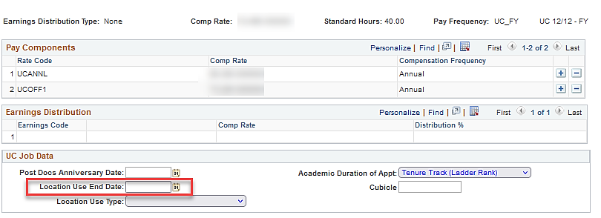
Location Use End Date Impact to Staffing List
This field is found on the Hire template and on the Job Data page in PayPath.
If this field is populated, the position will NOT appear as permanently budgeted on the KBM Staffing List.
Job Data page in PayPath

Slide 9
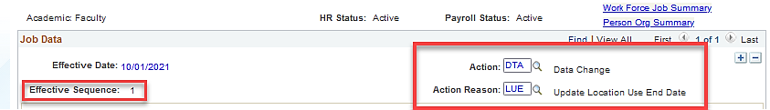
Steps to Remove Location Use End Date
Job Data page in PayPath
Add a new row in PayPath with same Effective Date used on the previous entry, if there are no rows on top of that row.
  Note: The Effective Sequence field should increment to the next number.
Enter the following Action/Action Reason:
  DTA – Data Change, LUE – Update Location Use End Date
Remove the date from the Location Use End Date field.
Save and submit transaction.

Slide 10
Updating I-9 & Visa Information

Slide 11
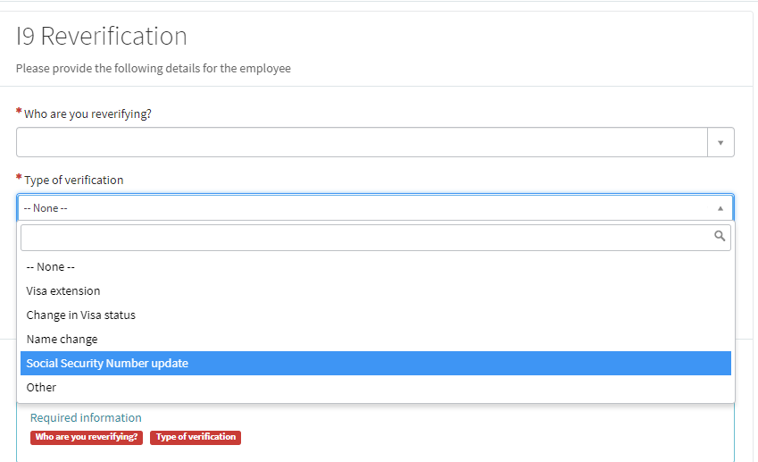
How to update I-9/Visa Information
Open an EEC Ticket
  Onboarding
  I-9 Reverification

Slide 12
Post-Doc Paid Directs

Slide 13
Post-Doc Paid Directs
Post Doc Paid Direct employees are not compensated through UCI Payroll but hold actual UCI title / jobs.
- Post-Doc employees are paid directly by a third party agency.
Post-Doc Salary Increases:
  Generally, the post-doc paid direct would get a letter stating that the funding agency will be increasing their salary as of their anniversary date in those cases (so long as it meets the 2% increase minimum).
  The school can just update UCPath with the new rate. If the funding agency does not plan on providing an increase, then it will be up to the unit to supplement the postdoc's pay in a postdoc employee job (003252).
  If agency agreed to pay increase, but employee has not been paid correctly, it is the post-doc’s responsibility to contact and work directly with the agency.

Slide 14
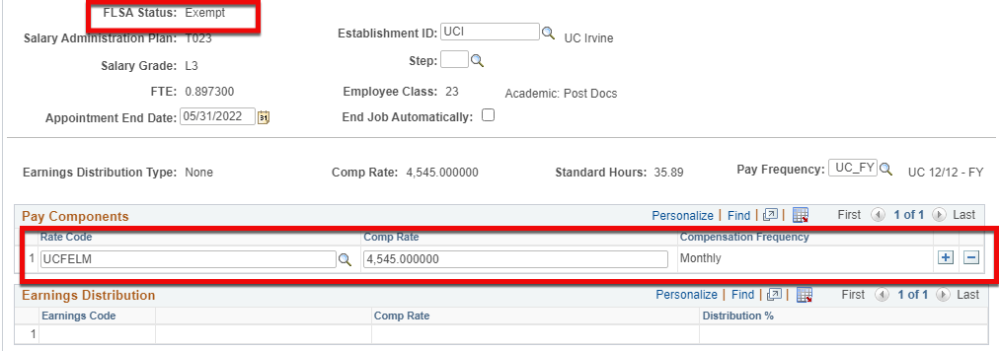
Use Case 1
If you have a 100% fellow, their comp rate code should be UCFELL.
- If they are getting their scheduled salary increase on their anniversary date and we need to pay the supplement, then we do a paypath action to update the FTE AND change the comp rate code in the fellow appointment from UCFELL to UCFELM so the monthly rate is paid as a flat rate, not based on FTE.

Slide 15
Use Case 2
If you have a postdoc-employee and they get a fellowship that pays some, but not all of the salary then the new fellow appointment needs to have the UCFELM monthly comp rate code. Divide the award into monthly not annual.
The UCFELM code will pay a FLAT amount NOT based on FTE %

Slide 16
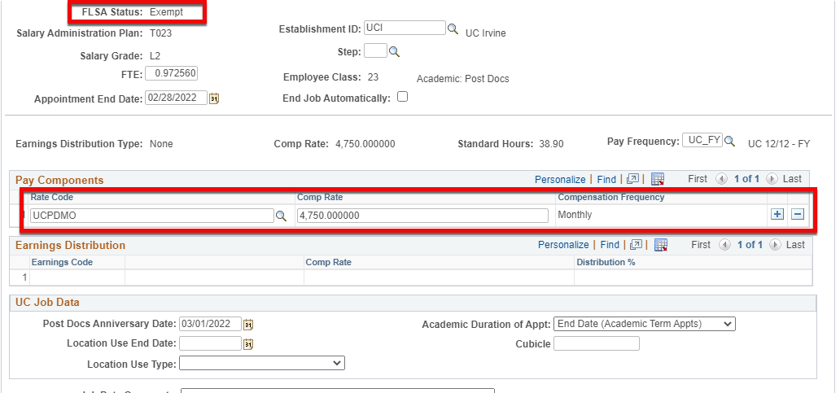
Use Case 3
If you have a 100% paid direct without any supplement, their comp rate should be UCPDPD with annual comp frequency so you can see the MO rate paid by 3rd party, and $0 from UC.
If they get a range adjustment that requires an employee appointment to pay a supplement, do a paypath action to update the FTE AND change the comp rate code in the paid direct appointment from UCPDPD to UCPDMO…. With monthly comp frequency.
This will still show but not pay the flat amount, regardless of FTE. The postdoc-employee appointment should reflect total annual rate using UCANNL and is paid the correct amount based on FTE %.

Slide 17

Did You Know?

Slide 18
Did You Know?

Slide 19



