Slide 1
UCPath Training Updates
Tips & Lessons Learned
12/15/20

Slide 2
Quick Announcements I
Check ALL End Dates
Please ensure that you have identified all employees who have an Appointment End Date of 12/31
There is a really large number of employees across all UC’s that have a 12/31 appointment end date.
UCPath Center is asking us to make sure we comb through our data to prevent unwanted terminations.
Please update appointment end dates prior to next deadline
Please check all positions/jobs that have funding expiring on 12/31.
Please update the funding information to avoid charges to the incorrect KFS account.
Otherwise, Direct Retro will need to be submitted.

Slide 3
Quick Announcements II
Upcoming Bi-weekly & Monthly UCPath Transaction Deadlines
Monthly Employees: 12/21
Bi-Weekly Employees: 12/22
*Not TRS Deadlines*

Slide 4
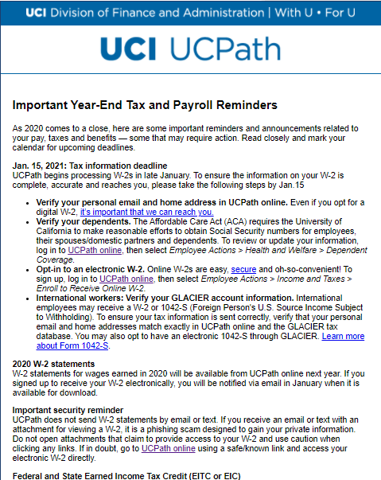
Quick Announcements III
Curtailment Period (Winter Recess)
Drop-In Support Center will be open 12/21 & 12/22 from 8:30am – 2:30pm
Tax Information Notice
Please review the tax information notice sent from UCPC

Slide 5
Agenda
Post Docs Processing & Updates – Amy Ruth & Jean Chin
FTE & Short Work Break
Benefit Impacts

Slide 6
FTE & Short Work Break
UCPath Center has implemented a fix to PayPath Actions which now eliminates the FTE from impacting benefits when employees go on Short Work Break.
What this means:
You no longer have to reduce/change an eligible employee’s FTE when they go on Short Work Break.
UPK to be updated to reflect this change.
Notes:
POCs – I know we recently discussed this, but this is a recent changed we just learned about over the last few days.

Slide 7
Benefit Eligibility & Triggers – Job Aid
There is a new job aid available – Benefit Triggers & Eligibility to learn more about how benefits are derived.
Link to Job Aid –
NOTE: There are no manual overrides departments can perform to change or provide employee benefits.
ALL key fields must be reviewed in order to provide the correct benefit package.

Slide 8
Questions?

