Slide 1
UCPath Training Updates
Tips & Lessons Learned
12/8/20

Slide 2
Quick Announcements I
Training Updates
We’ve been notified that some courses may not be appearing, we are working to address that issue.
If you are unable to locate a particular course, please use the UCI UCPath website as a back-up to review desired content.
Transactional Users > Training Presentations

Slide 3
Quick Announcements II
System Outage
Expected system outage starting Wednesday 12/9 @ 10pm – Monday 12/14 6am

Slide 4
Quick Announcements III
Upcoming Transaction Deadline
UCPath transaction deadline is Tuesday 12/8 !!
Upcoming Direct Retro processing dates
12/7 & 12/9
Curtailment Period (Xmas Break)
Drop-In Support Center will be open 12/21 & 12/22 from 8:30am – 2:30pm

Slide 5
Reminder to Check for Expired Funds!
Periodically funding will expire and need to be updated in UCPath.
Be sure to check KFS regularly to look for funds nearing expiration.
If funds are approaching expiration, please update UCPath via the Funding Entry page with new funding information.
Failure to make these updates will result in funding hitting department default/suspense accounts. And will then require a direct retro to move the expenses to the correct accounts.

Slide 6
Agenda
Report updates – Matt Levin
Post Docs Processing & Updates – Amy Ruth & Jean Chin
Anniversary Kahoot!

Slide 7
Happy 1 year anniversary UCI !

Slide 8
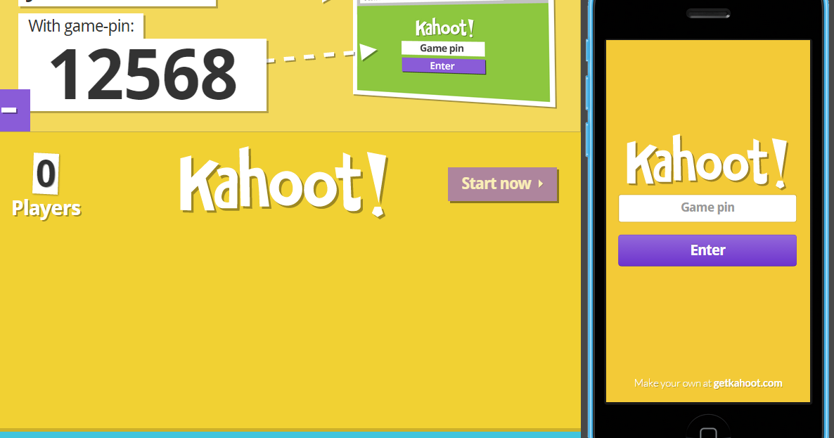
Let’s play
It is recommended to use a separate device!
Open your browser, navigate to www.Kahoot.it

Slide 9
Questions?

