Slide 1
UCPath Training Updates
Tips & Lessons Learned
2/2/21

Slide 2
Quick Announcements I
Drop-In Support Center: Schedule change
Starting February 8th 2021 the Drop-In Support Center hours will be Mon-Fri 8:30 am – 11:30 am
Known Finance Issues
We are aware of some kinks in the UCPath functionality that are impacting finance reports.
We are still working to resolve and fix the issue.

Slide 3
Quick Announcements II
Former Employee Access to W-2
Former employees can only access the UCPath Portal for W-2’s using their personal e-mail addresses.
If the employee does not have a personal e-mail on file, please submit a UC_Person_Data template and add/change the email to reflect former employee’s personal e-mail address.
Standard Approval processing time

Slide 4
Agenda
Off-Cycle Dashboard: Additional Information
Accrual Adjustment Process: Follow-up

Slide 5
Off-Cycle Dashboard Changes
Dashboard – Initial Version
Dashboard - Improvements
Payroll request transaction statuses were not updating correctly, consistently
Access to detail view accessible through summary view only
Search parameters limited
Transaction statuses/reason definitions limited
Access to detail summary and detail view available by separate links on the left menu navigation
Search for transactions now include additional parameters:
Search by transaction ID
Business unit
Search by date range auto populates 30 days
Improved transaction statuses/reason definitions
Streamlined access to legend
Download to Excel
Payroll request transaction statuses are updating correctly
Paging controls

Slide 6
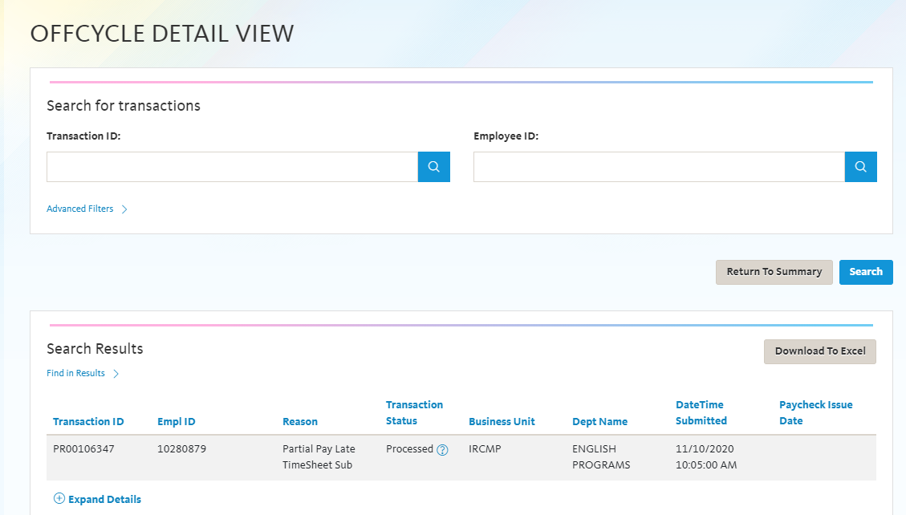
Off-Cycle Dashboard Changes (cont)
Select Quicklinks on the navigation menu: Offcycle Dashboard and then Details View or Summary View
Access to detail summary and detail view available by separate links on the left menu navigation
Search for transactions now include additional parameters:
Search by transaction ID
Business unit
Search by date range auto populates 30 days
Improved transaction statuses/reason definitions
Streamlined access to legend
Hovering over(?) definition of transaction status
Download to Excel
Payroll request transaction statuses updating correctly
Paycheck issue date in header row

Slide 7
Terminology and Definitions – Transaction Status
Transaction Status | Definition
Approved | Payroll transaction has been approved by the location and received at UCPath
Ready | The off-cycle payroll request is received at UCPath and is ready to be worked with
Pending | UCPath waiting for location feedback
Processed | Payroll processing in progress
Cancelled | See Appendix for cancellation reasons
Paycheck Status | Definition
Calculated | Transaction has been loaded to pay sheets and is in calculated status in the system
Confirmed | Payroll transaction has been processed and finalized in the system with a check or advice number and an issue date

Slide 8
Transaction Cancellation Reasons
Term | Definition
Instant Pay Card Requested | The payroll request has been cancelled due to location has requested an instant pay card for the employee. Cancellation will prevent overpayment
Duplicate Request Received | Location submitted more than one payroll request for the same employee, earnings dates and amounts
Potential Overpayment | Payroll request submitted will create an overpayment due to employee already paid on-cycle or on a previous payroll request processed off-cycle
Resubmission – Data Conflicts | Data submitted on the payroll request requires correction
UCPath Sys Error | System processing error encountered requiring the transaction to be manually processed and not loaded and batch processed

Slide 9
Payroll Request- Submission Reasons
Drop-Down Transaction Choices
Term | Definition
Death Pay | Payroll request submitted for deceased employee
Involuntary | Final payment for involuntary separation
Retirement | Final payment for retiree
Voluntary | Final payment for voluntary separation
Exception – Damage Pay | Missed pay for employee who has not signed oath
Partial Pay Late Hire | Partial missed pay for new hire entered after the cut-off for on-cycle processing
Partial Pay FTE Increase | Partial missed pay for employee with an increase in time entered after the cut-off for on-cycle processing.
Partial Pay No Access Time Rpt | Partial missed pay for employee that could not access time report for timely submission for on-cycle processing
Partial Pay Late Timesheet | Partial missed pay for employee where the timesheet was submitted/approved after the cut-off for on-cycle processing

Slide 10
Payroll Request- Submission Reasons Cont’d
Drop-Down Transaction Choices
Term | Definition
No Pay Submitted Late Hire | Full missed pay for new hire entered after the cut-off for on-cycle processing
No Pay Sub No Access Time Rpt | Full missed pay for employee where the timesheet was submitted/approved after the cut-off for on-cycle processing
No Pay Submitted Late Timesheet | Full missed pay for employee where timesheet was submitted/approved after the cut-off for on-cycle processing
Emergency Pay – EEMGLN | Missed pay for employee where location issued pay from their local AP. The difference owed is processed off-cycle and issue to employee. (Refer to deck on the Emergency Pay Process details)
Instant Pay – PAYCRD | Missed pay for employee where location issued pay via instant pay card. The difference owed is processed off-cycle and issued to employee. (Refer to deck on the Instant Pay Card Process for details)
Legal (Severance, Court Order) | Payroll request where pay to employee is set out in legal terms of an agreement
Current Year | Submissions for overpayments
Prior Year | Submissions for overpayment

Slide 11
2. Accrual Adjustment Process: Follow Up
Moving forward, Employees (Staff & Academic) who require adjustments to their accruals, will need to submit an EEC ticket to Payroll.
Department identifies need for accrual adjustment
Initiator submits EEC ticket to payroll
Employee name & ID
Cause for adjustment
Current hours; Adjusted Hours
Payroll receives ticket and validates request
If valid, Payroll will send form via the EEC ticket to fill out and send back.
5. 3-5 business days processing time.

Slide 12
Comp-Time Payout
Comp Time payouts (CTO) are included as part of the new Accrual Adjustment process.
If you have an employee who needs to have their CTO paid out (not as final pay), submit an EEC ticket and direct it to payroll.
Be sure to include:
Employee Name & ID
Amount of CTO hours to pay out
Include any agreements, requirements/details

Slide 13
Questions?

