Slide 1
UCPath Training Updates
Tips & Lessons Learned
2/23/21

Slide 2
Quick Announcements I
This week is a Quad Payroll for UCPC - expect delays in processing off-cycle and payroll requests.
Feb. 22, 23,24, 25 are all payroll confirm days
PayPath Black-out and Deadline for Approvals
Mo PayPath Black-out Mon. 2/22 5pm until Thurs. 2/25 6am
BW PayPath Transaction Deadline today 5pm, Black-out starts 5pm today until Fri. 2/26 6am

Slide 3
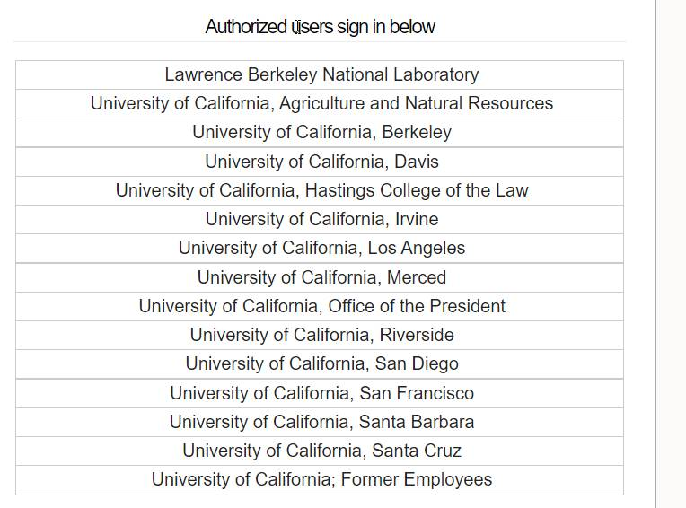
Quick Announcements II
Employee Email Address Reminders
With ending all WOS appointments for Grad students please ask Grad students to put personal non-UCI email address into UCPath as their home email address prior to 3/31/21.
If the WOS was their only appointment they will not be able to get into UCPath Online except through the former employee Portal

Slide 4
Quick Announcements III
UCPath Training
Training courses are available via UCLC for new employees.
Training can be assigned based on curriculums provided in UCLC (HR and HCM, GL & Finance)
DSA will need to submit a KSAMS request for UCPath access upon employee’s completion of required training.

Slide 5
Former Employee UCPath Portal
New Information on Former Employee Portal
If Employee has home email address in UCPath when employment is ended they will get email with information and link to the former employee portal
If they do not; when the home email address (non-UCI) is added, this will trigger an email with information to set up the former employee account.
This is a two step process.
First email to register and activate account.
Second email to complete including verifying personal data and creating security questions. Once both are complete login to UCPath using Former Employee page.

Slide 6
Key Dates for Grad Student Processing
Key Dates | Requirements
Feb. 22 | Complete Hiring Transactions for Spring Quarter
Feb. 26 | Any changes to WOS, 0 FTE jobs to be ended sent to UCPath@uci.edu
March 1 @ 10am | Mass PayPath templates uploaded to One Drive (Scenario 1 and 4)
March 8 | PayPath Error reports to Divisions via One Drive
March 8-12 | Manually process all Mass Template errors in UCPath through PayPath
March 12 @ 5pm | All PayPath transactions approved to ensure reflected in Fee Remission processing on March 15th.
Presentation and Recordings from both 2/17 Presentation on Grad Student Processing changes and 2/22 Discussion on Mass PayPath Template process are available at UCPath.uci.edu/Transactional Users/HR and HCM/Academics

Slide 7
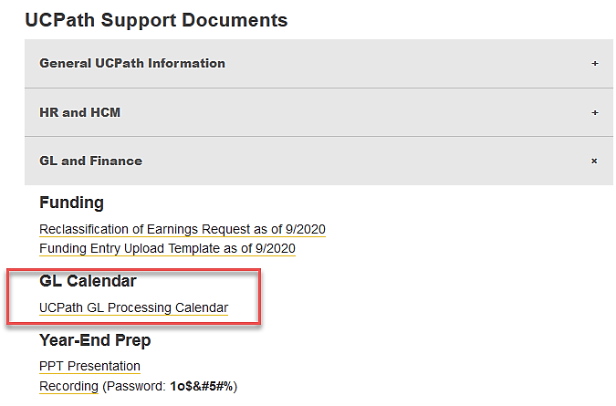
GL Processing Calendar
Location: UCI UCPath Transactional Users page > UCPath Support Documents > GL and Finance > GL Calendar
Notes:
This is developed once a quarter. This calendar is for January – March 2021.

Slide 8
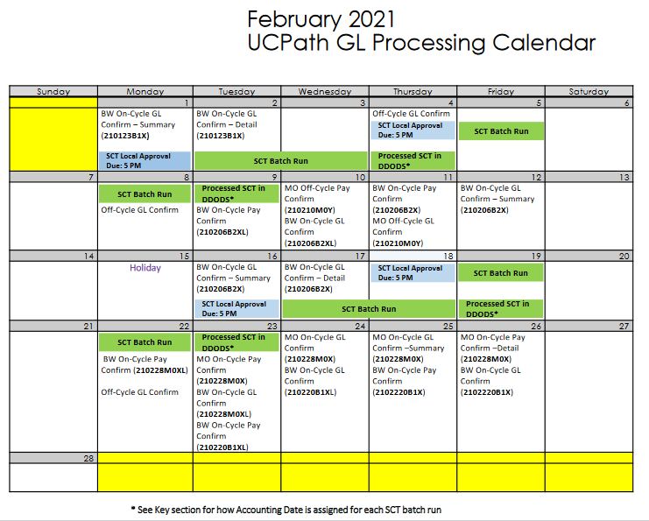
February 2021 Schedule
NOTE: Transactions submitted for 2/16 deadline were processed with the 2/22 SCT batch run.
If you do not see entry on the DOPE report, there was likely a delay.
Notes:
Notice this process is taking more than a day like the SCTs.

Slide 9
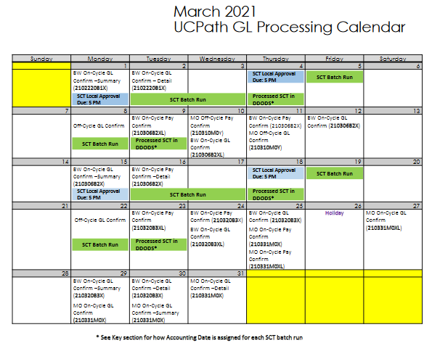
March 2021 Schedule
Notes:
Notice this process is taking more than a day like the SCTs.

