Slide 1
Training Tips March 22, 2022

Slide 2
Quick Announcements I
Upcoming Deadlines
NEXT BW Transaction deadline: Thursday March 3/31 at 3pm (for templates, extended absences, etc.)
BW PayPath deadline: Today 3/22 (5pm) – blackout through Friday 3/25 @ 6am
NEXT MO Transaction deadline: Wednesday April 18 at 3pm (for templates, extended absences leaves, etc.)
MO PayPath deadline: Wednesday 3/23 (5pm) - blackout until Tuesday 3/29 @ 6am

Slide 3
Quick Announcement II
Expected Job End Date of 3/31
Please monitor employees with end dates of 3/31.
Terminate or Extend as needed
850+ UCI employees with end dates of 3/31.
750 are Students
If an employee is auto-terminated and not reinstated in time, they may lose their UCI Net ID & access and benefits.

Slide 4
Quick Announcements III
Extended Absence Support
Tuesdays & Thursdays 10-12pm in the Drop-in Support Center (Charlene Dodd & Melissa Moffat)
Vacation Accrual Issues
UCPath has identified an issue with vacation accrual eligibility. Some employees may show incorrect vacation accruals. It is not necessary to submit any requests for accrual updates as these will be updated as part of the resolution of this issue. Current estimated to be fixed end of April

Slide 5
Future Training Tips Meetings
April 5
April 19
May 3
May 17
May 31
June14

Slide 6
Agenda
Managing Employee Records
Sample Use Cases for Empl Record Selection

Slide 7
Managing Employee Records

Slide 8
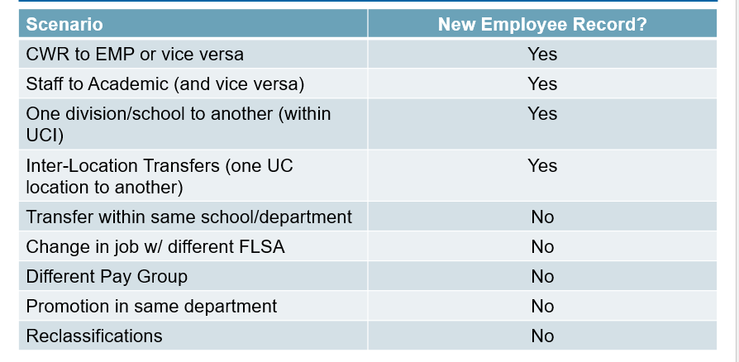
When to Create New Employee Record
Analysis Req’d
Analysis Req’d
Analysis Req’d
Analysis Req’d
Analysis Req’d

Slide 9
Pros of Having Fewer Empl Record
Easier to view Employee Work History via Person Org Summary and Workforce Job Summary
Decrease chances of choosing wrong record for changes or transfers.
Easier to manage actions for employees.
Records will not go away or be archived. Will exist permanently.
Easier to troubleshoot and find discrepancies.

Slide 10
Cons of Having a Fewer Empl Records
Access could be limited if they have jobs in other departments.
Employee History can be misleading (unable to see when jobs change)
Employee data does not transfer to new record.
Requires assessing which record to use.

Slide 11
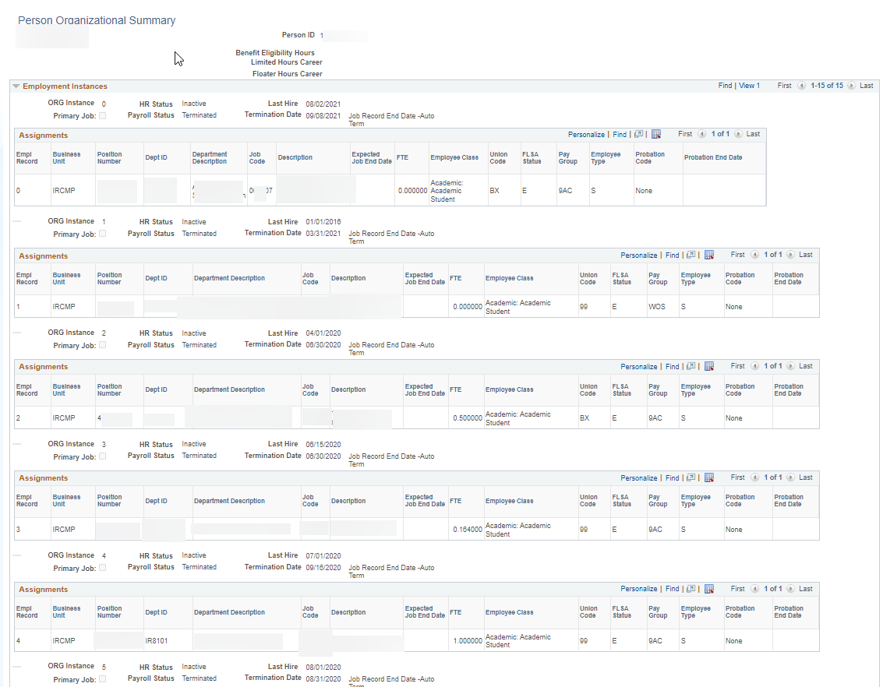
Example of Many Empl Records - GSR

Slide 12
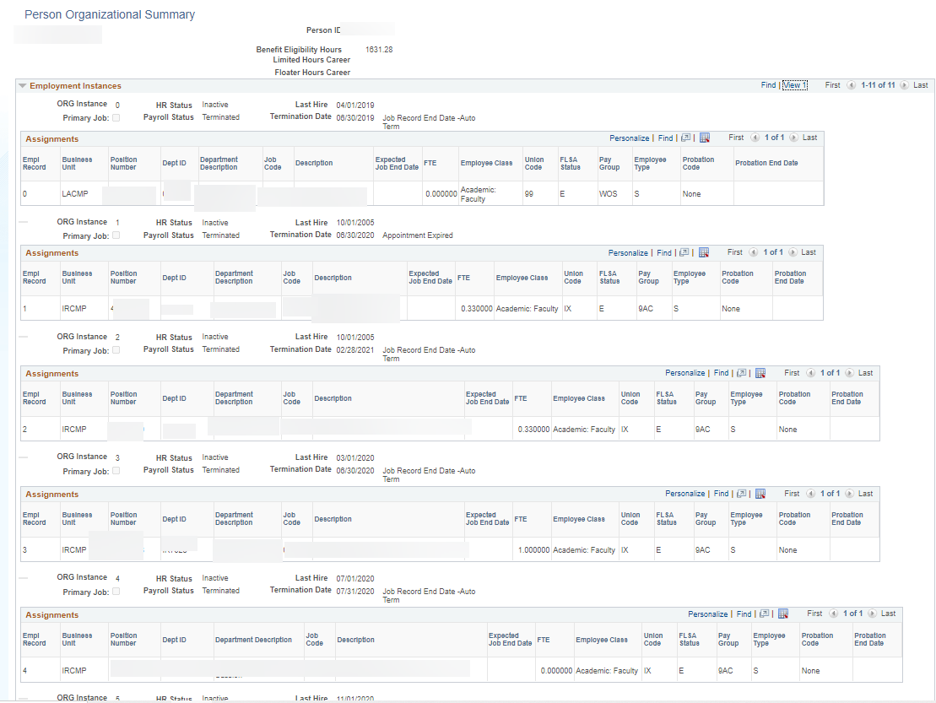
Example 2

Slide 14
Did you know: There is detailed information about how earn codes are configured in UCPath UCPath updates the file regularly with all earn codes and their attributes including status, allowable employee types, subject to FICA, etc. Navigate to UCPath > Quicklinks > Payroll Resources > Payroll Configuration Codes > Earn Codes
Did you know: When an employee on unpaid leave of absence or short work break is being terminated, the employee should be returned from the non paid payroll status prior to termination in order to pay out their final hours (e.g. TRM) Note: An employee on paid leave of absence does not need to be returned prior to termination to pay out the final hours Other Updates & Reminders: Forms Library: The Forms Library in UCPath has been updated to display the benefit forms by employee category: Faculty/Staff Benefits Postdoctoral Scholar Benefits Medical Residents Benefits (Pending forms approval) Other Benefits Forms Other updates to the page include: The eBenefit forms are under the Faculty/Staff Benefits category The link for Evidence of Insurability under the Faculty/Staff Benefits category was updated to direct employees to the correct pages in UCNet The Late Enrollment Request Form has been added to the Postdoctoral Scholar Benefits category Other Benefits category includes miscellaneous forms such as the Dependent Information Update Form and Declaration of Tax Dependency (UPAY 886)

