Slide 1
Training Tips & Lessons Learned April 20, 2021

Slide 2
Quick Announcements I
Drop-In Support Center: M – F 10am – 12pm
HR
Extended Absences
PayPath Actions / Additional Pay
Funding
Direct Retro
General Support
Payroll Office Hours: Mon. & Wed 1pm – 2pm
*Pilot project to partner with Payroll to focus on Payroll Request transaction support:
Off-cycle
Overpayments
Final pay
Zoom Details:
https://zoom.us/j/8519035805
Meeting ID: 851 903 5805

Slide 3
Quick Announcements II
Upcoming Deadlines for Template and Retro Pay Transactions:
Monthly: Today 4/20 3pm
Bi-Weekly: 4/29 3pm
PayPath Blackout Period (BW):
Starting: Today 4/20 @ 5pm
Back Online: Friday 4/23 @ 6am
PayPath Blackout Period (MO)
Starting: Friday 4/23 @ 5pm
Back Online Wed. 4/28 @ 6am

Slide 4
Quick Announcements III
Emergency Pay is handled by UCI Payroll through an EEC ticket
If an employee needs missed pay immediately, open an EEC ticket with payroll and label emergency pay
Do not create an off-cycle check- the Transaction code Emergency pay is only to be used by Payroll, this process is separate from UCPC off-cycle
If the missed pay does not require emergency pay then proceed with off-cycle request
OIT message when a student employee no longer has any active employee appointments:
Our records indicate that you are no longer a student employee. Your directory entry has been updated to reflect that you are no longer an employee. Your student status has not changed. If you return as an employee in the future, your directory entry will be updated accordingly.
If you believe the job termination is in error and you are still actively working as an employee, please contact your supervisor and/or HR staff in your school/department.

Slide 5
Quick Announcements IV
Reminder Direct Reports are tied to a Position # not an individual Supervisor’s name
When possible use the same Position # when a Supervisor changes to avoid the need to move all the employees to the new Supervisor’s position #
Feedback from recent surveys indicate that there are problems with people reporting to the correct Supervisor/Manager and this will need to be reviewed and fixed via a PayPath change
Reminder to use Favorites and/or Bookmarks to find transactions more quickly
Now that Grad student WOS appointments are terminated, ensure that those who have no active employment know they need to have a personal email in UCPath and register for former employee access

Slide 6
Agenda
Effective Date Hierarchy
Funding Entry

Slide 7
Effective Dates
Funding Entry

Slide 8
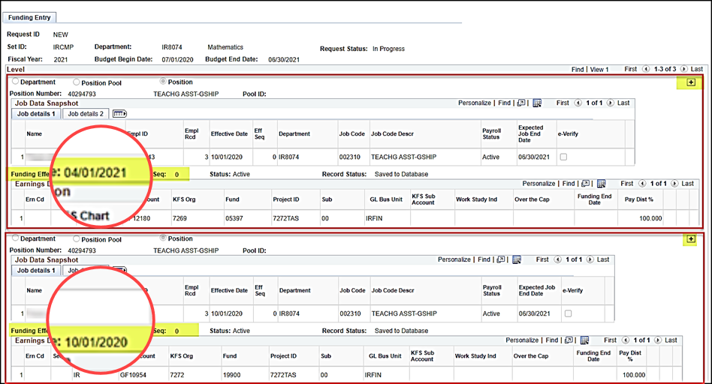
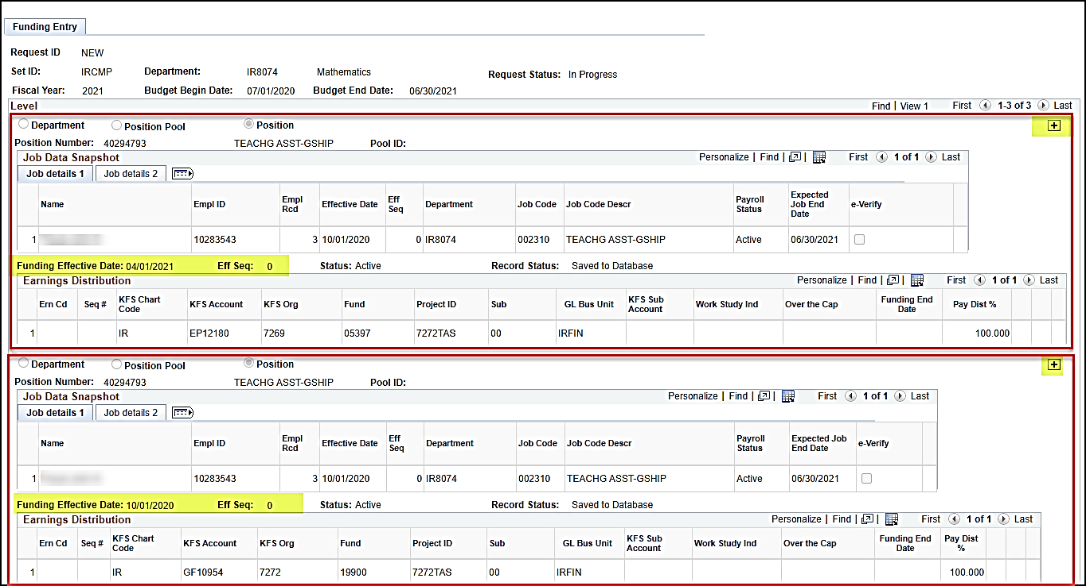
Example: 3 Effective Dated Rows, insert within

Slide 9
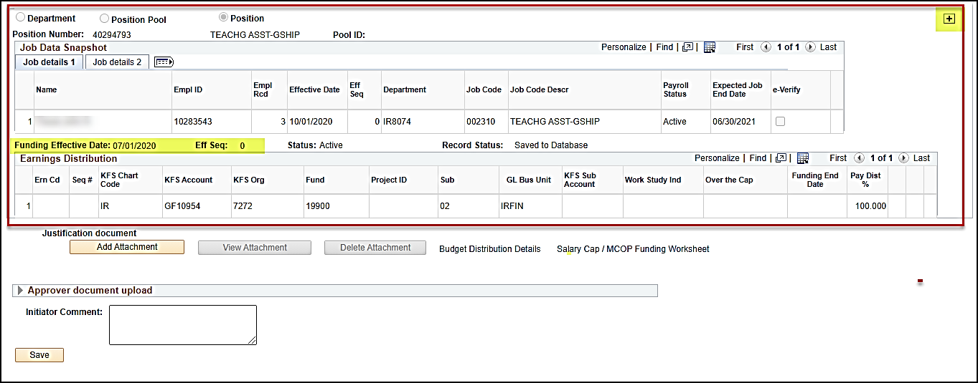
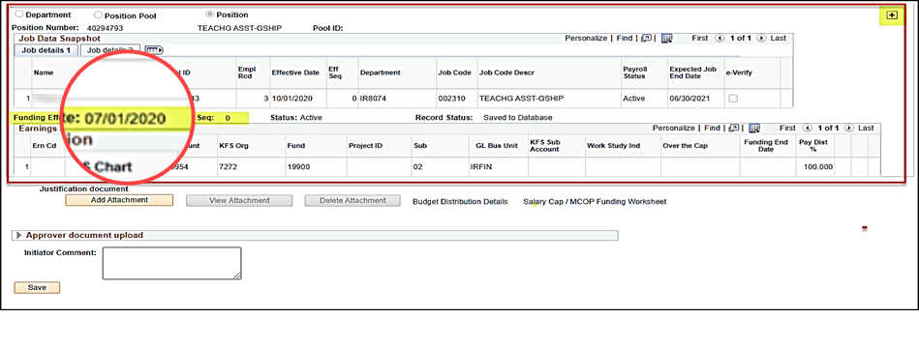
Example: 3 Effective Dated Rows, insert within
3 existing effective dated
funding rows
04/01/2021,
10/01/2020,
07/01/2020).
Lets Visualize as 3 rows in Excel.

Slide 10
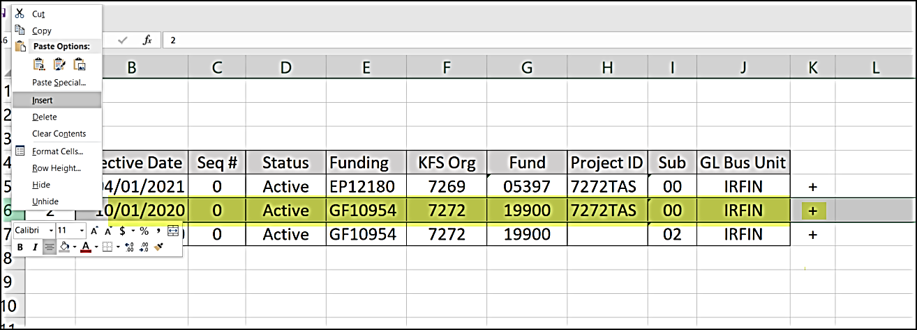
Example: If you were to do this in Excel…
“insert a row above 10/01/2020
but below 04/01/2021”
Select 10/01/2020 row; right mouse click and select insert.

Slide 11
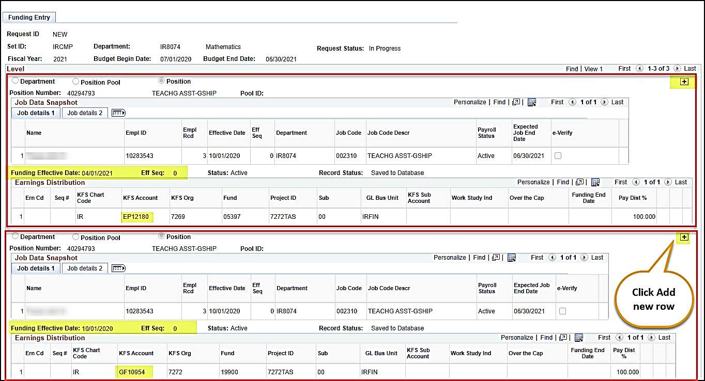
Lets try this on a funding entry page

Slide 12
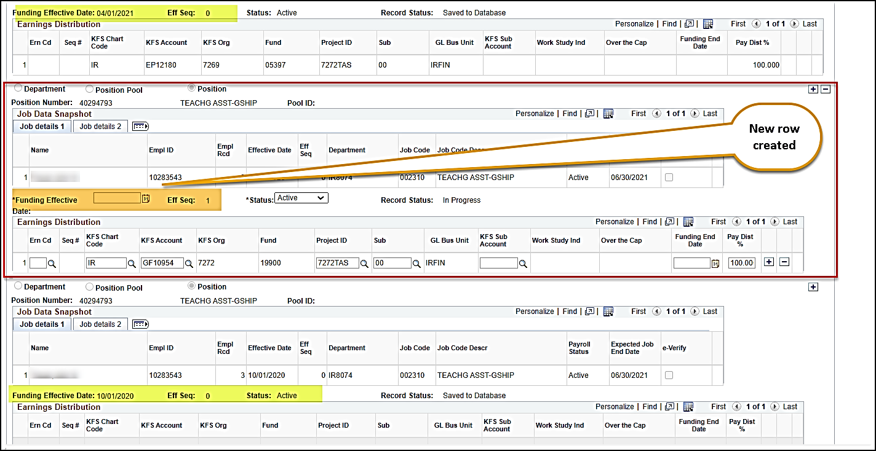
Example: Funding Entry page

Slide 13
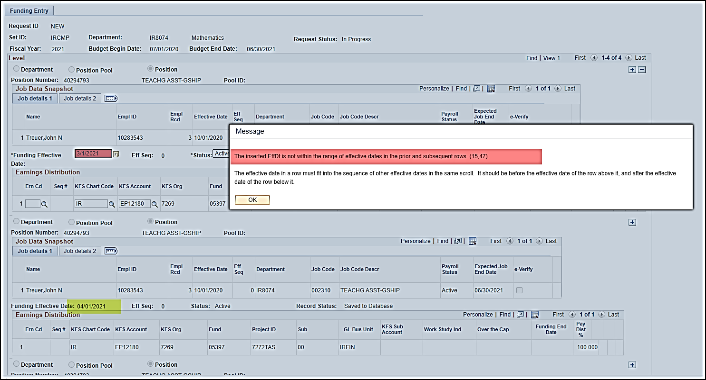
Keep your timeline straight!
Error message when trying to insert
03/01/2021 row ABOVE the 04/01/2021 row.

Slide 14
Effective Date Order
Position Active Effective Date
Funding Open Date Range
Job
Pay Begin & End Date

Slide 15
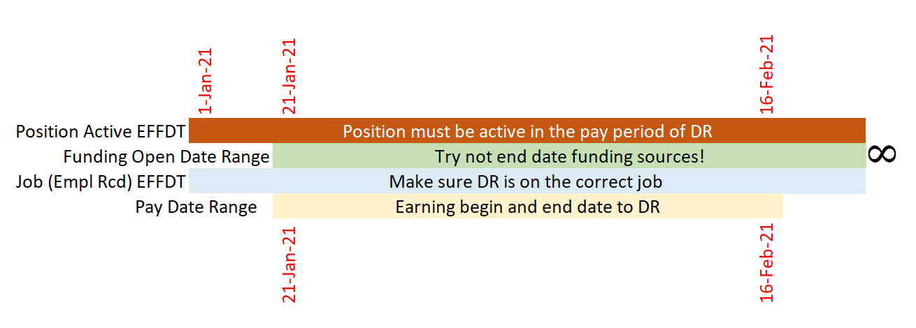
Which Effective Date Wins?
If funding ends…
Salary and benefits start going to department suspense account
another DR!
For any left over!
SCT & BCT
Reminder: Funding End Dates are not required for Grad students or most funding
Make sure to change Position Active Effective Date to be before pay end date as necessary!

Slide 16
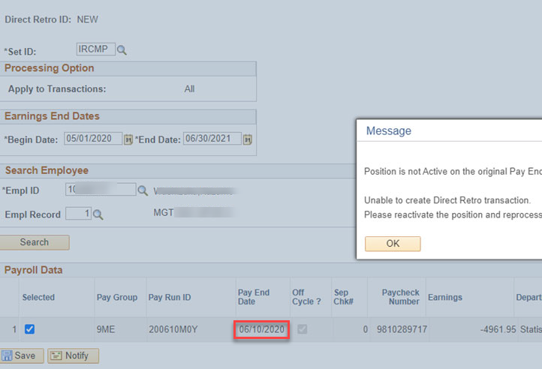
Example
Position is active as of 06/19/2020.
Pay ‘End Date’ is 06/10/2020,

Slide 17
Questions?

