Slide 1
Training Tips & Lessons Learned May 25, 2021

Slide 2
Quick Announcements I
Payroll Office Hours: Mon. & Wed 1pm – 2pm - Pilot Ending this week 5/26*
Off-cycle
Overpayments
Final pay
PayPath Blackout Period (MO):
Starting: Monday 5/24 @ 5pm
Back Online: Thursday 5/27 @ 6am

Slide 3
Retro Deadline
Upcoming Deadlines: One-Time Payments, Retro Payments, Extended Absences, Templates Trx, etc.:
Bi-Weekly: 5/26

Slide 4
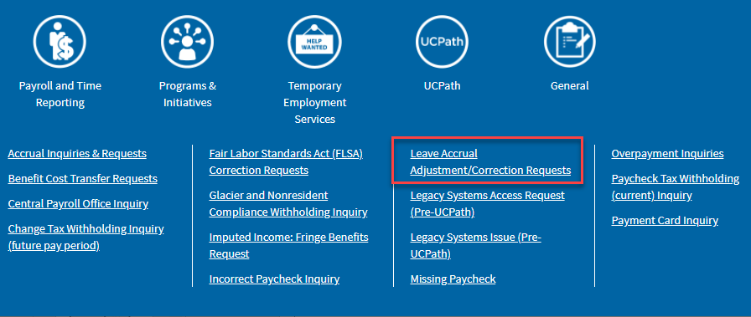
Quick Announcements II
Leave Changes to Timesheets > 3 months
If a departments needs to make adjustments to an employees’ timesheet greater than 3 months old, an EEC ticket needs to be submitted to Payroll - Leave Accrual Adjustment/Correction Requests.

Slide 5
Quick Announcements III
UCPath Refreshers / Learning Labs
Live zoom sessions will be hosted to provide a short recap of training provided alongside working labs for simulated practice in the UCPath Training Environment.
Registration Links:
Summer Salary: UCPath Training Team: Learning Lab / Refresher: End-to-End Summer Salary Processing (signupgenius.com)
Direct Retro: UCPath Training Team: Learning Lab / Refresher: Direct Retro (signupgenius.com)
Funding & Budget: UCPath Training Team: Learning Lab / Refresher: Funding Entry & Budget Distribution (signupgenius.com)
Virtual Learning Labs (Zoom)
Courses: | Lab Dates
End-to-End Summer Salary Processing | Wednesday: 6/9/2021 10am – 12pm
Direct Retro | Thursday: 6/10/2021 10am – 12pm
Funding Entry + Budget Dist. | Thursday: 6/17/2021 10am – 12pm

Slide 6
Quick Announcements IV
Review All Employees with 6/30 End Date
Review the Jobs with Approaching End Dates report - ensure end date is correct
Extend appointment if necessary
Avoid overpayments & accidental Terminations
Funding Entry Troubleshooting Guide
UCPath Center has provided a new job aid to assist in troubleshooting for Funding Entry transactions.
Job aid can be located on our internal UCI UCPath website.

Slide 7
Quick Announcements V
Work Study Workshop on 5/27
This workshop is intended for departments who have student employees with Work Study programs.
Participant limit increased to 50
Sign up here to participate:
UCPath Training Team: Work Study Training (signupgenius.com)

Slide 8
Agenda
Retirement Processing Update
Promotion Entry Process in PayPath Actions
SWB (Short Work Break) Transactions for Grad Students

Slide 9
Retirement Processing Update

Slide 10
Things to Know…
Process for July 1 retirement (1976 Tier)
Eligible for COLA
Final day of work: June 29
Effective date of retirement: June 30
Employees on LOA or SWB who do not return to work,
the last day worked should be prior to the LOA or SWB.
Refer to job aid for additional info
Process for July 1 retirement (non-1976 Tier)
Not eligible for COLA adjustment
Final day of work: June 30
Effective date of retirement: July 1
Employees on LOA or SWB who do not return to work,
the last day worked should be prior to the LOA or SWB.
Refer to job aid for additional info

Slide 11
Emeriti Processing
Effective with the 1st day of retirement (July 1), the faculty member is rehired as WOS Emeriti in UCPath.
Retirement transaction must be fully processed first.
After Retirement is completed, submit a rehire transaction for the WOS Emeriti
Refer to job aid for additional info

Slide 12
Promotion Entry Process in PayPath Actions

Slide 13
Promotions with Pay Increase
When entering a Promotion with a pay increase in PayPath Actions – users MUST complete both the Position Data tab AND the Job Data tab.
Each tab (Position + Job Data tab) should have an Action / Action Reason code entered that represents the promotion.
Relevant job aids available on UCPath Helpsite (UPK):
PayPath Position Data + Job Data Change – Academics
PayPath Position Data + Job Data Change – Staff
PayPath Position Data + Job Data Change – Academic HS

Slide 14
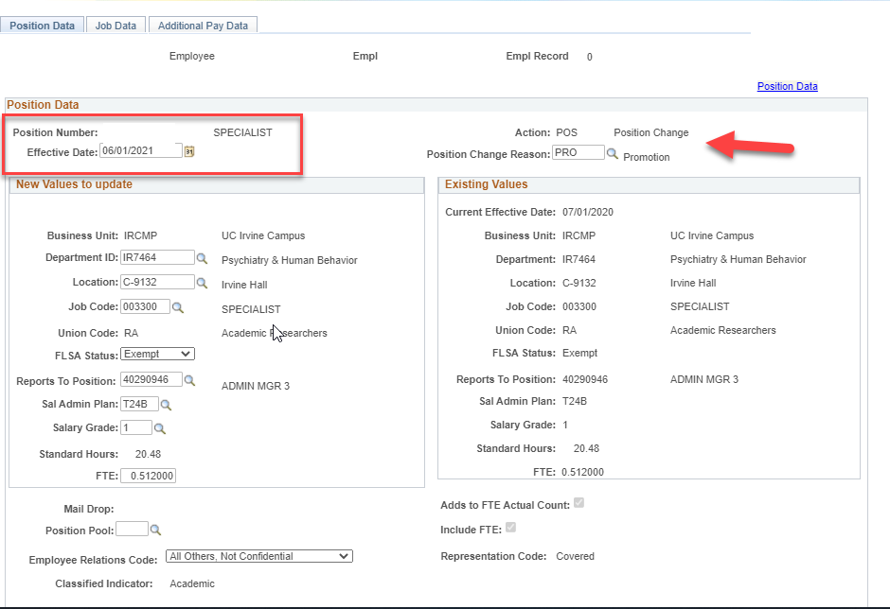
PayPath Actions for Promotion
Position Data Tab
First, enter the Effective Date of the Promotion.
Can be retro, current, or future dated.
Next, enter the Action / Position Change Reason code.
Action: Defaults to POS
Pos. Chg Reason: PRO
Ensure no other Position details need to change (i.e. FTE, Reports-to, Employee Relations code)

Slide 15
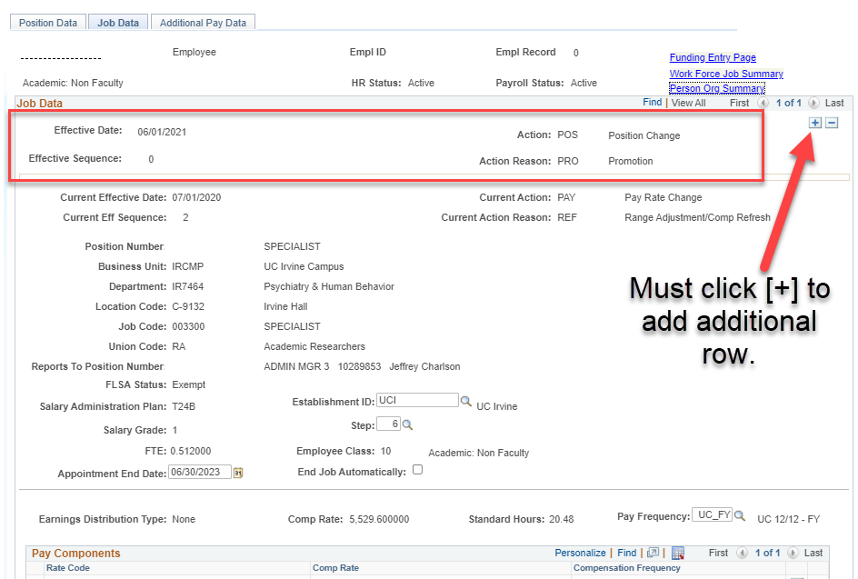
PayPath Actions for Promotion II
Job Data Data Tab
The job data tab will auto-derive the Effective date entered on the Position Data tab (cannot be edited)
To properly incorporate Job Data changes (i.e. pay rate changes, step increase) you must click the [+] button to add an additional row.

Slide 16
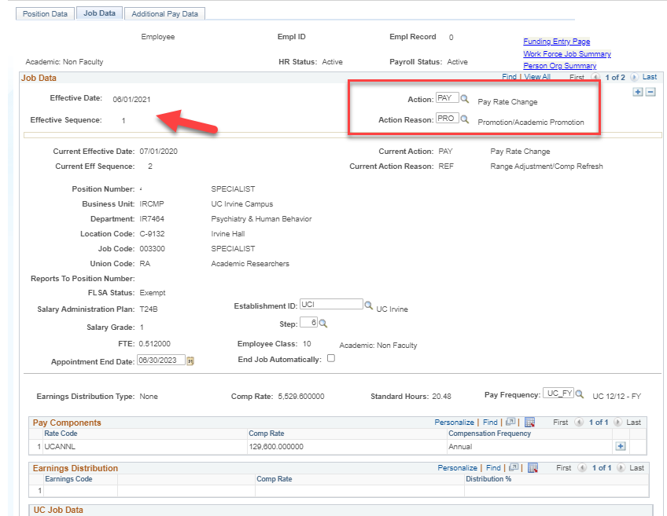
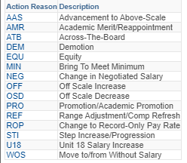
PayPath Actions for Promotion III
Job Data Data Tab
Once you add a new row, the effective date will stay the same but the Effective Sequence will now be “1” – meaning its is the next part of the same transaction.
You will then be able to enter the Action / Action Reason Code:
Action: PAY
Action Reason: PRO
*Other Action Reason codes

Slide 17
SWB Transactions for Grad Students

Slide 18
Key Dates – Grad Student Mass SWB
The table below reflects the key dates for processing Mass SWB Transaction entry.
Population: Grad students returning in the fall *UCI HRIS: Erice Cheng
June 7th (EOB) | Division CPO completes template and submits to One Drive. Link to be provided by HRIS
June 8-9th | UCI HRIS/UCPC uploads test file
June 10th | UCI HRIS provides errors/corrections to CPOs. List of grad students who fall out of test will be available.
June 11th | UCI HRIS uploads final file to UCPath
June 14th | Division CPO begins manual data entry required for errors in Mass Upload
June 23rd | PayPath deadline before payroll processing black out
Population: Grad students who are graduating, not returning in the fall or have no plans to be on payroll for over 4 months
June 18th | Unit’s payroll transactor processes UCPC Termination template before payroll processing black out
June 23rd | Or ensure job end date flag is set so that the job will be auto termed on the end date.
**Questions about the Mass PayPath Template can be directed to Philip Nguyen (philin3@uci.edu) in the daily drop-in center or to Erice Cheng (echeng@uci.edu)
Notes:
Mass paypath processing is not only for Grad Students or SWB….It can be used for other employee types & paypath actions - as long as they meet the deadlines for file submission & include changes for more than 50 employees.

Slide 19
Manual SWB Processing
If your department will be manually processing Short Work Break transactions for Grad Students in PayPath Actions, please be aware of the following steps.
If the Graduate Student will continue employment in the fall, proceed to enter a Short Work Break transaction in PayPath Actions.
Navigate to the Job Data tab
Enter Effective Date of SWB (first day they will be on SWB)
Reason: SWB
Action Reason: GST (AC Students) or SWB (Staff Students)
Enter the “Expected Return Date” of the Short Work Break
When entering this transaction, please ensure the Expected Job End Date is not prior-to the expected return date.
Appointment end date may need to be updated

Slide 20
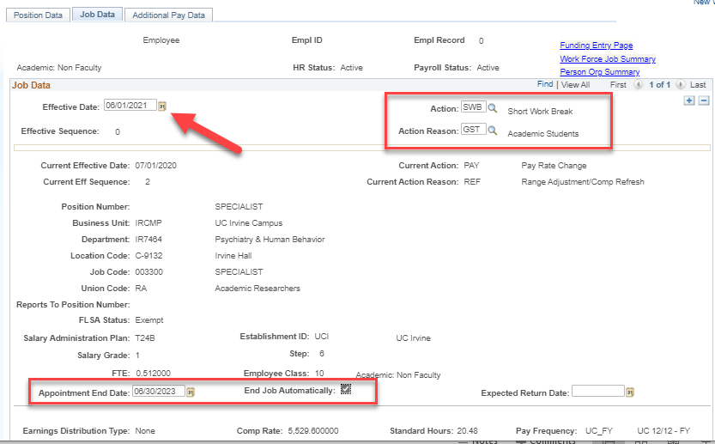
SWB – GS Returning in Fall
1
2
3

Slide 21
Manual SWB Processing II
2. If the Graduate Student will not be returning to work in the fall, there are two (2) options on how to process termination.
Option A: Submit a PayPath Action to update the Appointment End Date on Grad. Student’s related job (Job Data tab) to reflect the date they should be terminated.
Navigate to Job Data tab
Enter Effective Date of the change (can be “today’s” date, but has to be prior to their current end date)
Reason: DTA
Action Reason: COR (Staff & Academic date changes) or TMF (If only Updating Auto-Term flag for Academic)
Enter the new Appointment End Date and/or check the auto-term flag if they’re an Academic Employee.
Option B: Submit Termination template with appropriate Effective Date

Slide 22
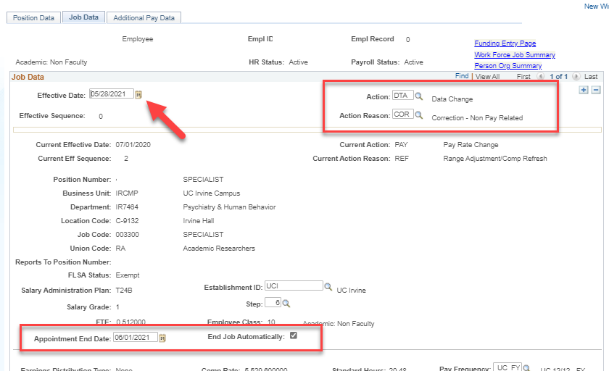
Option A - Updating Appt. End Date
1
2
3

