Slide 1
Training Tips & Lessons Learned May 4, 2021

Slide 2
Quick Announcements I
Drop-In Support Center: M – F 10am – 12pm
HR
Extended Absences
PayPath Actions / Additional Pay
Funding
Direct Retro
General Support
Payroll Office Hours: Mon. & Wed 1pm – 2pm - Pilot Ending 5/6*
*Pilot project to partner with Payroll to focus on Payroll Request transaction support:
Off-cycle
Overpayments
Final pay
Zoom Details:
https://zoom.us/j/8519035805
Meeting ID: 851 903 5805

Slide 3
Quick Announcements II
PayPath Blackout Period (BW):
Starting: Today 5/4 @ 5pm
Back Online: Friday 5/7 @ 6am
Overpayment Process Discussion 5/11
UCI Central Payroll will be providing information regarding Overpayment process.
Year-End Activity Discussion – 5/18
Please invite members from Finance to participate in discussion

Slide 4
Retro Deadline
Upcoming Deadlines for One Time Pay, Retro Pay, Extended Absence, Templates, etc.:
Bi-Weekly: 5/13
Monthly: 5/19

Slide 5
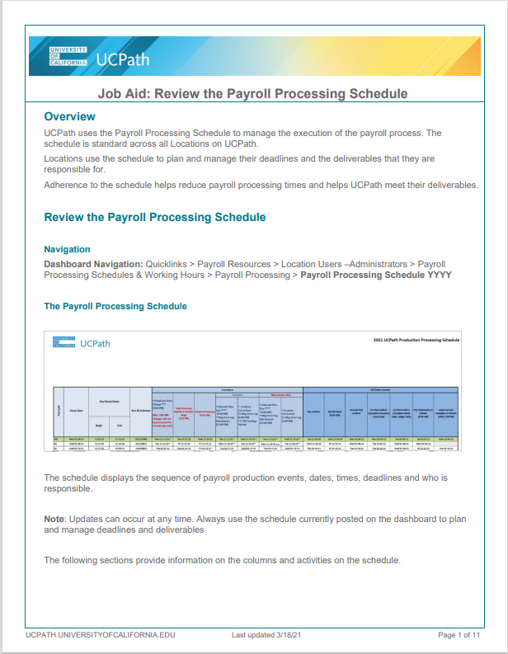
Quick Announcements III
Reviewing Payroll Processing Calendar Job Aid:
Review the Payroll Processing Schedule (ucop.edu)

Slide 6
Quick Announcements V
Instructor Led Training in May
Limited training will be available in May for select courses via Zoom. Registration is available in UCLC for the following dates:
Instructor Led Training (Zoom)
Courses: | Training Dates
Summer Salary | Monday: 5/3/2021 9am – 11am | Thursday: 5/6/2021 1:30pm – 3:30pm
Multiple Components of Pay | Thursday: 5/13/2021 10am – 11:30am | Thursday: 5/20/2021 1:30pm – 3:00pm
Funding Entry + Budget Dist. | Monday: 5/10/2021 9am – 12pm | Monday: 5/17/2021 9am – 12pm
Direct Retro | Wednesday: 5/12/2021 9am – 11:30am | Wednesday: 5/19/2021 1pm – 3:30pm

Slide 7
Agenda
Fiscal Year Close Reminders
New Dashboard Report
SWB for Grad Students

Slide 8
Applying Work Study Retroactively
Scenario:
Student started working in a department on 2/1/2021.
On 4/30/2021 the student informed you they were using Federal work study.
Department adds Position Pool ID in PayPath with a retroactive Effective Date of 2/1/2021.
Once the PayPath transaction is approved. Department can process Direct Retros for all prior pay checks so the work study split can be applied.
Only process one paycheck at time, per directive from Work Study.
Select the option of Apply Work Study in the New Data field to the Department account.
Never (EVER) enter the Work Study account in Direct Retro.

Slide 9
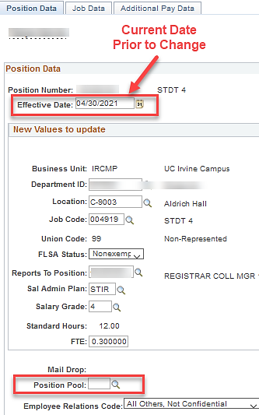
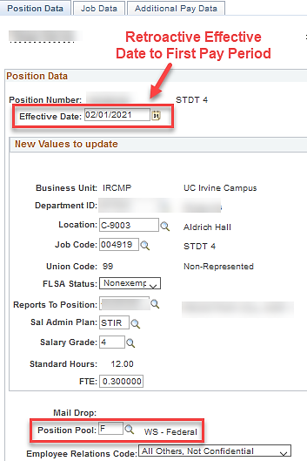
Updating of Position Pool ID
PayPath Position Data tab
Before
After

Slide 10
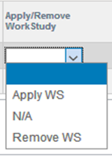
Add/Remove Work Study Values
There are three options in the New Data section on the Direct Retro for the work study splits:
Apply WS – apply work study to this account
N/A – do nothing; leave as is
Remove WS – remove work study from this account
Note: A selection has to be made for each line in the new data section in order to submit this transaction.
Notes:
A selection must be made for each line that has an editable option. If you want UCPath to apply work study to the account on that line, then select the Apply WS. If you want to leave the line as is, select N/A. And if you want to remove work study from the line, select the Remove WS option.
The only time Apply Work Study should be select from the drop down:
The split never took place and 100% of the charge went to the department account.
This happens usually when the department account is not linked to the current year work study fund. AND/OR
The Position Pool ID was either missing or incorrect.
The N/A option usually comes into play when the split took place and the department wants to move the department portion to another department account number. In this scenario, you would only change the department account information on the line with the D indicator. And both lines would have option selected of N/A, N/A because the split has already taken place.
Remove Work Study should be selected:
Only if the department wants to reverse the split and add it back to the work study award.
The “Apply/Remove Work Study” Dropdown in the New Data section is used to determine if WS Split logic needs to be executed on DR transactions.
Moving a WS transaction to non-WS is identified by selecting “Remove Work Study” option.
Moving a non-WS transaction to WS is identified by Selecting “Apply Work Study” option.
No Change/No Work Study impact to the Transactions by Selecting “N/A”.

Slide 11
Applying Work Study on Direct Retro
Select one pay check at a time to retroactively process the work study splits.
Only the Department accounting information is displayed in both Old Data and New Data section.
In the Apply/Remove Work Study field, select Apply Work Study because the split has never happened for this transaction.

Slide 12
Funding End Dates
Please ensure funding end date are removed for graduate student employees
Use Position Funding reports to check for upcoming Funding End Dates (6/30 or prior) in UCPath.
This funding will not will rollover to FY 2022.
When entering funding for FY 2022, you must enter the new Fiscal year first, then enter positions / dept details.
Check KFS for expired funds so that you can make appropriate updates in UCPath.
Process any Direct Retros, as soon as possible, to avoid the large volume at FYE.

Slide 13
New Dashboard Report
Here is the link to the latest Dashboard Report in the Decision Support section of the Zot Portal.
https://cognos.oit.uci.edu/ibmcognos/bi/?pathRef=.public_folders%2FUCPath%2FReports%2FHidden%2B-%2BQA%2FDashboard%2FGeneral%2FUCPATH-DASH-003-Payroll%2BDashboard&ui_appbar=false&ui_navbar=false
Report includes:
# of Employees on Department Default Funding
# of Paychecks, Total Salary Amount and Total Fringe Amount sitting on the Invalid Suspense Account (BF10002)
Funding Expiring (Funding Expired/ 10 Days / 25 Days / 50 Days / 100 Days)
Work Study Remaining Balance (Zero Balance / $0-$100 / $100-200 / $200-$400 / $400-$600 / $600-$800 / $800-1000)
Additional Pay Ending by Date (Addl Pay Expired / 10 Days / 25 Days / 50 Days / 100 Days)
Addition Pay Ending by Remaining Balance ($0-$100 / $100-$250 / $250-$500 / $500-1000 / $1000-$2000 / >= $2000)

Slide 14
SWB For Graduate Students
There will be an opportunity to do a Mass PayPath for departments to put Grad Students on Short Work Break. This will be done as a regular Mass PayPath Action entry into UCPath.
Deadlines will be shared soon, but will be in late May
Recommended for Schools/Depts to start identifying Grad Students that will be placed on SWB and those that will not have a job/position this upcoming Fall and will need jobs to be ended. Use of Mass PayPath is an option for setting expected job end date and auto Term flags

