Slide 1
Training Tips & Lessons Learned June 15, 2021

Slide 2
Quick Announcements I
Review All Employees with 6/30 End Date
Review the Employee Roster report - ensure end dates are correct. (including CWR employees)
Please notify employee if they are approaching their job end date.
For employees terminating – they will need to have their personal email addresses entered to access former EE portal.
CPOs were sent a template that can be used to inform employees of what to do before leave/job ends.
Extend appointment if necessary
Avoid overpayments & accidental Terminations

Slide 3
Retro Deadline
Upcoming Deadlines: One-Time Payments, Retro Payments, Extended Absences, Templates Trx, etc.:
Monthly: 6/18
*BW PayPath Cutoff: 6/15 5pm

Slide 4
Quick Announcement II
For those participating in the Learning Labs, please bring any work / Summer Salary related work to assist you along further in the transaction lifecycle.
Completed Hire Transactions for Funding / MCOP
Pending / Outsanding Direct Retros
Etc.

Slide 5
Agenda
New Paid Family Care & Bonding information
Extended Absence Review

Slide 6
UC Pay for Family Care and Bonding (PFCB) July 1, 2021
UCI Path Transactors Meeting – June 15, 2021
Notes:
n

Slide 7
Agenda
Pay for Family Care and Bonding Program Background
Overview of PFCB
Qualifying Reasons for Leave
Eligibility
How Taken
Pay and Eligible Earnings
Eligible Employees and status of bargaining units
Extended Absence Types in UCPath
More to Come…
New Earn Codes and Timekeeping
Frequently Asked Questions
Resources

Slide 8
Background
Supported by systemwide groups such as Systemwide Advisory Council on the Status of Women (SACSW), the Council of University of California Staff Assemblies (CUCSA) and the Staff Advisors to the Regents and involved cross-functional workgroups from Human Resources, Academic Personnel, UC Legal, staff representatives and leadership to develop recommendations.
Recommendation Approved by Council of Chancellors in 2020.
Workgroup to develop and implement recommended paid family leave option consisted of members from HR, Academic Personnel, Leave & Disability management, Health & Welfare, UCPath, UC Legal and Labor Relations.
Pay for Family Care and Bonding (PFCB) is effective July 1, 2021.

Slide 9
Overview
PFCB is effective July 1, 2021.
Employees may opt to receive 70% of their eligible earnings during certain approved Family and Medical Leaves (FML).
PFCB is available for up to 8 workweeks per calendar year.
PFCB is available for FML taken for the purpose of caring for a family member with a serious health condition, bonding with a new child, Military Caregiver Leave and Qualifying Exigency Leave.

Slide 10
Qualifying Reasons for Leave
Reminders:
An employee is eligible for FML under FMLA/CFRA if:
The employee has at least 12 months cumulative University service and
The employee has actually worked 1,250 hours during the 12 months immediately before the start of the leave.

Slide 11
Qualifying Reasons for Leave
There are six reasons employees may take FML (FMLA/CFRA/PDLL).
PFCB may be an option when employees are taking FML for the following four reasons:
To care for a family member with a serious health condition (FMLA and/or CFRA)
For Parental Bonding Leave aka Baby Bonding Leave (FMLA/CFRA)
For Military Caregiver Leave (FMLA)
For Qualifying Exigency Leave (FMLA/CFRA)
PFCB is NOT an option when FML is taken for:
Employee’s own serious health condition (FMLA/CFRA)
Employee’s pregnancy disability (FMLA/PDLL)

Slide 12
Qualifying Reasons for PFCB
An employee can take FML leave to care for the following family members if they have a serious health condition:
Child
Child under 18 or incapable of self-care due to physical or mental disability (FMLA/CFRA)
Adult child (18 years or older) who does not have a disability that renders them incapable of self-care (CFRA only)
Parent
Spouse – same or opposite sex
Domestic Partner – same or opposite sex
Grandparent (CFRA only) Grandchild (CFRA only)
Sibling (CFRA only)

Slide 13
Qualifying Reasons for PFCB
Parental Bonding Leave (Baby Bonding Leave)
must be taken within 12 months of the birth of an employee’s child.
must be taken within 12 months of the placement of an adopted or foster care child with the employee.

Slide 14
Qualifying Reasons for PFCB
Military Caregiver Leave
leave to care for a covered servicemember undergoing medical treatment, recuperation, or therapy for a “serious injury or illness” incurred or aggravated in the line of duty if the covered servicemember is employee’s parent, spouse, domestic partner, son, daughter, or next of kin.
Note: The definition of “covered servicemember” includes veterans in certain circumstances.

Slide 15
Qualifying Reasons for PFCB
Qualifying Exigency Leave
leave taken because of a “qualifying exigency” arising out of the fact that the employee’s spouse, domestic partner, son, daughter, or parent is a military member on covered active duty or call to active duty (or has been notified of an impending call or order to covered active duty).
generally speaking, this will involve the military member’s deployment to a foreign country.
A variety of circumstances are qualifying exigencies, including:
Short Notice Deployment (7 or fewer calendar days)
Military events and activities
Childcare and school activities for child of the military member
Financial and legal arrangements
Post-deployment activities (for 90 days following deployment)

Slide 16
How Can PFCB be Taken?
PFCB is only available for Block/Continuous FML leaves
While FML may generally be taken as a block leave, intermittently, or by working a reduced schedule, PFCB is only an option if the employee’s FML is being taken in a block and the block is a minimum of one workweek.
If an employee elects to use PFCB, the employee must continue to use PFCB until they either exhaust their full 8 workweeks of PFCB for the calendar year or that qualifying FML block leave ends.

Slide 17
How Can PFCB be Taken?
If their leave ends before they have used the full eight workweeks of PFCB, the remainder is available to use during a qualifying FML block leave later in the calendar year.
For an employee holding an appointment with a definite end date, FML may not be approved beyond the end date of the appointment; therefore, the PFCB pay option is not available beyond the end date of that appointment.
While an eligible employee is generally entitled to 12 workweeks of FML in a calendar year, the PFCB entitlement is up to 8 workweeks in a calendar year
Note: PFCB does not provide additional FML leave time, it provides pay during the leave, up to 8 workweeks in a calendar year.

Slide 18
Pay Provision
Beginning July 1, 2021, UC is offering for use with eligible block FML leaves a partial income replacement option (calculated at 70% of eligible earnings) for up to eight workweeks per calendar year.
PFCB provides wage replacement calculated at 70% of base salary
an employee must be on an approved block leave under the Family and Medical Leave Act and/or California Family Rights Act for one of the following qualifying reasons:
Care for Family member with a serious health condition
Parental Bonding
Military Caregiver Leave
Qualifying Exigency Leave
AND
2. the leave must be taken in a block of at minimum one workweek or more.

Slide 19
Pay Provision
Eligible Earnings
include an employee’s base salary payable through the University. Eligible earnings do not include bonuses, perquisites, overtime pay, administrative stipends, shift differentials, uniform allowances, certification pay, specialty pay, emergency response pay, charge differentials, on-call differentials, or any pay that is received in addition to that of the employee’s regular appointment, including “by agreement” payments and any other additional cash compensation received that is more than 100%of the base salary of the full-time equivalent of the employee’s regular position. However, if the employee’s only appointment is a “by agreement” appointment, and the employee meets all other PFCB eligibility criteria, those earnings are considered eligible earnings”
Considered Taxable Income. Normal deductions are taken.
Vacation and Sick accruals prorated based on hours on pay status
An eligible employee on PFCB will receive 70% of the retirement service credit they would have earned in their regular and normal appointment.

Slide 20
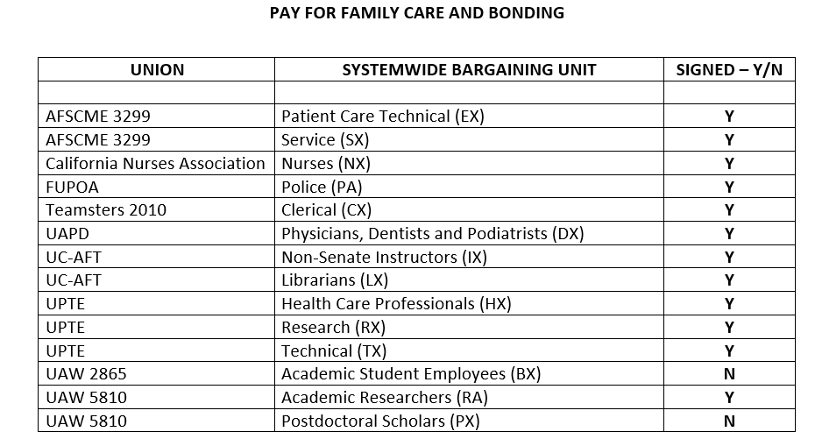
Eligible Employees & Status of Bargaining Units
Non-represented Staff Employees (PPSM)
Non-represented Academic Appointees
Subject to Collective Bargaining for Represented Employees (see chart as of 6/14/21)

Slide 21
Extended Absence in UCPath
New FMLA/CFRA/PDLL Leave types in drop down:
Family Care- CFRA-PFCB
Family Care- FMLA-PFCB
Family Care-FMLA/CFRA-PFCB
Military Caregiver-FMLA-PFCB
Parental Bonding-CFRA-PFCB
Parental Bonding-FMLA-PFCB
Parental Bonding-FMLA/CFRA-PFCB
Qualifying Exi-FMLA-PFCB
Qualifying Exi-CFRA-PFCB
Qualifying Exi-CFRA/FMLA-PFCB
Note: PDLL is not eligible for PFCB

Slide 22
Extended Absence in UCPath

Slide 24
More to Come…
New Earn Codes and Timekeeping (Payroll)
Frequently Asked Questions – anticipate release of final policies along with FAQs
Additional Communications and Resources

Slide 25
Extended Absence Overview

Slide 26
General Extended Absence Info
An Extended Absence transaction in UCPath should be entered for any employees who will be absent for 5 consecutive days (or more).
Employees who plan to be absent for less than 5 days, can report their absence via TRS timesheet.
UCPath Extended Absence Transactions Examples:
FMLA/Medical/Injury
CFRA / PDLL
Parental Bonding
Jury Duty
Military
Etc.
*DO NOT SUBMIT FOR:
Vacation
Sick leave less than 5 days

Slide 27
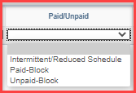
Paid / Unpaid Block
When entering an Extended Absence transactions in UCPath, in the Paid/Unpaid field, you will be required to identify whether the leave is:
“Paid-Block”
“Unpaid-Block”
or “Intermittent / Reduced Schedule”.
Paid Block: Entire period of absence (based on effective dates) will be paid.
Unpaid Block: Entire period of absence (based on effective dates) will be unpaid.
Intermittent / Reduced Schedule: System will rely on timesheets to apply leave hours to cover unworked time. This process ensures employee is paid accurately during their absence. (Intermittent leave looks at EE job FTE.)

Slide 28
TRS vs. UCPath
Bi-Weekly Employees: Can report all absences via TRS timesheets, even if absence is longer than 5 days.
Extended Absence transaction still required for absences >5 days.
Leave accruals and decrements occur in “real-time”, requiring timesheets to be accurate.
Monthly Employees: Initiators should communicate with DTAs which EEs are on an EA to ensure leave codes are not entered on timesheets unnecessarily.
This will cause a double deduction of leave hours from their accrual bank.
Extended Absences >5 days should only be entered in UCPath. (Includes LWOP)
System will report leave in arrears for monthly EE’s.
TRS Website: https://www.accounting.uci.edu/payroll/trs/dta-resources.html

