Slide 1
Training Tips & Lessons Learned August 17, 2021

Slide 2
Quick Announcements I
Upcoming Deadlines
Bi-Weekly Transaction deadline (Aug. 19) 3pm (templates, leaves, etc. )
BW PayPath deadline 8/24 5pm, black-out until Aug.27 6am
Monthly Transaction (Aug. 20) at 3pm deadline for templates, leaves, etc.
Mo PayPath deadline Aug. 23 5pm black-out until Aug. 30 6am
During July some transactors experienced issues due to delays at UCPC. I have been informed that they have returned to their normal processing timeframes.
Expect that there may be delays again in September due to anticipated high volumes

Slide 3
Quick Announcements II
CBR Issues
Issue: UCPC in some situations misapplied the 2022 CBR rates to 2021 SCT/Direct Retros and can’t correct in UCPath
Resolution:
Open an EEC case with Payroll Accounting who can provide options on how to correct these historical errors.
Examples:
FT employee rate was 46.1% in 2021 and 33.1% in 2022. The 2022 rate was applied to 2021 paycheck DRs creating a balance cannot be corrected in UCPath
Summer salary employee in 2021 and in 2022 the employee is not on summer salary, the rate of 46.1% was applied where it should have been 9%.

Slide 4
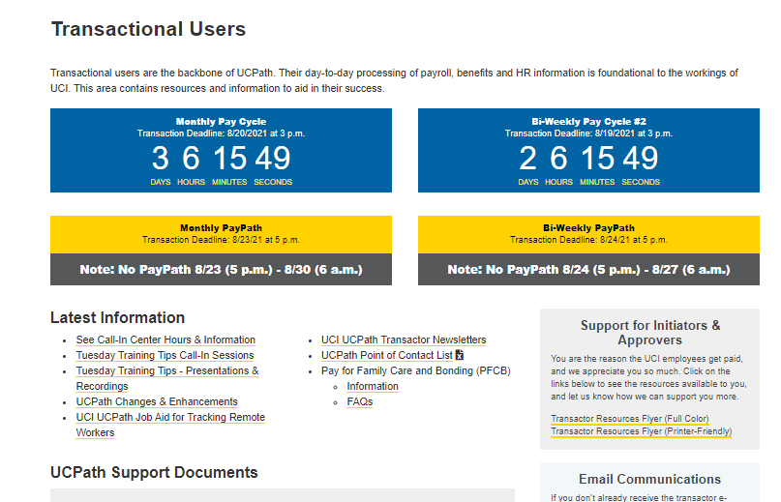
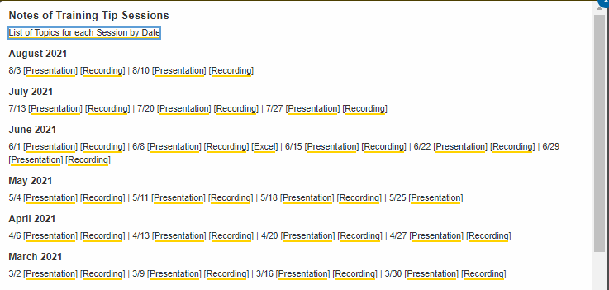
Quick Announcements III
Meeting Index Updated
The Tuesday Tips n’ Tricks meeting index has been updated on our UCI UCPath website.
Go to the Latest Information section, then click the Notes of Training Tips Session link to open the document.
Use this document to search & scan agendas or specific topics discussed previously. This will make it easier to find desired content.

Slide 5
Quick Announcements IV
Fall Hiring
Mass PayPath Transactions to Return Grad students from SWB.
Mass PayPath templates to be loaded to the Box location no later than Aug. 23 at 10am
Open an EEC ticket with category of Mass Transactions
We will not be using Mass Hires this fall due to instability in that transaction; Mass concurrent hire available if needed
All Transactions for Grad Students to ensure Fee Remission must be approved and finalized in UCPath by Sept. 13, includes Rehires, New Hires, returns from SWB.
To allow time for UCPath Center to process the hires. Recommend all approved by Sept. 1.

Slide 6
Agenda
Recent Lessons Learned
Q&A

Slide 7
Budget Distribution Updates
Please be sure to update the Budget Distribution page when:
Processing hire, retire, or terminate transactions for any employees in any permanently budgeted positions.
Or whenever there is a pay impacting change (i.e. PayPath Actions) to permanently budgeted positions.
The Effective Date of the transaction should be used as the Effective Date on the Budget Distribution page.
You can easily access the Budget Distribution Page from the Funding Entry page and/or from Position Control page.
Please contact the Budget Office for assistance with budget details.

Slide 8
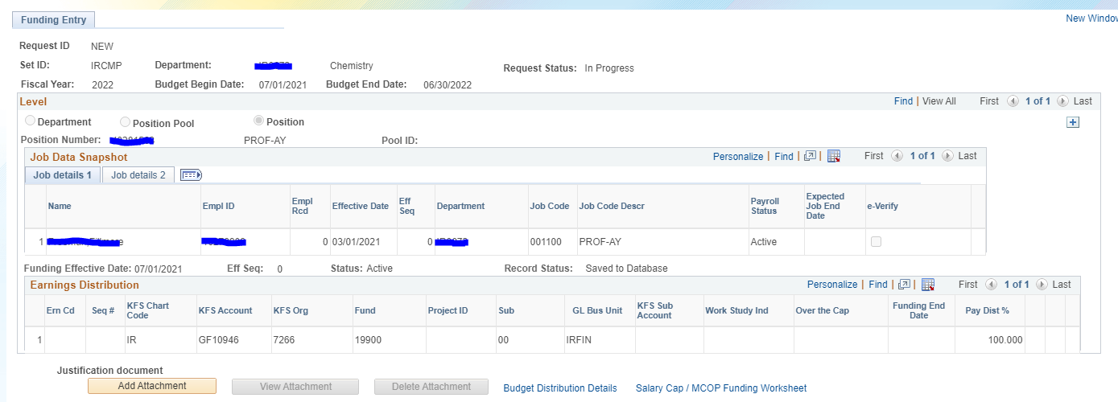
Budget Distribution Page
From the Funding Entry Page, you can click the Budget Distribution Details link to navigate to the Budget Distribution Page.

Slide 9
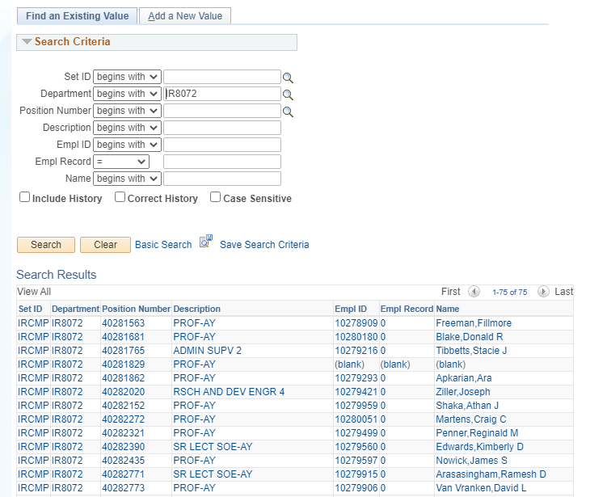
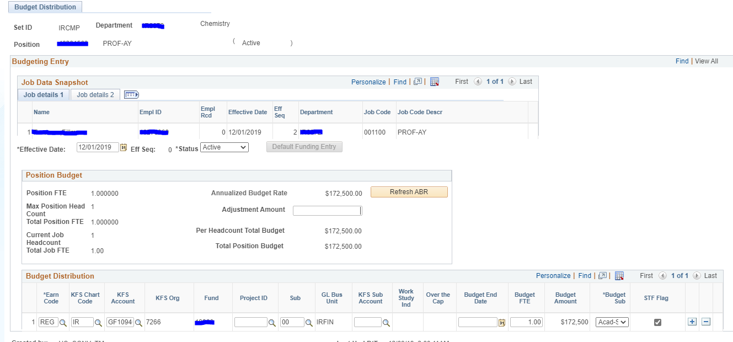
Budget Distribution Page
If you need to make a change to the BDP due to a pay impacting change, you can also access the page by navigating to the Budget Distribution Page directly.
PeopleSoft Menu > Setup HCM > Commitment Accounting> Budget Information > UC Customizations > Budget Distribution
Search by Position or Empl ID
Enter changes to budget (Effective Date must match the date of pay impacting change entered in UCPath)

Slide 10
Lessons Learned- Identity Issues
Avoid Duplicate IDs for 1 employee & putting 2 employees in same ID
Ask employee if they have ever worked at any UC, including student employment
Double check DOB and SSN are entered accurately
Review any Search Match warnings
If you discover a duplicate ID or 2 employees with same ID
Open an EEC ticket and alert UCPath support team
Wait for direction before doing any further transactions
There may be many impacts that take time to fix including with UCPC
Recent case: employee called OIT to ask why they needed to use a new UCI net ID; wanted to switch back to student employee ID
SSN was input incorrectly by 1 digit, which resulted in no match
Hiring organization did not realize an employee ID from student employment
Employee missed pay and delayed in signing up for benefits.
OIT brought case to UCPath support and working to resolve
Another case, where two employees had the same Employee ID
Search match warnings were misunderstood that was a match when was not
Issues with pay going to wrong person and other not getting paid
W-2 implications

Slide 11
Person Search functionality
When preparing to hire a new employee, it is recommended to perform a Person Search (Person Search Match) in UCPath, in addition to using Person Org Summary, to search for any possible existing employee records.
Both pages can be used to identify if there is any existing data for future employees
When performing a Person Search Match in UCPath you will need to enter at least 2 (two) types of personal data to generate results.
Allowable Data:
Legal Name (First & Last)
Date of Birth
National ID (SSN)

Slide 12
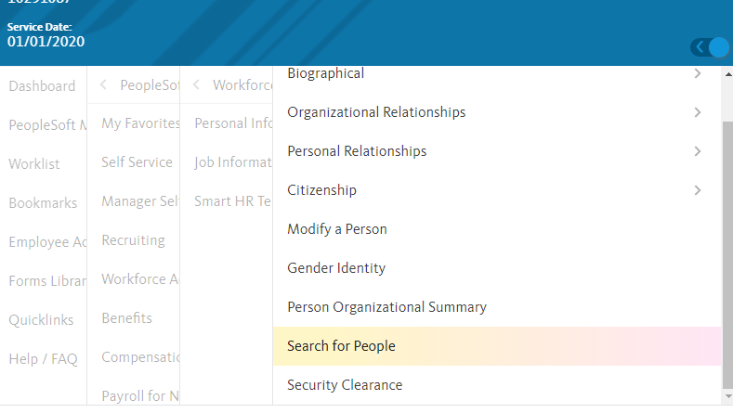
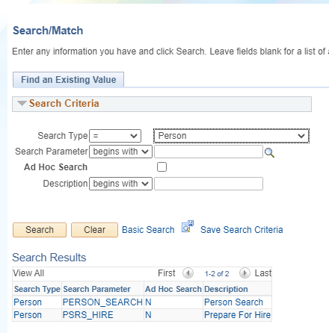
Person Search Steps
Step 1: Access the Person Search page.
PeopleSoft Menu > Workforce Administration > Personal Information > Search for People
Step 2: Select “Person” in the Search Type field drop down menu. Click Search.

Slide 13
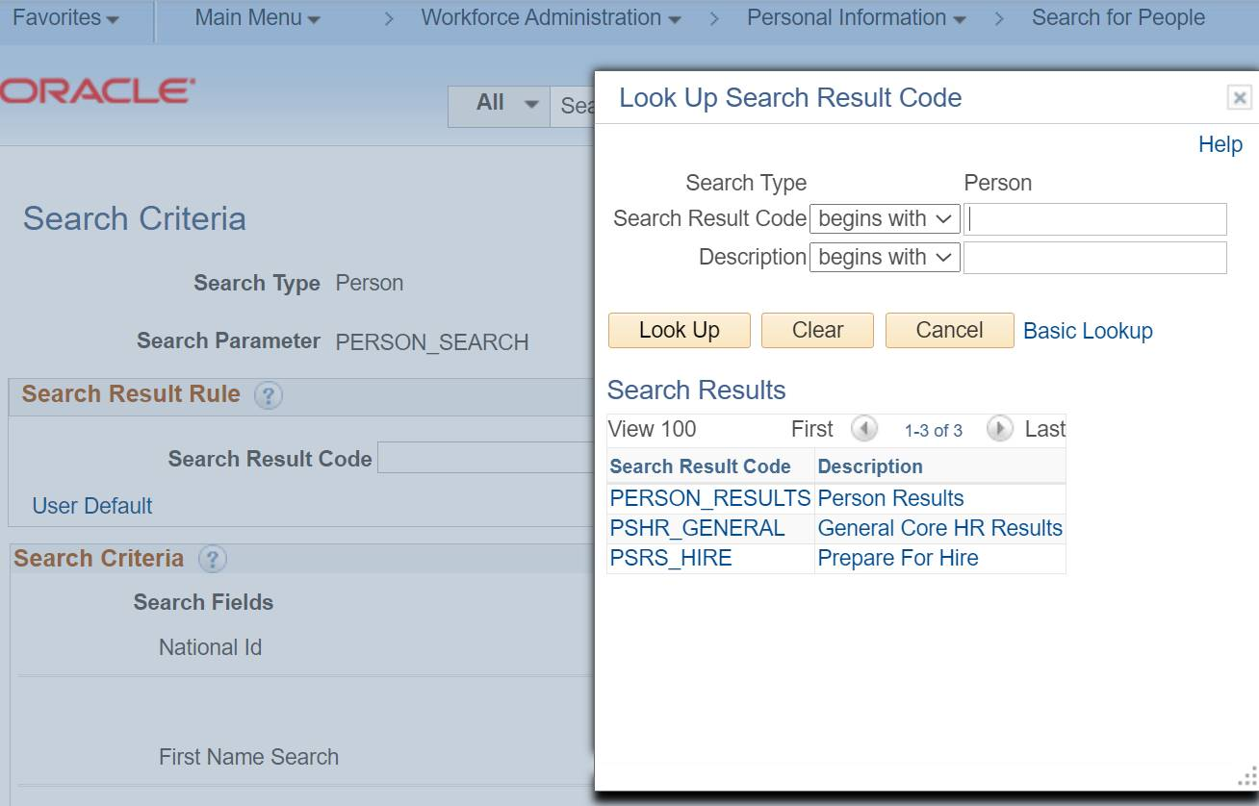
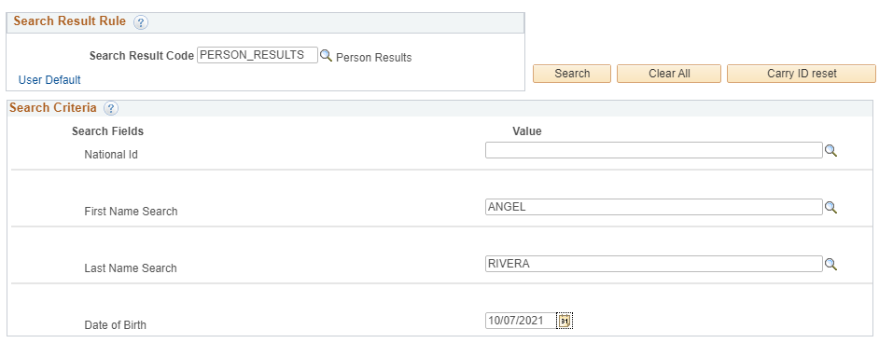
Person Search Steps (cont.)
Step 3: Click the magnifying glass in the Search Code Result field and select Person Results from the menu.
Step 4: Enter the person’s personal data in provided fields, then click search.

Slide 14
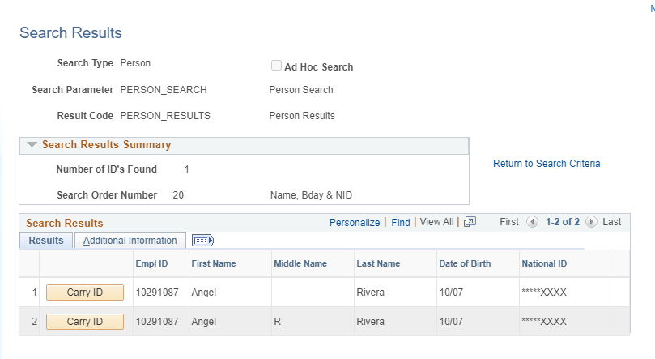
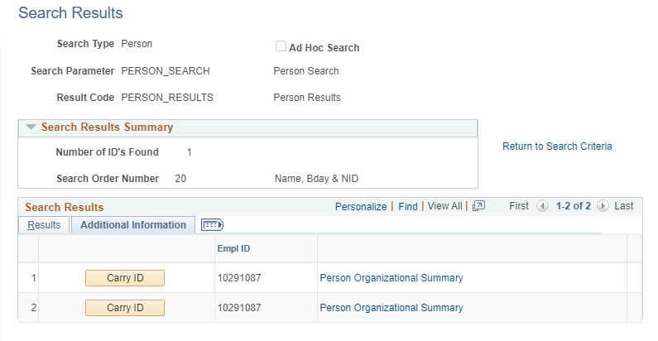
If you find a match…
When you find a match, please review the information and proceed to cross reference with any existing documentation.
You can click the Additional Information tab to view Person Org Summary for that matching record.
It is also recommended to check with the person to ensure their personal information is correct and hasn’t changed.

Slide 15
Key Notes
Person Search Match functionality is another method of being able to search for existing data prior to initiating the hire process.
The difference between Person Org. Sum. & Person Search Match are the data parameters needed to perform a search.
Person Org searches are based on existing & historical job data information in UCPath.
Person Search Matches are based on personal employee/person information.
If a match is found and confirmed, please ensure you are using the appropriate Smart HR Template and/or Reason code to process the hire.
Some cases may require a Rehire or other type of template
Others may require a New Hire template but with a rehire reason code.
Please refer to the Template Transaction User Guide if needed.

Slide 16
Did You Know?

Slide 17
Did You Know?
It is important to have a personal email address in UCPath Upon separation, UCPath will send an email to the personal email address with registration instructions for the former employee portal During a leave of absence, UCPath may contact the employee about benefit premiums using the personal email address UCPath may use the personal email address to send UCRP buyback information UCPath also sends new hire system notifications to the personal email address after determining benefit eligibility Encourage new and existing employees to add or update their personal email address in UCPath

