Slide 1
Training Tips & Lessons Learned August 3, 2021

Slide 2
Quick Announcements I
Upcoming Deadlines
Bi-Weekly Transaction deadline (Aug. 5) 3pm (templates, leaves, etc. )
BW PayPath deadline Aug. 10 5pm, black-out until Aug. 13 6am
Monthly Transaction (Aug. 20) at 3pm deadline for templates, leaves, etc.
Mo PayPath deadline Aug. 23 5pm black-out until Aug. 30 6am

Slide 3
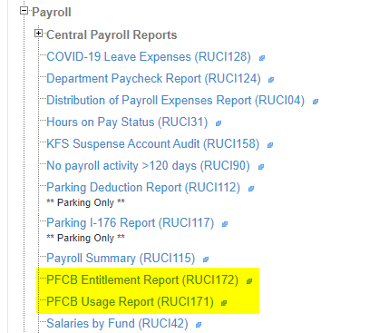
Quick Announcement II
**TRS work around for BW employees will continue through August as TRS updates have not been completed.
Please continue to keep DTAs updated on any new employees electing PFCB
Two new PFCB Cognos
Reports:
PFCB Entitlement Report
PFCB Usage Report
Reminder: Holidays during
PFCB will be recorded as PFCB
not holiday and paid at 70%

Slide 4
Quick Announcements III
CWR for Fellowship Students
It is important to hire all Fellowship Grad Students into a CWR021.
This will allow them to register for the Return to work training that is now required
Also provides access to UC Buy, parking and other systems

Slide 5
Quick Announcements IV
Work Study Job Code
UC no longer use Job codes specific to work study as of July 25th
Actions:
Filled Positions: Update a Filled Position From Work Study to Non-Work Study using PayPath Actions on the Position Data tab.
All currently filled Work Study positions to be updated immediately
Vacant Positions: Use Position Control (Update Vacant Position) to change Job Code to a Non-Work Study code.
This needs to be completed before you hire or transfer a student into this position.

Slide 6
Quick Announcements V
Fall Hiring
Mass PayPath Transactions to Return Grad students from SWB.
Mass PayPath templates to be loaded to the Box location no later than Aug. 23 at 10am
We will not be using Mass Hires this fall due to instability in that transaction; Mass concurrent hire available if needed
All Transactions for Grad Students to ensure Fee Remission must be approved and finalized in UCPath by Sept. 13, includes Rehires, New Hires, returns from SWB.
To allow time for UCPath Center to process the hires. Recommend all approved by Sept. 1.

Slide 7
Quick Announcements VI
Additional Pay Effective Dates
All Additional Pay entries in UCPath should have Effective Dates that reflect a FULL pay period.
Please consider appointment / job end dates, when applicable.
All HR / Pay transactions with “End Dates” cannot exceed expected job end date.
Retro Returns from Extended Leave
Does NOT trigger retro pay
If you submit a UCPath transaction to return an employee from an extended leave at any point AFTER the payroll deadline, you will need to submit a Payroll Request to get them paid.

Slide 8
Agenda
UCPath Support Resources
Methods to Search & Find Support

Slide 9
UCPath Support Resources

Slide 10
UCPath Support Resources
Here is a list various UCPath support resources available to UCI UCPath transactors.
Resource | Description / Uses | Link / Location
UCI UCPath website | UCI’s primary location for UCPath related training materials, Payroll calendar/deadlines, announcements,, office hours, etc. | UCI UCPath site > Transactor User Materials
UPK Help Site | UCPath Center’s step-by-step video library for all UCPath transactions & associated job aids. Note: You’re required to select your location site (Irvine) and login with your UCINet ID. | UCPath UPK Helpsite
UC Learning Center (UCLC) | Users who require training in order to obtain new/additional security roles must complete via UCLC. | UCLC.uci.edu
UCI Academic Personnel website | UCI AP site for policies, salary info, etc. | AP website
Zot Portal | All UCI UCPath Cognos reports are located in the Decision Support section. | Zot Portal
UCI HR website | UCI’s site for HR policies regarding Staff, students, CWRs, etc. | UCI HR website
Off-Cycle Dashboard | View off-cycle transactions that are in process or paid. | Off-Cycle Dashboard (UCPath)
Drop-In Support Center | Live UCPath support M-F 10:00am – 12:00 noon | https://zoom.us/j/8519035805

Slide 11
How to Find Support Resources

Slide 12
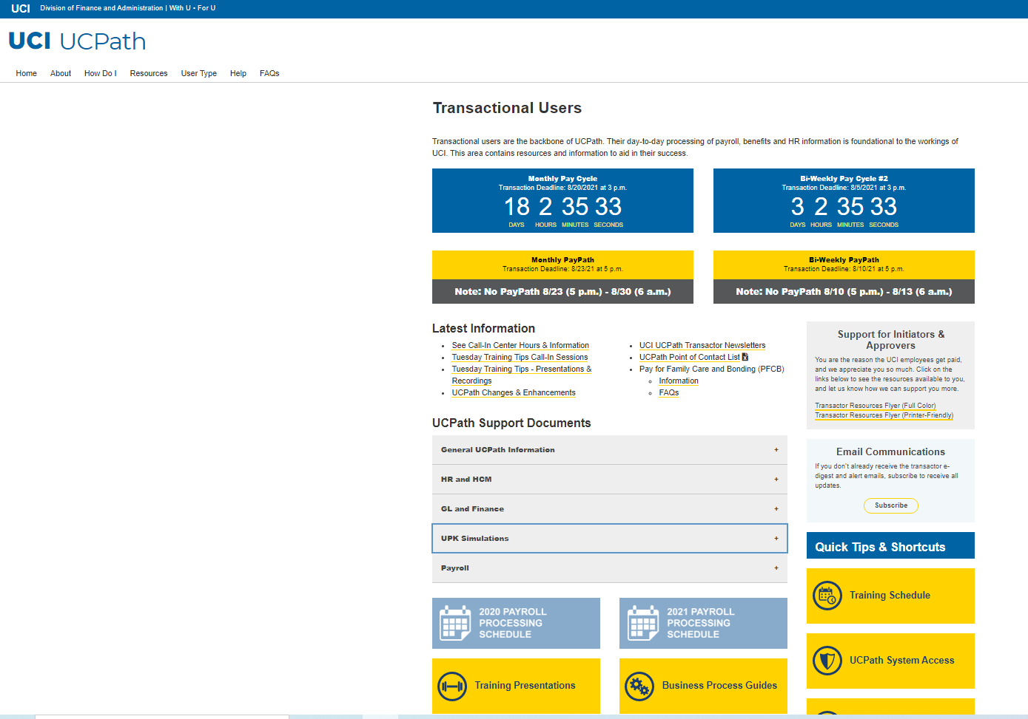
Searching the UCI UCPath Website

Slide 13
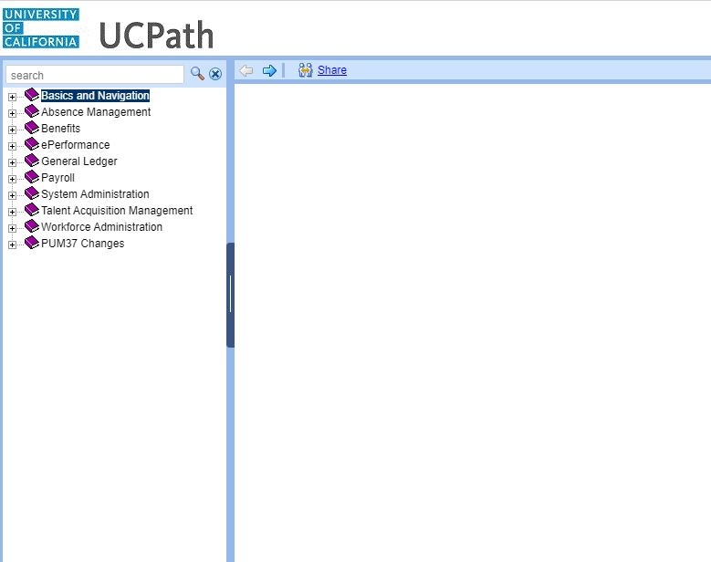
Searching the UPK Help Site

Slide 14
UPK Utilization
Did You Know? - The UCI UCPath Training Guide is a great tool for both new and novice UCPath users to review various security & training requirements, available UCPath support resources, and instructions on how to access the UCPath Training Environment.
Here is some additional information on Searching in the UPK tool:

Slide 15
Different UPK Modes

Slide 16
Did You Know?

Slide 17
Did You Know?
? Summer Salary can be paid as additional pay, through a concurrent job or as a primary job depending on different factors. Summer Salary can be paid as additional pay if it is for job-related activities performed during off-duty periods, such as summer or vacation. For Senate faculty, this includes teaching, research and service For non-senate appointees, the location must determine if the summer activity is job-related A concurrent job is needed: If the funding source requires effort be tracked For non-instructional appointees and Unix IX Lecturers teaching in Summer Session A new primary job is required if the summer appointment is the only job Reference the Summer Salary Processing job aid for more details

