Slide 1
UCPath Manager/Supervisor Roadshows
October and November 2019

Slide 2
Agenda
What is UCPath and how does it impact employees?
What do I need to do to prepare?
What will I do differently?
What do I do on January 2?
What do I have access to as a Supervisor?
What should I look for in my first paycheck?
What do I do if my paycheck doesn’t look right?
Where do I go if I have questions about pay, benefits or how to use the system?

Slide 3
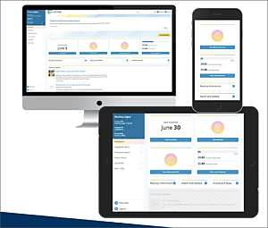
What is UCPath?
UCPath is a project launched by the University of California (UC) to modernize its current, nearly 40-year-old payroll system(PPS) for all UC locations.
TRS will continue to be the timekeeping system for most UCI employees. Some minor changes to enable interface with UCPath.

Slide 4
How does it impact employees?
UCPath Online will replace AYSO for most human resources and payroll transactions:
Viewing Paycheck information
Updating personal information
Home address
Home email
Emergency contact information
Recording life events – Birth, marriage, etc.
Adding or changing Direct Deposits (can elect up to 3 bank accounts)
Changing tax information
Enrolling in benefits

Slide 5
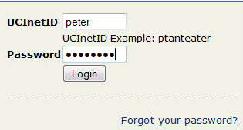
What do I need to do to prepare?
Make sure personal information is correct in At Your Service Online Local home address will be the mail destination for paper paychecks. P.O. Box not accepted
If you don’t already have Direct Deposit, sign up for it now on ZotPortal. Sign up by Nov. 14 to ensure it is set up for January pay. You can sign up after January 2, using UCPath Online.
Know your UCInetID, which you will need to login to UCPath Online. Visit oit.uci.edu or contact your supervisor with UCInetID questions.
DUO Multi-Factor Authentication is a second layer of security which will be required to access UCPath Online. Sign up at oit.uci.edu/mfa.

Slide 6
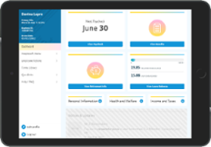
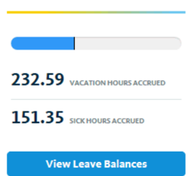
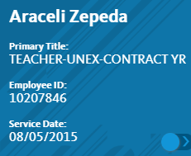
What will I do differently?
Log in to UCPath Online instead of AYSO to view your paystub via ucpath.uci.edu.
Use Smart Phone, Tablet or Computer
Ensure that you meet deadlines for timecard submission and approval
View vacation and sick leave balances in UCPath Online
New employee ID will be visible in UCPath Online
No need to get new ID Cards

Slide 7
What do I do on January 2, 2020?
Go to ucpath.uci.edu and click the UCPath Online button
Log-in to UCPath Online using your UCINet ID and password
Continue with required DUO Multi-Factor authentication
First time log-in will require setting up five security questions
See next slide for your security question options
You will also need to answer demographic questions the first time only (state-mandated)
See the next slides for examples of these questions.
Monthly paid employees should review their paycheck including all deductions
Bi-Weekly employees will review on January 8, 2020

Slide 8
UCPath Online
First Step

Slide 9
UCPath Online

Slide 10
Security Questions
• Use each question once. Choose 5 to answer. • Choose questions only you know the answer. • Answers must be a minimum of four characters.
What city would you most like to live in?
What is your dream car?
What is your favorite book?
What is your favorite drink?
What is your favorite food?
What is your favorite hobby or pastime?
What is your favorite movie?
What was the name of your favorite childhood pet?
Who is your childhood best friend?
Who is your favorite musician?

Slide 11
End of Security Question Setup

Slide 12
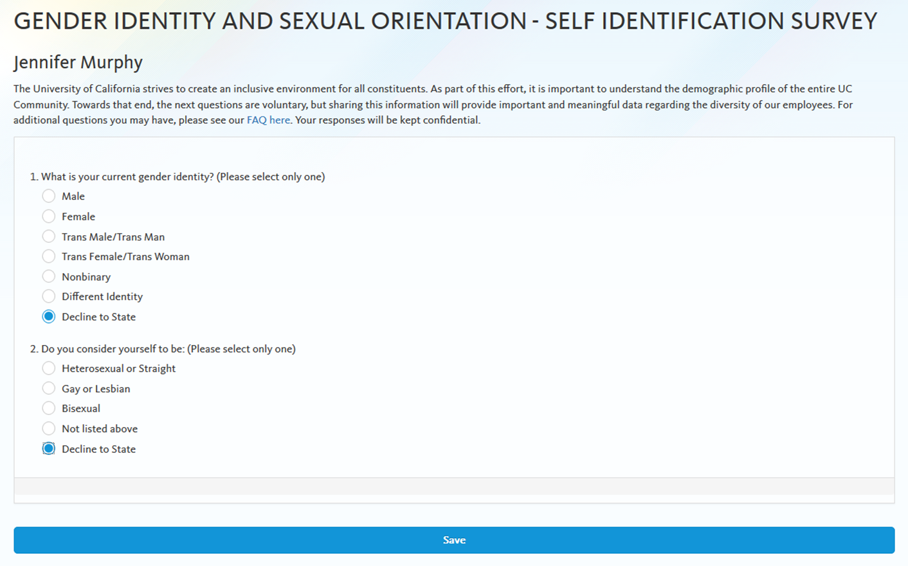
Demographic Questions
Additional questions include:
Veteran Status
Disability

Slide 13
UCPath Online: Employee Self Service Portal (ESS)
UCPath Online Dashboard
View Paycheck, Vacation and Sick Leave Balances
Update personal information, such as home and mailing address, direct deposit and benefits enrollment.

Slide 14
Actions Available in UCPath Online

Slide 15
What is the Role of “Reports To” in UCPath
Determines who you will see in Manager Self Service
View employee absence balances
View Employee Information:
Email Address
Emergency Contacts
Home and mailing addresses, Phone #’s
View Current Team Profile:
Education
Honors and Awards
Licenses and certifications
View Compensation History

Slide 16
Employee Information Available

Slide 17
Reports To Additional Information

Slide 18
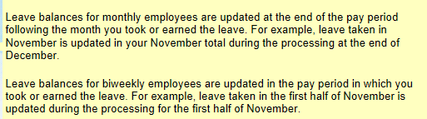
View Employee Absence Balances

Slide 19
Employee Compensation History

Slide 20
What should I look for in my first paycheck?
Compare your UCPath January paycheck with previous paychecks
Compare gross pay is it as expected
Review deductions for unexpected differences
Benefit deductions change in January due to open enrollment changes and new deduction amounts
Tax rates often change each year
Small differences may be the result of updated, more accurate calculations from PPS in line with industry standards

Slide 21
Changes in Paychecks
Paycheck format (e.g., deductions have different labels)
New employee ID
Vacation and sick leave balances are no longer displayed on the earnings statement; they are on the UCPath portal
You may have up to three direct deposit accounts
Small calculation differences for percentage 403b and 457b deductions when both are taken in the same pay period
Small tax calculation differences; out-of-state and local taxes are now automated
Changes
Executive life insurance is taxed in the current period and displayed on the earnings statement
FICA taxes applied in the current pay period, not the following pay period
Employer contributions split between first and second biweekly earnings statements instead of all in the first earnings statement
Credit union deductions made via direct deposit
Garnishments now shown on earnings statements; percentage garnishments are automatically calculated
Small calculation differences in FLSA earnings
Flat tax amounts now deducted evenly across all pay periods

Slide 22
Sample Monthly Earnings Statement
Understanding Your Paycheck
Employee Actions > Income and Taxes > View Paycheck
Current name and address in UCPath.
Newly assigned Employee ID number.
Filing status and allowances for state and federal tax forms.
Earnings displayed for the month and year-to-date. Vacation and sick time used are included in the hours and earning display.
Federal and state tax withholdings for the current pay period and the year to date.
Before tax and after tax deductions are displayed separately.
All contributions UC pays on your behalf to health and welfare plans and retirement.
OASDI (Social Security) and MED (Medicare) gross amounts are included in current year and year-to-date display.
Check (advice) numbers, account type, and total amount of pay deposited to accounts. You may have up to three direct deposit elections.

Slide 23
Bi-Weekly Earnings Statement Sample

Slide 24
What else do I do on January 2, 2020?
Any questions about non-critical information will be addressed after all critical pay and benefits issues have been resolved
Update any other missing or
inaccurate information
Review your benefits to ensure they reflect the choices from your recent open enrollment
Review other personal information for accuracy
Review that dependents are listed correctly
Enter emergency contact information

Slide 25
UCI UCPath Support Model EEC Support Stakeholder Contributors
Medical Center
Academic Personnel
Finance
OVPTL
HR
Payroll Campus, HS & MC
Health Sciences
School of
Bio Sci
UCPath Project Team
School of Engineering
School of Law
Social Sciences
DFA & Third Party
People Services
Faculty Advisory Grp
OIR
OIT
*Note: The Faculty Advisory Group includes individuals from the following schools: Grad Division, Claire Trevor School of Arts, School of Biological Sciences, Health Sciences, School of Humanities, School of Physical Sciences, School of Social Sciences

Slide 26
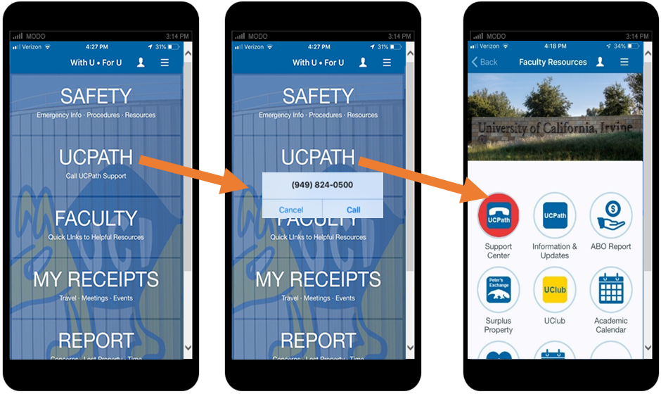
Where do I go if I have paycheck questions?
Go to who you go to today- Division Human Resources or payroll points of contact
Employee Experience Center
949-824-0500 or EEC.hr.uci.edu website
Knowledge articles
Open case to ask a question, ask for help
UCPath.uci.edu website
Links to UCPath Online
FAQ, job aids, etc.
With U • For U App

Slide 27
Employee Service Made Simple Dedicated Support Team
Ensure Employees know where to go
Eliminate duplication of services and efforts
Keep local issues local
Ensure UCI employees are getting the assistance they need and deserve

Slide 28
Future State: UCI Employee Facing Support
Where to go for support
Academics, Staff, Retirees, Non-Employees,
Student Workers
Employee Experience Center (EEC)
Payroll, Taxes, Time Reporting
Benefits
Leave
HR Systems
TAM, ePerformance
UCPath Support
AWE Admin
Security Admin
UCPath Communications
UCPath Reports
UCPath Transactors Training and Support
Local Point of Contact
Support for local issues managed at UCI on same platform
Confidential: HR/AP Case Managers
Subject Matter Experts
Enterprise Wide Work Groups
UCPath Center (UCPC) and Quality Care Unit (QCU)
Central Functions
Decentralized functions
OIT

Slide 29
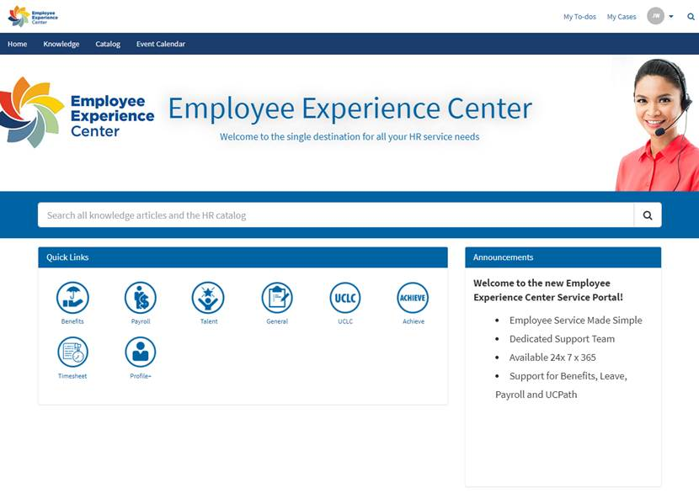
UCI UCPath Support Model Landing Page Example

Slide 30
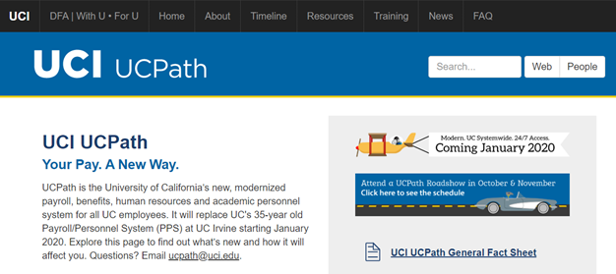
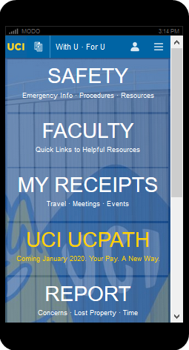
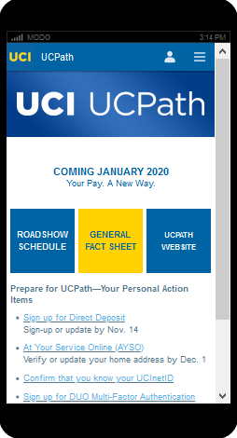
Where can I get additional information now?
UCPath.uci.edu
With U • For U mobile app

Slide 31
Questions?
Email
ucpath@uci.edu
Website
ucpath.uci.edu

