Slide 1
Training Tips July 12, 2022

Slide 2
Quick Announcements I
Upcoming Deadlines
NEXT BW Transaction deadline: Thursday July 21 at 3pm (for templates, extended absences, etc.)
BW Pay Path Deadline: Today 7/12 (5pm) – blackout through Friday July 15 @ 6am
NEXT MO Transaction deadline: Tuesday July 19 at 3pm (for templates, extended absences leaves, etc.)
MO Pay Path Deadline: Friday 7/22 (5pm) - blackout until Wednesday 7/27 @ 6am

Slide 3
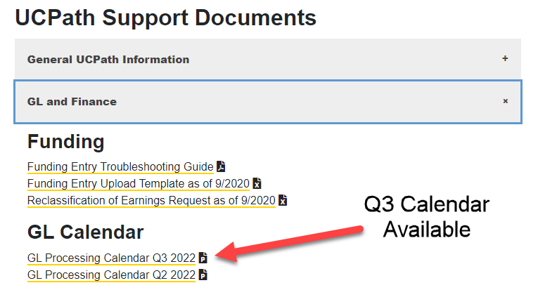
Quick Announcements II
Q3 GL calendar now available on our website

Slide 4
Quick Announcements III
Check your “Decoupled” positions!
If your position FTE is decoupled, changes made to the position FTE will NOT update the FTE in Job Data for employee and cause an error during approval.
The correction of this issue was deployed last week
Original transactions that were unable to be approved have now been cancelled

Slide 5
Future BW Training Tips Meetings
July 26
August 9
August 23
September 6

Slide 6
Agenda
UCPath Future Changes
Changing Bookmarks to Favorites in UCPath
Reinstatements
Effective Date vs. Termination Date
Earn Code and JED
Upcoming Training
Q&A

Slide 7
UCPath Changes

Slide 8
Upcoming UCPath Changes- Introduction
Set to Deploy Oct. 22
Improved Navigation (Fluid)
Improved method to find transactions
First step to enable future improvements such as PayPath
Traditional navigation that we have today will be maintained
Lived Name/Preferred Name changes
Support the Gender Recognition Lived Name Policy
Utilization of Employee ID in all transactions will be highly recommended
Many transactions including Person Org will only display lived name
Legal name display will be limited based on approval from UCOP
Search for an employee and Modify a person will be other ways to confirm that the correct employee ID is being used
Training via Zoom and e-learning, will be available on how to find and search for information and complete transactions
Transactions will not change, except for hire transactions new name fields
Searching will be the primary change

Slide 9
Improved Navigation Project – Oct. 22

Slide 10
HR Tasks

Slide 11
Traditional Navigation
Left-side when click on navigator (compass)
Location of Favorites

Slide 12
Changing Bookmarks to Favorites

Slide 13
Bookmarks conversion to Favorites
With the conversion to Improved Navigation(Fluid) Bookmarks for Peoplesoft transactions will not convert
Favorites will convert
The naming of a favorite has limited 30 characters – if you have long descriptions in your bookmarks, may want to screen shot
Recommendation to begin converting current bookmarks to Favorites so they will be there at conversion
Process:
Open bookmarked item
Click on ‘new window’
It opens the same page in native Peoplesoft
Upper left-hand corner ‘Favorites’
Add to Favorites
Job Aid in UCI UCPath website: General UCPath Information/
UCPath/How to Add Favorites in Peoplesoft
Note: Any bookmarks on Portal non-Peoplesoft web pages will be retained and converted, cannot be converted to favorites (ex: self-service: Paycheck, Payroll calendar, etc.) no action needed for these

Slide 14
Reinstatements and Effective Dates/Term Dates

Slide 15
Reinstatements and Job – End Dates
UCI experienced a large # of required reinstatements from 6/30 auto-term
Please continue to monitor Job End date reports to avoid this issue
Please notify employees if their job is terminating to avoid calls to OIT or EEC
Students may get confused between the job being terminated and the fact that they are still a student and/or have a fellowship or CWR
When entering a reinstatement use the Effective Date of the Termination

Slide 16
Last Date Worked / Appointment End Date
The Last Date Worked & Appointment End Date fields both indicate the employee’s LAST DAY ON PAY STATUS.
This is NOT the employee’s termination date. The employee’s termination date is usually a date AFTER the employee’s last day worked / on pay status.
Example: Expected Job End Date = 6/30
Termination Eff. Date = 7/1

Slide 17
Effective Date of Termination – Smart HR Template
When terminating an employee via a Smart HR Template, the official date of an employee’s termination is the SAME as the Effective Date entered during entry..
The actual Termination Effective Date of an employee is the first day the employee is NOT on pay status.

Slide 18
Identifying Termination Date in UCPath
Person Org Summary :
Termination Date = Last Day Worked
Workforce Job Summary :
Effective Date for a termination row = Official Date of Termination (first day NOT on pay status)

Slide 19
Identifying Termination Date in UCPath
Job Data Page:
The Job Data page will display rows with effective dates entered and used for a transaction, along with the Action / Action reason code.
For terminations, Effective Date shown on Job Data page indicates the ACTUAL termination Date of the employee.

Slide 20
Earn Code and JED

Slide 21
Job Earnings Distribution
Job Earnings Distribution (JED) is used for employees who have earnings that need to be distributed by earn codes on the job record (either by percentage or by amount).
Some examples:
Summer Salary
Negotiated Salary Trial Program (NSTP)
Employee Reduction in Time Program (ERIT)
Extended Absence (entered by UCPC)
During the hire process, JED can be established on the available tab on the Smart HR Template. Use PayPath to update JED information (Job Data tab) for an existing employee record.

Slide 22
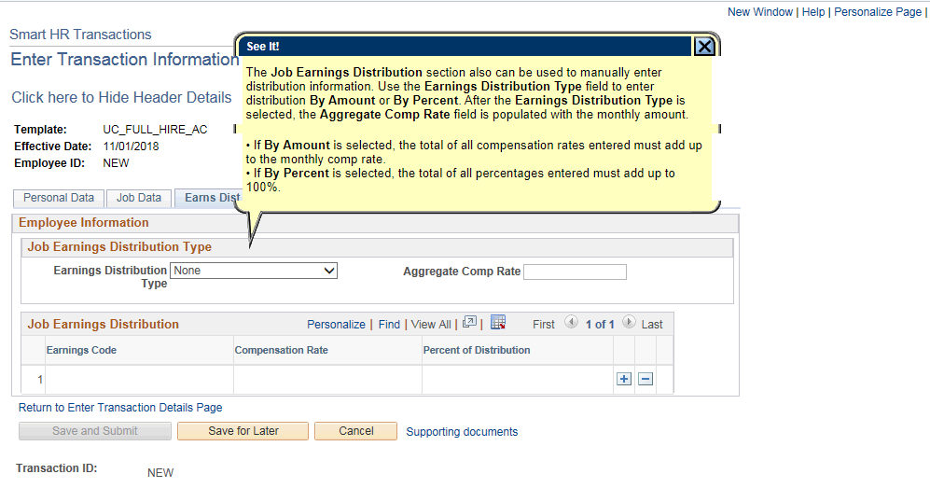
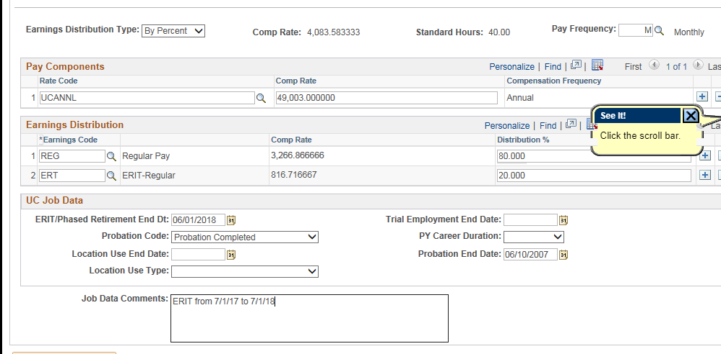
JED Entry Modules
SmartHR Template
Use the Earn Dist tab to enter the earnings distribution information by amount or percentage.
PayPath Actions
Use Job Data tab in PayPath to enter JED information.
To trigger the JED functionality, use the appropriate Action/Action Reason codes.

Slide 23
JED Correction
If the Job Earnings Code was not entered prior and the employee’s earnings have been paid, UCPath will not automatically update the payroll records after the JED has been corrected.
How to update paid earnings:
Update Job Data to reflect the correct earnings distributions
Complete a “Reclassification of Earnings” spreadsheet
Submit spreadsheet via case to UCPC:

Slide 24
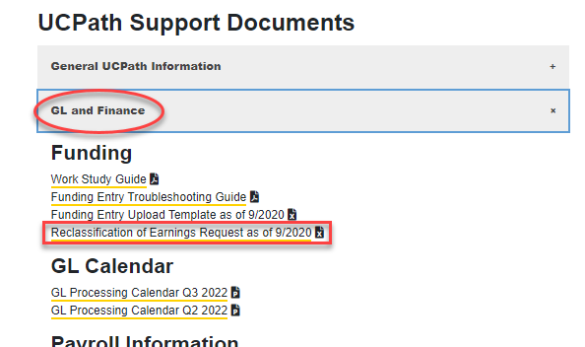
JED Correction, cont’d
Where to find the Reclassification of Earnings Spreadsheet –
The spreadsheet is located on the UCI UCPath Transactional Users page.
This page spreadsheet can only be used after a paycheck has been generated.

Slide 25
Submit Reclassification of Earnings
Review the example on the “Example” tab.
Use the “Request” tab to complete your employee’s information and attach to your UCPC case.

Slide 26
Upcoming Training & Workshops

Slide 27
Summer Salary Workshops
Andrea Garrison & Angel Rivera will host 1-on-1 mini workshops for divisions who need additional guidance with Summer Salary processing.
When: July 18th – 22nd
Who: HR & Finance transactors from all Divisions
Where: Zoom
Registration: https://www.signupgenius.com/go/70A0849A4A92DA2F49-ucpath1

Slide 28
New Hire Training
Virtual Instructor Led New Hire training will be offered in November
If you have new hires that need training in order to be granted system access:
Please have new hire view the recorded training sessions for their role via UCLC.
Completion of training will be monitored for system access.
If they are unable to find the desired course in UCLC or encounter an error, please view the recorded version on our UCI UCPath site > Transactor Materials > Training Presentations.
If there are immediate training needs or if your division has questions or concerns, please reach out to Debbie Kistler (dkistler@uci.edu) or Angel Rivera (arriver2@uci.edu) .

Slide 29
Unit 18 PFCB Absence Job Aid
Job Aid is now available on UCPath in help UPK :
Job Aid: Pay for Family Care and Bonding- Unit 18 PFCB

Slide 31
Did you know? Only one case should be submitted for an employee, even if the employee has multiple issues If separate cases are submitted, the cases will likely route to different case owners causing duplicate efforts
UCPath will begin the first phase of its transition to a new phone system provider, Talkdesk.
Beginning July 13, 2022, employees calling UCPath will experience the following changes:
Callers will enter the first initial of their last name for authentication purposes in addition to the previously required entries (last four digits of their social security number and date of birth)
Callers may leave a voicemail while waiting to speak with an agent when the “call back” feature is not available
Callers will hear the average estimated wait time while waiting to speak with an agent
Additional notices will follow as new Talkdesk features are released.
The phone system will go down tonight and will be the new system tomorrow morning

