Slide 1
Training Tips July 26, 2022

Slide 2
Quick Announcements I
Upcoming Deadlines
NEXT BW Transaction deadline: Thursday August 4 at 3pm (for templates, extended absences, etc.)
BW Pay Path Deadline: Today 7/26 (5pm) – blackout through Friday July 29 @ 6am
NEXT MO Transaction deadline: Friday Aug. 19 at 3pm (for templates, extended absences leaves, etc.)
MO Pay Path Deadline:- blackout until Wednesday 7/27 @ 6am

Slide 3
Quick Announcements II
Across the Board entries in UCPath
Please check the Job Data page for any future dated rows before making ATB entries in UCPath.
Retro dated pay changes will impact future dated rows and may cause downstream impacts to current data, employee pay, amongst other things.
If you encounter any issues or have questions, please come to the Drop In Support Center for assistance.

Slide 4
Quick Announcements III
Grad Student Transaction Processing (pt. II)
The next training session will be hosted August 2 from 1 - 2:30pm
A meeting invite was sent out to divisions who process Grad Student transactions.
If you process Grad Student transactions in UCPath & would like to attend, please contact Deborah Kistler (dkistler@uci.edu )

Slide 5
Future Training Tips Meetings
August 9
August 23
September 6
September 20

Slide 6
Agenda
Decoupling & Managing Position FTE
Profile Management
Changes to Additional Pay
Q&A

Slide 7
Decoupling & Managing Position FTE

Slide 8
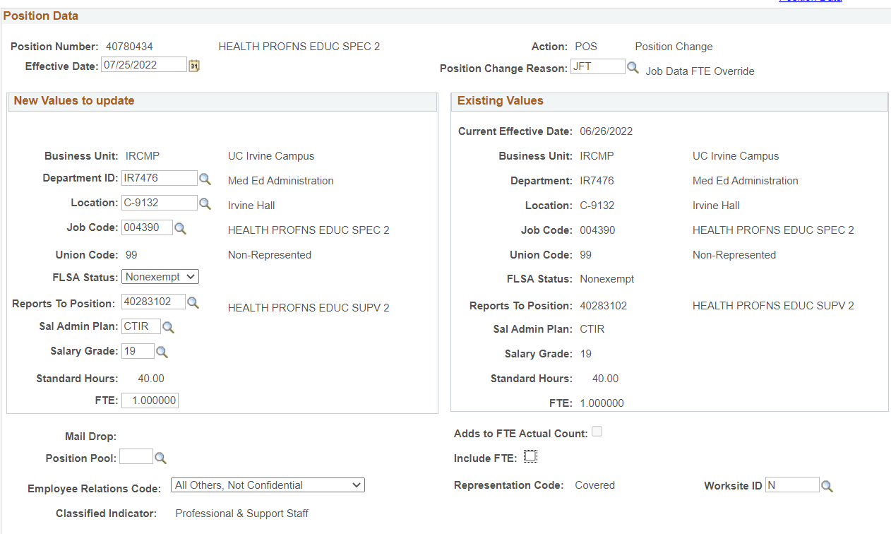
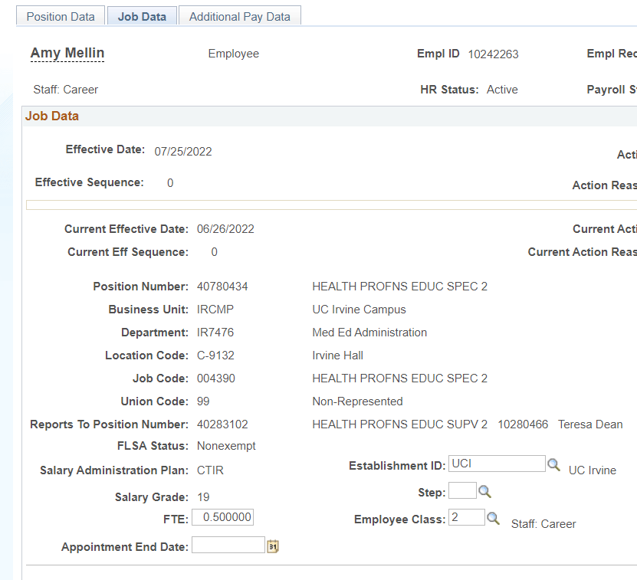
Decoupling the Position FTE
Decoupling the Position FTE is a PayPath Action executed in UCPath in which the department can “unpair/separate” the Job FTE value from the Position FTE.
This will allow Position FTE (Position Data Tab) & Job FTE (Job Data tab) to be independent from one another in UCPath and reflect different values.
v
v
Notes:
Most of you who are HR initiators by now should understand when an employee is hired, they will automatically inherit the FTE identified on the position they’re hired into, and the same FTE will also display in their Job Data.
With Position FTE coupled to Job Data by default, any changes made to the Position FTE will then also reflect in Job Data.
When you decouple the FTE from the position, this will unpair/separate the Job FTE from the Position FTE and allow them to be independent of one another in UCPath to reflect different values.
To decouple the FTE: While on the Position Data tab, use the JFT – Job Data FTE Override position change reason code to unlock the “Include FTE” field. Proceed to Uncheck the box and this will allow you to change the FTE

Slide 9
When Do I Decouple FTE?
The decoupling of position FTE should be done with caution. Decoupling FTE is intended to be a temporary process that is more applicable for permanently budgeted positions or full-time Staff (Limited / Career) Employees.
For Example:
If the department has an employee working in a permanently budgeted position with a 1.0 FTE (40hrs), but the employee has a limitation where they can only work 50% time due to non-medical extraneous circumstance.
Position FTE = 1.0
Job Data FTE = .50%
Note: You cannot change FTE or any other Position attributes for multi-headcount positions.

Slide 10
Why Should I Decouple?
May assist in maintaining allocated budget for the position and prevent unnecessary changes & discrepancies in BDP.
Decoupling the Job FTE from position, can help ensure the employee’s health & other benefits will remain intact and unchanged despite the reduction in time.
Please note, reduction in FTE and duration of appointments could have implications to an employee’s benefits.

Slide 11
Decoupled Positions & Terminations
After terminating an employee from a decoupled FTE position, the position will remain decoupled.
It is recommended to recouple the position FTE once it becomes vacant.
This action is done on the Position Control – Request page and can help avoid discrepancies or data issues with potential future incumbents.
Steps:
1. Navigate to Position Control - Request Page, select Update vacant position option.
2. Query the newly vacant decoupled position using a new effective date.
3. After selecting the desired position, navigate to the Specific Information tab and re-check the “include FTE” box under the FTE field.

Slide 12
Profile Management in UCPath

Slide 13
Profile Management
This module in UCPath allows departments and HR managers to define and modify professional attributes for jobs and persons.
Profiles summarizes competencies, qualifications, skills, education, oath & patent signature dates, tracker profile ID, etc. for a job or person.

Slide 14
Profile Types
There are 2 (two) different Profile types in UCPath:
Person Profile*
Non-Person Profile
Person Profile
Non-Person Profile
Profiles that are linked to a person with UCInetID or UCPath Empl ID.
Profiles which describe business entities like job codes, positions, and salary grades.
**WE DO NOT USE AT UCI**

Slide 15
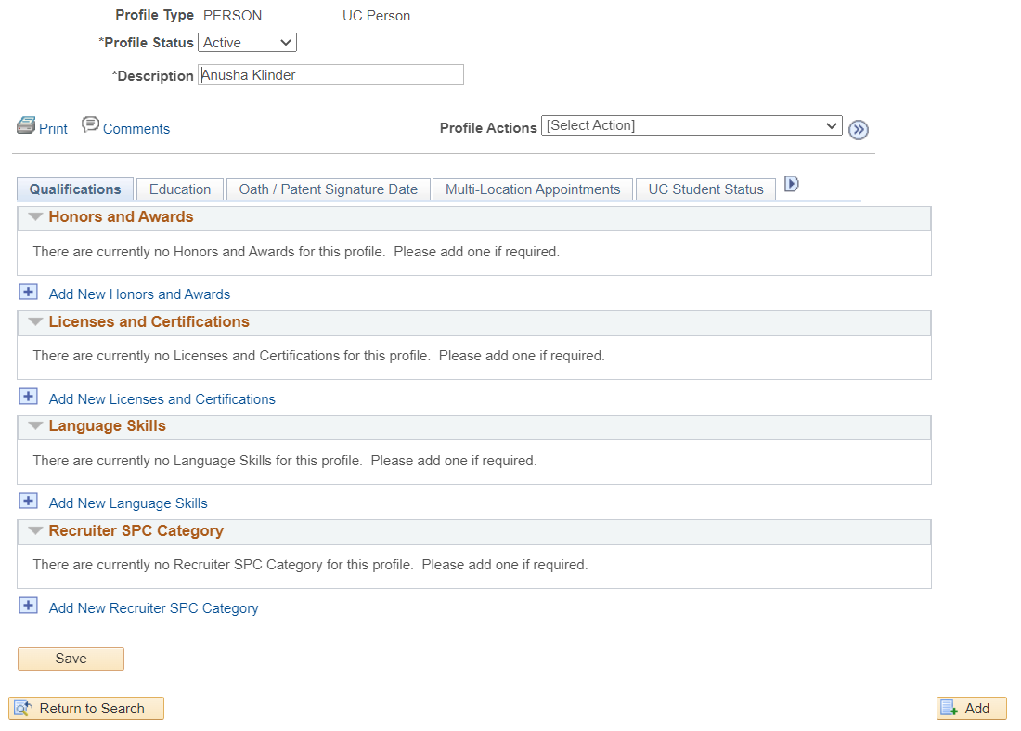
Person Profile Page
Tabs:
Qualifications
Education
Oath / Patent Signature
Multi-Location Appointments
UC Student Status
UC i-9 Verification

Slide 16
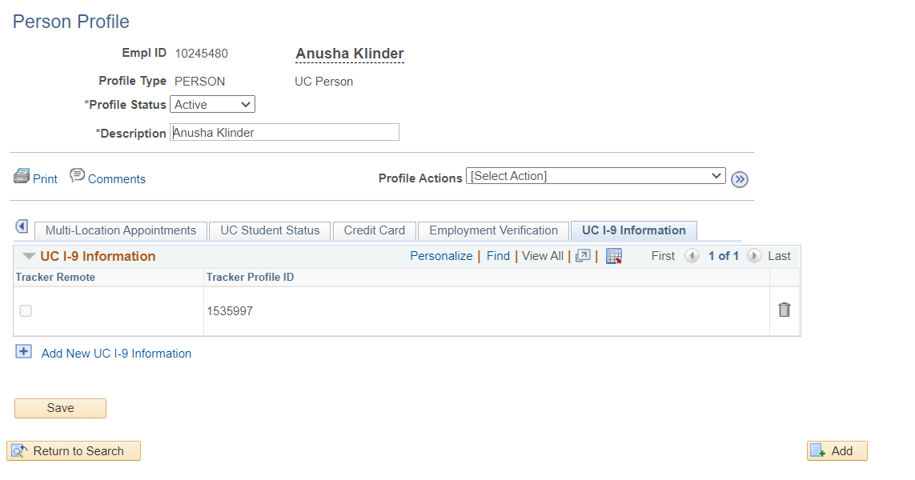
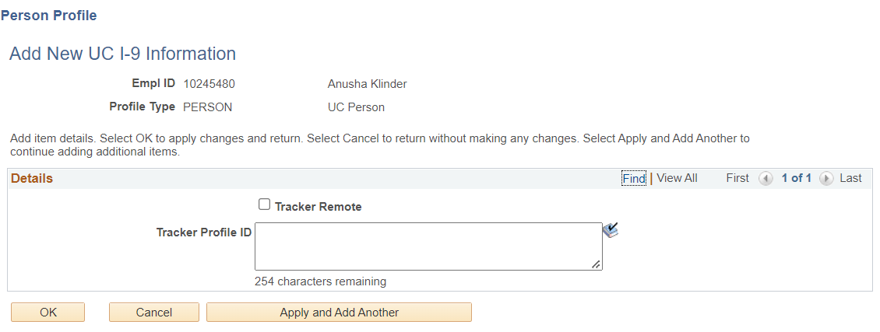
Add Missing Tracker IDs
Department HR Initiators can navigate to Profile Management and use the Person Profile page to enter/update missing Tracker Profile ID numbers for employees.
Navigation: PeopleSoft Menu > Workforce Development > Profile Management > Profiles > Person Profile > UC i-9 Information tab

Slide 17
Changes to Additional Pay

Slide 18
Changing Additional Pay Data
There are 2 (two) primary ways to make corrections to existing Additional Pay in UCPath.
Enter changes via PayPath Actions (Addt’l Pay tab)
Submit “Additional Pay Correction Form” (Ask UCPath case)
It is strongly recommended to be very cautious and analyze all details carefully when making changes to an employee’s existing additional pay. Improper entry or use of Effective Dates may trigger issues with employee pay.

Slide 19
Best Practices & Use Cases
The employee has been receiving the incorrect additional pay amount on their last few checks and the department is now being notified.
If Employee Underpaid:
Submit a One-Time Payment with the amount and pay periods missed. This can be done in a single transaction with multiple rows for each pay period.
If additional pay will continue at the new rate, end the incorrect existing additional pay in PayPath Actions, then enter a new additional pay transaction with a current date and correct amount.
If Employee Overpaid:
End the existing additional pay
Submit an overpayment Payroll Request
Enter new Additional Pay with correct amount & current effective date (if necessary)

Slide 20
Best Practices & Use Cases (II)
B) Department forgot to apply a Stipend to the employee’s record and owe the employee money.
If Additional Pay will continue:
Enter the recurring Additional Pay transaction in PayPath using a current effective date.
Submit a One-Time Payment for the amount owed to employee.
If it’s a One-Time payout:
Submit a one-time payment with the amount owed & applicable pay-periods.
C) Department entered additional pay for employee erroneously and needs to remove it.
Departments are unable to delete transactions
This will require you to submit a “Recurring Additional Pay Change Request” form.
Located in the Forms Library in UCPath (under Payroll)

Slide 21
Addt’l Pay Entry & Payroll Deadlines
New Additional Pay Entries need to be entered by the “Stop PayPath Processing & Position Mgmt” deadline shown on the Payroll Processing Calendar.
Corrections to existing Additional Pay must be entered by the “Employee Data Change” deadline on the Payroll Processing Calendar.
Additional pay must already exist, and previous earnings at the time of correction for the retro module to trigger and pay out.

Slide 22
Be Careful
Please analyze and assess your data before entry. Double check the effective dates, pay periods, pay amount, and date of entry for the transaction to try and avoid pay issues.

Slide 23
Training

Slide 24
New Hire Training
Live Virtual Instructor Led New Hire training will be offered in November.
If you have new hires that need training in order to be granted system access:
Please have new hire view the recorded training sessions for their role via UCLC.
Completion of training will be monitored for system access.
If they are unable to find the desired course in UCLC or encounter an error, please view the recorded version on our UCI UCPath site > Transactor Materials > Training Presentations.
If there are immediate training needs or if your division has questions or concerns, please reach out to Debbie Kistler (dkistler@uci.edu) or Angel Rivera (arriver2@uci.edu) .

Slide 26
Did you know? The Search/Match page should always be checked prior to processing a hire to determine if the individual has a current or prior UC position Navigation: PeopleSoft Menu > Workforce Administration > Personal Information > Search for People Users can search by social security number, first name and last name, or date of birth and first name Leverage the results on the Search/Match page to select the correct action/reason on templates Templates submitted with an incorrect action / reason will be cancelled and will require the user resubmit with the correct action / reason Resources: Search / Match Simulation Job Aid: Template Transactions – Action Reason Codes and Descriptions

Slide 27
Questions?

