Slide 1
Training Tips
May 3, 2022

Slide 2
Quick Announcements I
Upcoming Deadlines
NEXT BW Transaction deadline: Thursday May 12 at 3pm (for templates, extended absences, etc.)
  BW Pay Path Deadline: Today 5/3 (5pm) – blackout through Friday 5/6 @ 6am
NEXT MO Transaction deadline: Thursday May 19 at 3pm (for templates, extended absences leaves, etc.)
  MO Pay Path Deadline: Tuesday 5/24 (5pm) - blackout until Friday 5/27 @ 6am

Slide 3
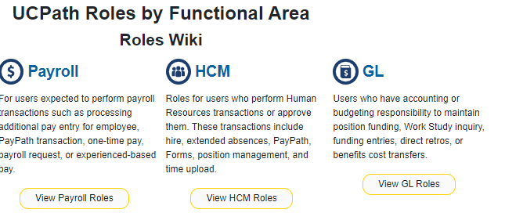
Quick Announcements II
KSAMS Roles
Note that the location/links to the roles information(WIKI) has been moved.
  VPN may be required
  In addition, log-in to Confluence may be required. Use your UCINetID@uci.edu: example dkistler@uci.edu; do not use alias email addresses

Slide 4
Login Steps
Step#1: On the upper right corner of this screen is an arrow symbol which represents ‘Log in’.
Step #2: You should see Confluence login screen (not put up by UCI). Enter you usual email address (ucinetid@uci.edu) that you’d use to do UCI SSO. Do NOT use alias email with “name.lastname”.
Do NOT add ‘ad’ prefix to the uci.edu email domain.
Step #3: Normal UCI SSO screen should show up at this point.

Slide 5
Quick Announcements IV
Updated Job Aid on Retirement Processing
https://sp.ucop.edu/sites/ucpathhelp/LocationUsers/LOCjobaids/UCPC_PHCMWFAL260JA_RetirementTransactionProcessForJuly1RetirementDate_D2Rev00.pdf
Includes General information from RASC and updated verbiage regarding the inactive COLA
General information provided by the RASC:
• Employees in the UCRP 1976 Tier or Safety classification may be eligible for the Inactive COLA
if they have at least one business day where they are not on active pay status prior to July 1st,
and have a termination date no later than June 29, 2022. The RASC will receive the termination
date as the separation date.
• All employees who elect UCRP monthly retirement income, regardless of their tier, are eligible
for the retirement COLA after receiving retirement benefits for one year following July 1, 2022.
• A UCRP eligible employee who previously retired and elected monthly retirement income are not
eligible for an Inactive COLA and should not have a one business day break.
For additional information, please refer to the 2022 COLA announcement for UCRP benefit
recipients available on UCNet or contact RASC at (800) 888-8267, Monday-Friday, 8:30 a.m. to 4:30 p.m. PST
Academic Personnel will be sending guidance on the Emeriti processing.

Slide 6

Agenda
Grad Students SWB
Pay and Frequency Changes
Vacation Accrual Update
Training Schedule
Q&A

Slide 7

Grad Students SWB

Slide 8
SWB For Graduate Students
There will be an opportunity to do Mass PayPath for departments to put Grad Students on Short Work Break. This will be done as a regular Mass PayPath Action entry into UCPath.
Recommended for Schools/Depts to start identifying Grad Students that will be placed on SWB and those that will not have a job/position this upcoming Fall and will need jobs to be ended. Use of Mass PayPath is an option for setting expected job end date and auto Term flags.

Slide 9
Key Dates – Grad Student Mass SWB
The table below reflects the key dates for processing Mass SWB Transaction entry.
Population: Grad students returning in the fall
June 6th (EOB) | Division CPO completes template (available on website) and submits via a case to EEC
June 7-8th | UCI HRIS/UCPC uploads test file
June 9th | UCI HRIS provides errors/corrections to CPOs. List of grad students who fall out of test will be available.
June 10th | UCI HRIS uploads final file to UCPath
June 13th | Division CPO begins manual data entry required for errors in Mass Upload
June 23rd | PayPath deadline before payroll processing black out
Population: Grad students who are graduating, not returning in the fall or have no plans to be on payroll for over 4 months
June 17th | Unit’s payroll transactor processes UCPC Termination template before payroll processing black out
June 23rd | Or ensure job end date flag is set so that the job will be auto termed on the end date.
**Questions about the Mass PayPath Template can be directed to Philip Nguyen (philin3@uci.edu) in the daily drop-in center or submit questions with your file using EEC ticket for Mass Transactions.
Notes:
Mass paypath processing is not only for Grad Students or SWB….It can be used for other employee types & paypath actions - as long as they meet the deadlines for file submission & include changes for more than 50 employees.

Slide 10
Pay and Frequency Changes

Slide 11
Pay Frequency Values
Did you know: When making changes to position or job, users should ensure the pay and compensation “frequency” fields are aligned to avoid negative downstream impacts Pay frequency and compensation frequency are on the “Job Data” page in PayPath. Pay Frequency is used to calculate the overall compensation rate for pay. Options include: H – Hourly C – Contract B‐ Biweekly UC912 – UC9/12 AY UC_10 – UC 1/10th Rate UC_11 – UC 1/11th Rate UC_12 – UC 1/12th Rate UC_9M – UC 1/9th Rate UC_FY – UC 12/12 Rate Compensation Frequency is used to define the compensation rate code. Options include: UCANNL (A‐ Annual) UCHRLY (H‐ Hourly)

Slide 12
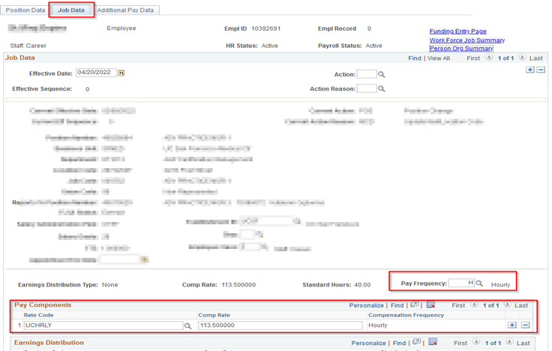
Updating Pay Frequency
When there is a compensation change, or a reclassification, please ensure the Pay Frequency and the Compensation fields are populated with the correct/updated information.

Slide 13
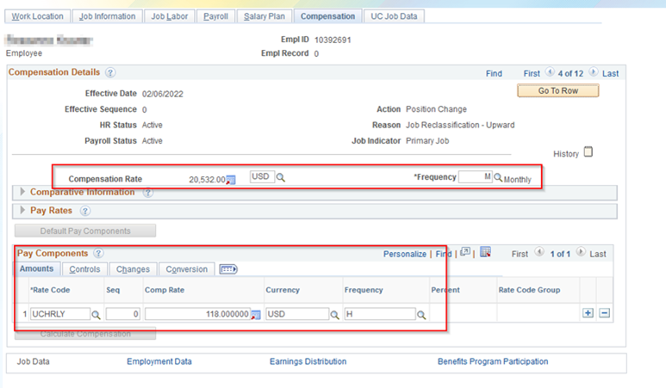
The UCHRLY compensation frequency only aligns with “H” pay frequency The UCANNL compensation frequency aligns with all other pay frequencies The frequency fields on the “Compensation” tab in Job Data determine the pay schedule and how the overall compensation rate is calculated When submitting position or job code updates, the frequency will default from the job code table Users must review the “Frequency” and “Pay Components” to ensure they are correct In the example below, a position and job change resulted in a frequency update to “M” while keeping an hourly rate code. This resulted in the employee moving incorrectly to an “Exempt Monthly” pay frequency.
Resources: Initiate Position Data + Job Data Change PayPath Staff Initiate Position Data + Job Data Change PayPath Academics

Slide 14
Vacation Accrual Issues

Slide 15
Vacation Accrual Issues
Affects employees who became eligible Dec.-March with a job end date. Some employees may show incorrect vacation accruals. Could be those who are newly hired or re-hired or transferred.
Go forward accruals have been fixed
Process of restoring the history is being manually worked by UCPC and taking some time
Accruals for April posted by Friday April 29 at 5pm
If the accruals are still not correct; open a UCPC case requesting them to be restored.
Send an email to UCPath@uci.edu with the case # that you open, if there already was a case, please let us know that #

Slide 16
Year End Reminders

Slide 17
Fiscal Year End Deadlines
Test run of Funding Rollover in test environment; exception reports sent to locations 6/6.
Last date to submit SCTs is 6/22.
All funding entry and funding updates should be entered 6/23.
Funding entry freeze from 6/24 – 6/30.
Funding Rollover process 6/24 – 6/30.
Rollover Exception reports distributed to locations:
  MCOP: 6/28 – 6/29
  Non-MCOP: 6/30 – 7/1

Slide 18
June 2022
UCPath FYE Processing Calendar
Sunday | Monday | Tuesday | Wednesday | Thursday | Friday | Saturday
 |  |  | 1 | 2 | 3 | 4
 |  |  | BW On-Cycle PAY Confirm (220528B1XL) | BW On-Cycle GL Confirm (220528B1XL) BW On-Cycle PAY Confirm (220528B1X) | BW On-Cycle GL Confirm (220528B1X)
5 | 6 | 7 | 8 | 9 | 10 | 11
 | BW On-Cycle GL Confirm –Summary and Detail (220528B1X)
12 | 13 | 14 | 15 | 16 | 17 | 18
 | MO Off-Cycle PAY Confirm (220601M0YL) | MO Off-Cycle GL Confirm (220601M0YL) BW On-Cycle PAY Confirm (220611B2XL) | MO Off-Cycle PAY Confirm (220601M0Y) BW On-Cycle GL Confirm (220611B2XL) | MO Off-Cycle GL Confirm (220601M0Y) BW On-Cycle PAY Confirm (220611B2X) | BW On-Cycle GL Confirm (220611B2X)
19 | 20 | 21 | 22 | 23 | 24 | 25
 | Holiday |  |  |  | Funding Rollover (6/24 – 6/30) Funding Entry Freeze starts at 8:00 AM (MCOP) | Funding Entry Freeze ends at 5:00 PM (MCOP)
26 | 27 | 28 | 29 | 30
 |  | Funding Entry Freeze starts at 8:00 AM (non-MCOP) Exception Reports Distributed MCOP (6/28 – 6/29) | Funding Freeze cont. | Funding Entry Freeze ends at 12:00 PM (non-MCOP) Exception Reports Distributed non-MCOP (6/30 – 7/1)
SCT Batch Run
Processed SCT in DDODS*
SCT Local Approval Due: 5:00 PM
SCT Local Approval Due: 5:00 PM
SCT Local Approval Due: 5:00 PM
SCT Batch Run
Processed SCT in DDODS*
Processed SCT in DDODS*
SCT Local Approval Due: 5:00 PM
SCT Batch Run
Processed SCT in DDODS*
Processed SCT in DDODS*
SCT Batch Run
SCT Local Approval Due: 5:00 PM
Funding Entry Deadline
SCT Batch Run

Slide 19
Training Schedule

Slide 20
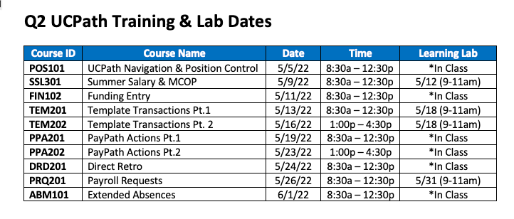

Slide 21


Slide 22
Resources:
Out-of-State Income Tax Withholding eForm (navigation path: UCPath > Forms Library > Access Form > Payroll > Out-of-State Income Withholding)
For step-by-step instructions: Update My Out-of-State Tax Withholding

Slide 23



