Slide 1
Training Tips May 17, 2022

Slide 2
Quick Announcements I
Upcoming Deadlines
NEXT BW Transaction deadline: Wednesday May 25 at 3pm (for templates, extended absences, etc.)
BW Pay Path Deadline: Today 5/17 (5pm) – blackout through Friday 5/20 @ 6am
NEXT MO Transaction deadline: Thursday May 19 at 3pm (for templates, extended absences leaves, etc.)
MO Pay Path Deadline: Tuesday 5/24 (5pm) - blackout until Friday 5/27 @ 6am

Slide 3
Quick Announcements II
The temporary change to vacation accrual maximum ends June 30, 2022.
If they submit usage for June in July and it brings them down enough to accrue in July, the system will grant them missing accruals.
The system will always go back and recalculate the calendar that has usage submitted and then grant any accruals they may have lost for that time period if they were at max.
Leave team will no longer be at the Drop-In Center. If you do have leave related questions Philip will be able to put you in touch with the appropriate leave individual to answer your questions or you can open an EEC ticket.

Slide 4
Quick Announcements III
When processing Emeriti hires please create a new empl record using the UC_Full Hire_AC template. When using the job aid please follow Option 2. Here is a link to the job aid found in UCPath location help.
https://sp.ucop.edu/sites/ucpathhelp/LocationUsers/LOCjobaids/UCPC_PHCMWFAL250JA_Emeritus_D2Rev00.pdf

Slide 5
Quick Announcements IV
Use of foreign characters in Legal Name
Legal name should only contain English characters.
UCPath does allow these characters, but many downstream systems cannot accommodate.
If the foreign characters are input in UCPath a request by OIT will be made to remove them to accommodate our downstream systems.

Slide 6
Agenda
Year-End Review
Mass PayPath Process
Final Pay Reminders
Training Schedule
Q&A

Slide 7
UCI UCPath Year-End Preparation May 17, 2022
Notes:
Debbie - Open meeting and Welcome! (1 minute)
Go to slide 2.

Slide 8
Year End Highlights
Funding Rollover
Direct Retro Discussion
Selecting Multiple Paychecks – Direct Retro
Contracts & Grants Considerations
Assessment Rate Update
Year End Accrual for Campus
Weekly reminders on Approvals for Funding and Direct Retro
Budget Distribution Page updates
Accounting has KFS year end workshop tomorrow

Slide 9
Funding Roll Over Explained
Funding entries in UCPath are created for each fiscal year. The Rollover process takes the existing entries and creates a new funding entry for the next fiscal year. There are 3 exceptions:
If a fiscal year 2023 funding entry has already been created, a new funding entry for 2023 will not be created or override the new entry.
If positions are inactive (Status of “I”), the funding entries will not rollover.
If there is a Funding End Date, on the Funding entry page, these entries will not rollover.

Slide 10
Funding Roll Over With Funding End Dates
This Funding End Date is a field on the Funding Entry page. This is not related to Fund/Grant Expiration Dates.
If the Funding End Date is a future date in the next fiscal year, the funding will rollover.
If lines have Funding End Dates that expire in the current/ending fiscal year, they will not roll over department level-funding will be used for all distribution lines.

Slide 11
Testing of Funding Roll Over
Testing of funding roll over week of June 6
Exception reports will be sent to MAABOs afterwards to review and make updates in production, if necessary
Purpose of this activity is to ensure unexpected results are not produced during the real roll over process in production

Slide 12
Fiscal Year End Deadlines
Test run of Funding Rollover in test environment; exception reports sent to locations 6/6.
Last date to submit SCTs is 6/22.
All funding entry and funding updates should be entered 6/23.
Funding entry freeze from 6/24 – 6/30.
Funding Rollover process 6/24 – 6/30.
Rollover Exception reports distributed to locations:
MCOP: 6/28 – 6/29
Non-MCOP: 6/30 – 7/1

Slide 13
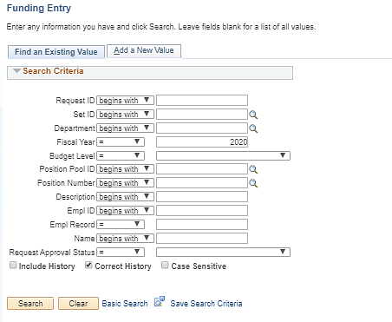
Direct Retro/Funding Tips
When inputting new funding for next year, change the fiscal year from current year default; needs to be done on the search screen
Direct Retro transactions that are initiated but not submitted or approved need to be submitted or cancelled
Last date for Direct Retros to
be included for 2021/22,
must be fully approved by
July 6 at noon- if the deadline is
missed it will post to next fiscal year

Slide 14
Direct Retros in Initiated Status
Direct retro transactions sitting in an Initiated status need to be reviewed
When a direct retro is in an Initiated status, it locks the pay record so it cannot be selected for processing from the Process Direct Retro page.
There are two options for these transactions:
Finalize and submit for processing
Cancel transaction
Details in Appendix

Slide 15
Selecting Multiple Paychecks – Direct Retro
Multiple paychecks can be selected when processing direct retros except in the following cases:
If the salary cap/MCOP worksheet was used in funding
If work study pay is involved
If any error is incurred during the processing of a direct retro and multiple paychecks are involved, please unbundle the paychecks and re-submit one at a time
- this will allow us to identify the problem paycheck

Slide 16
Direct Retros Affecting C&G Accounts
Direct retros placing charges or credits to C&G accounts require that all questions in the Questionnaire are clearly answered.
Explain how the error occurred and why the transfer is being requested. If partial transfer, explain the basis for proration and/or split.
Who approved the transfer of funds? (e.g. Name of PI, Department CAO; and Department needs to keep this backup on file)
How does the transfer benefit or impact the new funding source being charged?
Explain the untimeliness if transfer is: > 120 days after original transaction date, and/or > 90 days after the fund end date.

Slide 17
High Risk Direct Retros Affecting C&G Accounts
Direct retros not made within the 90/120 day rules are considered high risk and will be reviewed by C&G Compliance.
C&G Compliance will not approve direct retros missing clear answers to all questions in the Questionnaire, or if expense corrections cannot be deemed allowable and allocable to the award.
Process direct retros with enough time for C&G review
and approval of high risk transactions.

Slide 18
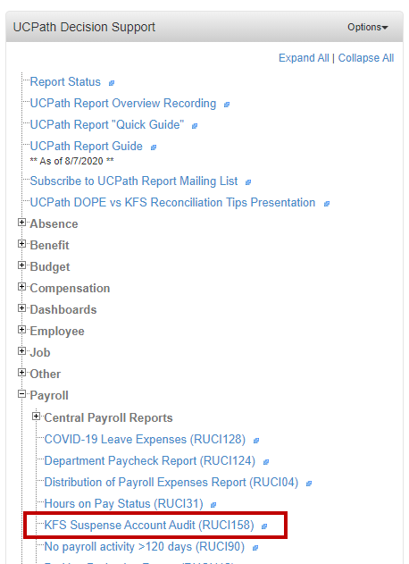
Clear Suspense Account BF10002 via Direct Retro
Please make sure department payroll expenses posted to BF10002 are cleared
Departments need to review the new KFS Suspense Account Audit Report (RUCI158)
Departments need to transfer salary expenses hitting the KFS Suspense account via the DIRECT Retro Process (Salary Cost Transfer) by the UCPath deadline of July 6, 2022 noon.
Please check and fix the root causes i.e. funding
Notes:
Review the new KFS Suspense Account Audit Report (RUCI158) to ensure that department salary and benefit expenses are not recorded against the KFS Suspense account (BF10002). Look for transactions posted against the KFS Suspense account and transfer them to the proper KFS accounts to ensure that these transactions are probably reflect in the departments’ financials for the current fiscal year. Salary expenses hitting the KFS Suspense account will need to be transferred via the DIRECT Retro Process (Salary Cost Transfer) by the UCPath deadline of July 6, 2021 noon. for the transactions to be reflected in the current fiscal year.

Slide 19
Assessment Rates for FY 23’
New Rates published by Controllers office
Due to UCPC May 13th
Effective July 1, 2022
CBR
GAEL
VLA
RPNI
New Rates available in Code look-up report after July 1.

Slide 20
Year End Accrual for Campus
Will account for last three days of June Bi-weekly that will be paid in July
Reversal in first July Bi-weekly GL run

Slide 21
Adjustment Process
MAABOs to collect the adjustments for their schools/departments and submit one EEC ticket per MAABO

Slide 22
When to Update Budget Distribution
The Budget Distribution page must be updated for permanently budgeted positions when:
New positions are created for permanently budgeted positions either by the department or the Budget office.
Any type of pay change occurs for permanently budgeted positions. This includes the following PayPath transactions:
Promotions and/or Reclassifications
Step increases
Merit increases
Equity increases
Permanently budgeted positions are vacated. This includes the following Smart HR Template transactions:
Terminations (Including transfers out)
Retirements
Note: Transactions must be fully processed before updating the Budget Distribution page.

Slide 23
Where to Get Help
The UCPath Help site is your first level of support. Search for conceptual content, job aids or step-by-step instructions for UCPath tasks.
From the Transactional Users website, expand the UPK Simulation section in the middle of page and then click the “Location Users” link to open the site. *An Adobe PDF version is available for users with screen readers.
Open an EEC ticket: EEC.hr.uci.edu UCPath Support/ UCPath Finance & Accounting Inquiry

Slide 24
Mass PayPath

Slide 25
Mass PayPath
Mass PayPath is used to facilitate mass data changes for Academic and Staff regarding position, job and additional pay. Employment data changes are immediately loaded into UCPath when Mass File is submitted through HRIS. A minimum of 10 employees are needed to request/submit a Mass PayPath File.
Planning Prior to Submitting Request:
What is the effective date of the change?
Review UCPath Production Processing Schedule Payroll Processing Schedules
Review UCI Transaction Deadline Schedule UCI Transaction Deadlines
Allow enough time for manual entries of mass hires which error out
Mass PayPath process does not support transactions where: - position numbers are vacant - position numbers have more than one incumbent - future dated rows exists (Programing Currently Under Review by Technical Team) - Academic Promotion/Merit (handled by Academic Personnel Office) - effective date cannot exceed the current Expected Job End Date - employee is inactive
Positions should already be funded.

Slide 26
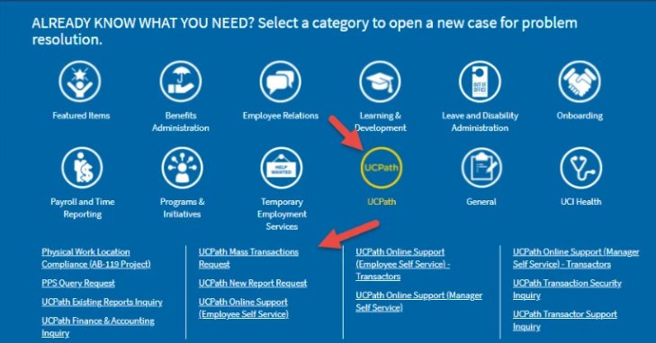
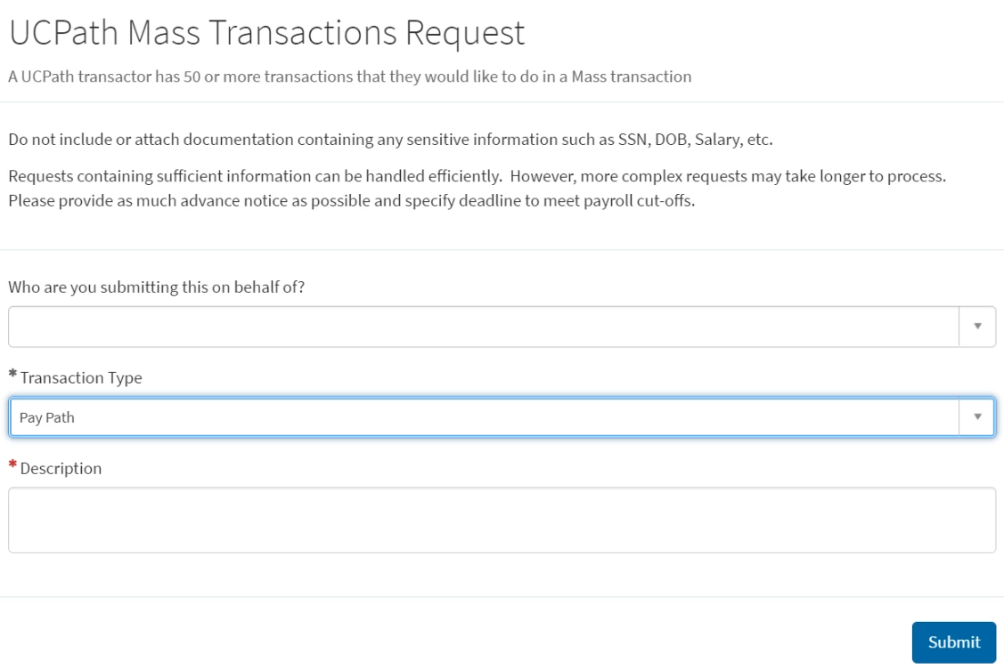
Mass PayPath Request
Select UCPath >UCPath Mass Transaction Request
Fill Out Required Fields and select Pay Path for Transaction Type and Submit

Slide 27
Creating EEC ticket
Instructions:
Step 1. Submit EEC Ticket to HRIS
This ticket can be used to request the Mass PayPath template from HRIS
Once the ticket is submitted, the HRIS team will upload the required template to the ticket for filling out by the department
Step 2. Filling out the Mass PayPath Template
Determine what record identifier is needed for the type of change
Record identifier 100 = Position Data Changes
Record identifier 200 = Job Data Changes
Record identifier 300 = Additional Pay Changes
Insert blank rows below the record identifier you will be using
Fill out the rows according to how you would submit an individual PayPath transaction
Save As file in CSV format
Example: Filling out a template for Reports to Change
Complete the following columns: Position Numbers, Effective Dates, Action Reasons, and Reports to Position Numbers
Enter 100 in both columns titled Record Identifier for an RTC
Attach completed Mass PayPath to the EEC ticket for processing

Slide 28
Mass PayPath Process
Step 3. HRIS to Upload File
HRIS team will audit file and upload to UCPath
Error handling: You will be notified through the EEC ticket of any updates that needed to be removed from the file - these will need to be processed manually by the department - Examples of updates that cannot be processed through Mass PayPath include any position numbers/employee IDs with future dated transactions in UCPath, position numbers that are vacant, and position numbers with more than one incumbent, effective date exceeds expected end date, employee inactive and Academic Promotion/Merit
School/Unit should conduct their own audit to confirm everything looks correct
Step 4. Complete Request
HRIS will Close Complete EEC ticket once results have been provided to the submitter

Slide 29
Final Pay

Slide 30
Final Pay Comments
Utilize the below template in the Initiator Comments box for Final Pay request.
Final Pay Comments Template:
Last day on paid status: MM/DD/YYYY
Termination Transaction ID:
Auto Termination Date:
Last day on pay status is one day prior to Termination Job effective date- Use the format above
Other Updates & Reminders: Navigate to UCPath > Help > Location Users to access recently updated training materials: Payroll (PAYL200: Additional Compensation and Payroll Requests): Job Aid: Termination and Final Pay New job aid provides an overview of the final pay termination process and the use of the new final pay comments template Simulation: Submit Final Pay Request Updated images and text to show the use of the final pay comments template

Slide 31
Training Schedule

Slide 32
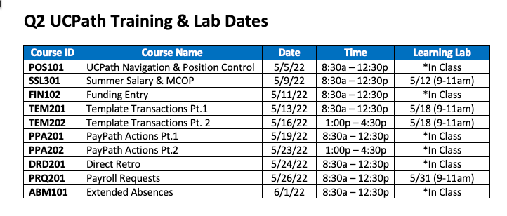

Slide 34
Did you know: The FMLA/CFRA eligibility hours are visible on the “Request Extended Absence” screen to users with appropriate access The “Eligibility Hours” displays all eligible hours based on the last rolling 12 months Eligibility is determined based on the earn codes used for the employee. The list of earn codes and their set up can be viewed on UCPath > QuickLinks > Payroll Resources > Payroll Configuration Codes > Earn Codes Page navigation UCPath > PeopleSoft Menu > Global Payroll & Absence Management > Payee Data > Maintain Absences > Request Extended Absence

Slide 36
Appendix
Detailed slides on Funding Entry and Direct Retro

Slide 37
Direct Retro Information (Appendix)
Direct Retro transactions that are initiated but not submitted or approved need to be submitted or cancelled
After SCT runs in UCPath, can see part of it in DOPE report, only loaded to KFS after labor ledger runs
Ensure all high risk transactions are done early enough for second approval by C&G before deadlines

Slide 38
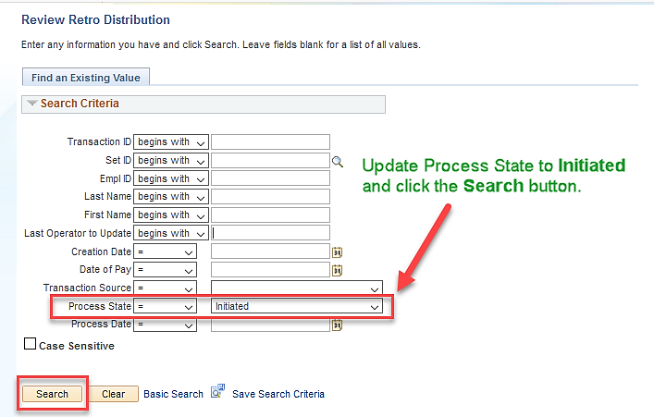
Locating Initiated Direct Retros
Navigation: PeopleSoft Menu > Payroll for North America > Payroll Distribution > UC Customizations > Review Retro Distributions

Slide 39
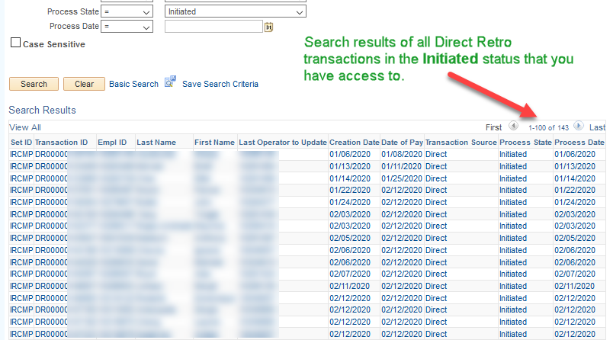
Reviewing Search Results
Total number in the Initiated status will appear in the far right corner of the Search Results section.

Slide 40
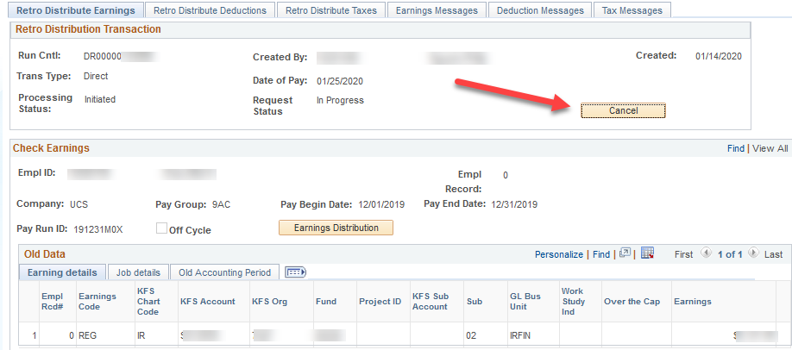
How to Cancel a Direct Retro
When you cancel a direct retro transaction it unlocks the record.
Select the transaction from the Search Results list.
Click the Cancel button.

Slide 41
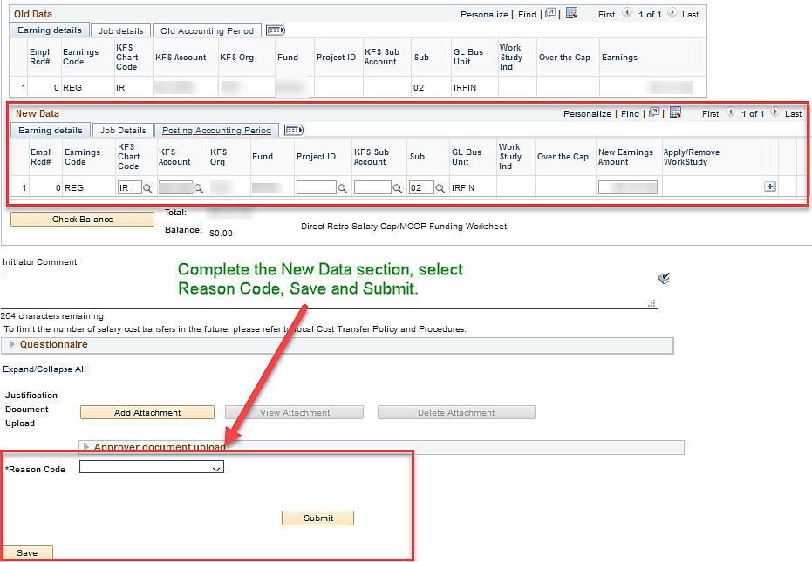
Continue Processing Direct Retro
Select transaction from Search Results list.
Complete New Data section, Reason Code, Save and Submit.

Slide 42
Key Dates & Reminders!!
6/7
Testing Funding Rollover Week
6/14
Test Results to MAABOs for corrections
7/7~
Results of Actual Rollover to MAABOs
Rollover Testing & Review
Rollover Rules
No End Date
End Date>6/30/22
6/24/22
AVOID
6/30/22
End Date <6/30/22
New Funding As Of 7/1/22
Funding Entry
6/23- Last day for Funding Update for any 2022 Earnings!

Slide 43
June 2022 UCPath FYE Processing Calendar
Sunday | Monday | Tuesday | Wednesday | Thursday | Friday | Saturday
 |  |  | 1 | 2 | 3 | 4
 |  |  | BW On-Cycle PAY Confirm (220528B1XL) | BW On-Cycle GL Confirm (220528B1XL) BW On-Cycle PAY Confirm (220528B1X) | BW On-Cycle GL Confirm (220528B1X)
5 | 6 | 7 | 8 | 9 | 10 | 11
 | BW On-Cycle GL Confirm –Summary and Detail (220528B1X)
12 | 13 | 14 | 15 | 16 | 17 | 18
 | MO Off-Cycle PAY Confirm (220601M0YL) | MO Off-Cycle GL Confirm (220601M0YL) BW On-Cycle PAY Confirm (220611B2XL) | MO Off-Cycle PAY Confirm (220601M0Y) BW On-Cycle GL Confirm (220611B2XL) | MO Off-Cycle GL Confirm (220601M0Y) BW On-Cycle PAY Confirm (220611B2X) | BW On-Cycle GL Confirm (220611B2X)
19 | 20 | 21 | 22 | 23 | 24 | 25
 | Holiday |  |  |  | Funding Rollover (6/24 – 6/30) Funding Entry Freeze starts at 8:00 AM (MCOP) | Funding Entry Freeze ends at 5:00 PM (MCOP)
26 | 27 | 28 | 29 | 30
 |  | Funding Entry Freeze starts at 8:00 AM (non-MCOP) Exception Reports Distributed MCOP (6/28 – 6/29) | Funding Freeze cont. | Funding Entry Freeze ends at 12:00 PM (non-MCOP) Exception Reports Distributed non-MCOP (6/30 – 7/1)
SCT Batch Run
Processed SCT in DDODS*
SCT Local Approval Due: 5:00 PM
SCT Local Approval Due: 5:00 PM
SCT Local Approval Due: 5:00 PM
SCT Batch Run
Processed SCT in DDODS*
Processed SCT in DDODS*
SCT Local Approval Due: 5:00 PM
SCT Batch Run
Processed SCT in DDODS*
Processed SCT in DDODS*
SCT Batch Run
SCT Local Approval Due: 5:00 PM
Funding Entry Deadline
SCT Batch Run

