Slide 1
Training Tips March 7, 2023

Slide 2
HR Transaction Deadlines
Payroll Type | Absence / Hire / +Pay / Retro Pay Transactions Due By: | PayPath Entries / Approvals Due By: | PayPath Blackout Period Ends:
Bi – Weekly | Thur. March 16 @ 3pm *(Check Date: 3/15/23) | Tues. March 7 @ 5pm* *(Check Date: 3/1/23) | Fri. March 10 @ 6am
Monthly | Fri. March 17 @ 3pm *(Check Date: 3/30/23) | Wed. March 22 @ 5pm* | Mon.. March 27 @ 6am
*Blackout period starts

Slide 3
Next Finance Transaction Deadlines
Funding Entry Approvals Due By: |  | SCT (Direct Retro) Approval Deadline:
Tue Mar 7 @ 5pm Bi-Weekly Check Date: 3/15 |  | Fri Mar 10 @ 5pm Available on DOPE: 3/15
Tue Mar 21 @ 5pm Bi-Weekly Check Date: 3/29 |  | Wed Mar 15 @ 5pm Available on DOPE: 3/18
Mon Mar 22 @ 5pm Monthly Check Date: 3/30 |  | Fri Mar 17 @ 5pm Available on DOPE: 3/22

Slide 4
Quick Reminders I
AB119 deadline March 17 to update all required information including for Grad Students
Upcoming Training Refresher March 14 1-2
Modifying Additional Pay

Slide 5
Quick Reminders II
Monitor Expected Job End Dates
With the approaching end of the Quarter there are many jobs with 3/31 end dates that will terminate
Avoid need for rehire/reinstatement by updating the job end date at least a day before expected end date. A rehire/reinstatement transaction alone will NOT automatically reinstate benefits.
The submitter must also create a case in UCPath requesting review of the employee's benefits:
o Topic: Benefits
o Category: Other Benefits Inquiry
o Subject Line: Benefits review after Auto-Term / Reinstatement

Slide 6
Future BW Training Tips Meetings
March 21
April 4
April 18
May 2

Slide 7
Agenda
CWR Auto-Term Capability
Expected Job End Dates & Benefits Reinstatements
Grad Student Leave of Absence (LOA)
Lived Name Update
Q&A

Slide 8
CWR Auto-Term

Slide 9
New CWR Functionality
Users may now use the "End Job Automatically" check box for CWR jobs:
The "End Job Automatically" flag will be available on both Smart HR and Mass Hire templates including Extend/Update templates
When this check box is selected, UCPath will insert a "Termination/Job Record End Date - Auto Term" row to a CWR record with an expired job
This should improve the management of CWR jobs with the ability to set the flag at the hire date and then update the end date as needed.
Job automatically terminating on end date with no need to process a completion template

Slide 10
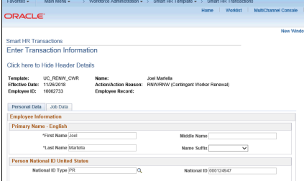
CWR Reinstatement
If a CWR job is ended in error; please process using the Renew template

Slide 11
Grad Student LOA

Slide 12
Leave of Absence – Grad Students
Questions asked regarding provision in new contract for an 8 week paid FML leave for Grad students
Use extended leave of absence transaction with reason LT MEDICAL BX, and do not select any FMLA reasons
AP confirmed and shared that the reason code will be updated to include BR in the title

Slide 13
Lived Name Update

Slide 14
Lived Name update in UCPath
Expected Deployment June 20, potential downtime June 16-19
Majority of pages will display only Lived Name
Some pages, will display only Legal Name
A few pages will allow search for both legal name and lived name
Job Data and Modify a Person
When deployed the fields will be labeled either Legal Name or Name
Some pages may look different than current
We will conduct workshops/training to familiarize transactors with how to search, where legal name will be, reminder to ask for Employee ID and any pages that may be changed

Slide 15
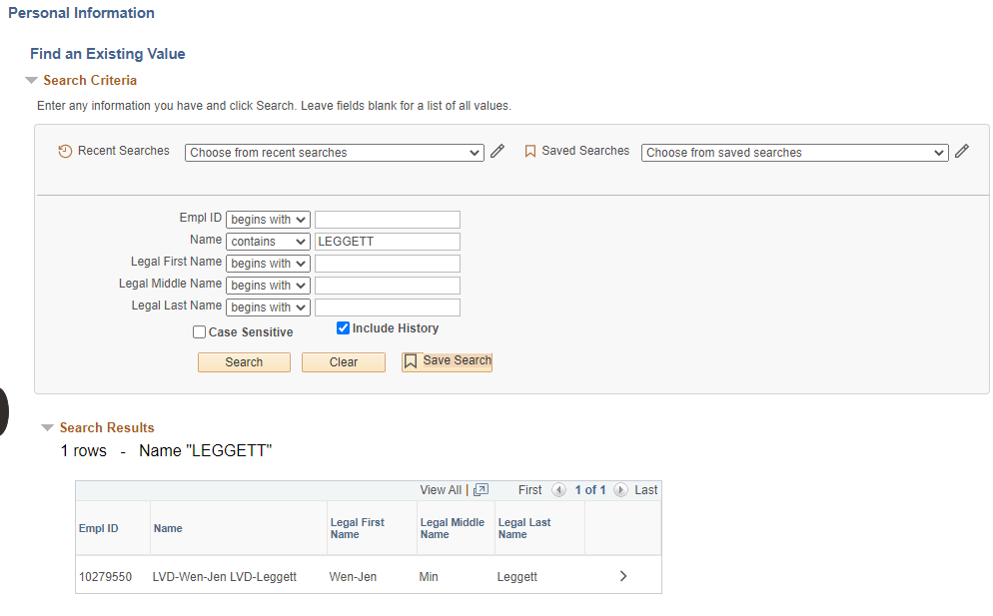
Modify a Person Search

Slide 16
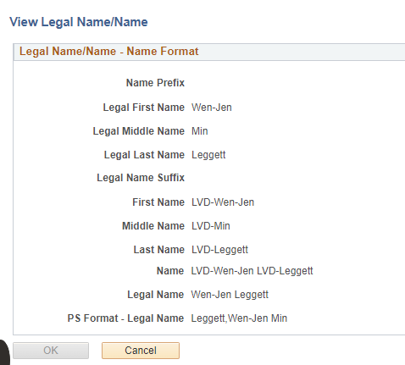
Modify a Person Information

Slide 17
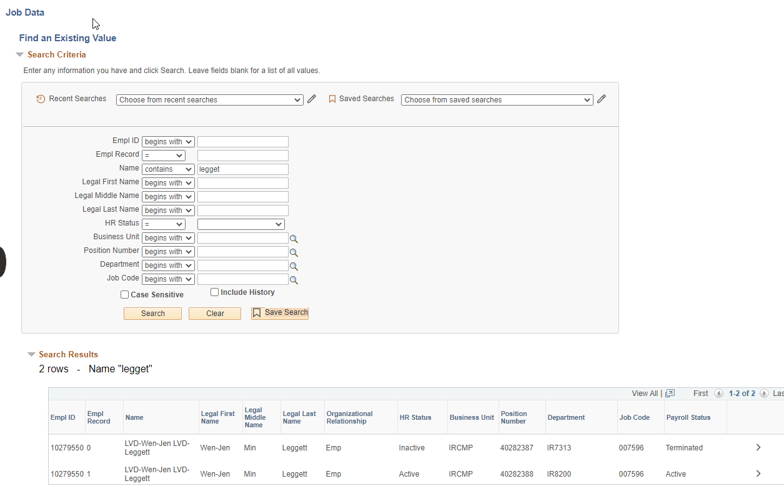
Job Data

Slide 18
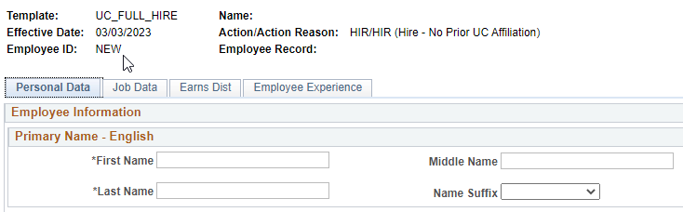
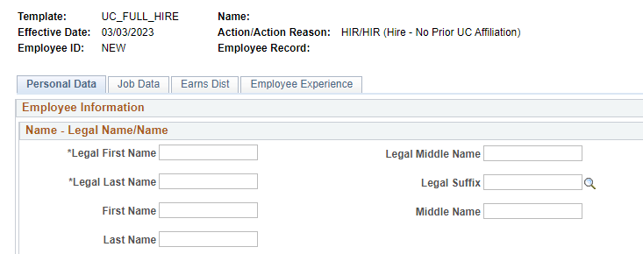
Hire Transaction
Current Information Entered
Future Information Entered

Slide 19
UCPath Training Refreshers

Slide 20
Training Refreshers
The UCPath Training Team will be hosting a series of Training Refreshers sessions to provide additional learning opportunities to transactors.
Hosted every other Tuesday
Bi-weekly 1 hour sessions
Different Trainer & Topic for each session
Different Topic explored in each session
Sessions will consist of the following:
“Topic of the Day” – Short, pre-planned training refresher / walk-thru using real-world scenarios.
Q & A / UCPath Support – After the “Topic of the Day” is completed, there will be additional time for questions and/or comments for related topics.

Slide 21
Training Refreshers Schedule
The Training Refreshers will be held every other Tuesday from 1pm – 2pm.
Date | Topic | Host
February 28th | Transfers – Part 1 | Angel
March 14th | Modifying Existing Additional Pay | Sheila
March 28th | Funding Updates | Andrea
April 11th | Transfers – Part 2 | Angel
April 25th | Budget Distribution Updates | Andrea

Slide 22
Did You Know?

