Slide 1
Training Tips
April 18, 2023

Slide 2
HR Transaction Deadlines
Payroll Type | Absence / Hire / +Pay / Retro Pay Transactions Due By: | PayPath Entries / Approvals Due By: | PayPath Blackout Period Ends:
Bi – Weekly | Thur. April 27 @ 3pm *(Check Date: 5/10/23) | Tues. April 18 @ 5pm* *(Check Date: 4/26/23) | Fri. April 21 @ 6am
Monthly | Tues. April 18 @ 3pm *(Check Date: 5/1/23) | Fri. April 21 @ 5pm* *(Check Date: 5/1/23) | Wed. April 26 @ 6am
*Blackout period starts

Slide 3
Next Finance Transaction Deadlines
Funding Entry Approvals Due By: |  | SCT (Direct Retro) Approval Deadline:
Tue Apr 18 @ 5pm Bi-Weekly Check Date: 4/26 |  | Fri Apr 14 @ 5pm Available on DOPE: 4/19
Mon Apr 24 @ 5pm Monthly Check Date: 5/1/23 |  | Wed Apr 26 @ 5pm Available on DOPE: 4/29
Tue May 2 @ 5pm Bi-Weekly Check Date: 5/10/23 |  | Fri Apr 28 @ 5pm Available on DOPE: 5/3

Slide 4
Quick Reminder I
Verification of Employment
Effective April 28 students needing verification of employment will now use the same process as other employees.
  They may opt-out via UCPath self-service>Personal Information>My Current Profile
Student employees can generate their own verification of employment documents directly from UCPath > Income and Taxes > Verification of Employment > Generate Summary Report
Instructions on the page explain how verifiers (such as banks, employers or leasing agents) can verify employment using UC’s third-party partner, The Work Number.
UCPath will send a targeted email to current student employees, as well as publish a banner on UCPath and a UCNet article

Slide 5
Quick Reminders II
Retirement Processing
General information provided by the RASC
• Employees in the UCRP 1976 Tier or Safety classification may be eligible for the Inactive COLA if they have at least one business day where they are not on active pay status prior to July 1st, and have a termination date no later than June 29, 2023. The RASC will receive the termination date as the separation date.
Process Steps
Select the UC_RETIREMENT Smart HR Template
Enter 6/30/2023 in the Effective Date field
Enter the Employee ID and select the Employment Record Number
Accept the default of 6/29/2023 in the Last Date Worked field, or enter the employee’s actual last working date if prior to 6/29/2023
Enter any Comments or Supporting documents as needed
Please review the Updates for 2023 Retirement processing published in UCPath Help Site
Workforce Administration (PHCMWFAL260: Template Transactions - Part II):
  Job Aid: Emeriti Processing Following Retirement
  Job Aid: Retirement Transaction Process for July 1 Retirement Date - COLA
    Updated to reflect 2023 dates

Slide 6
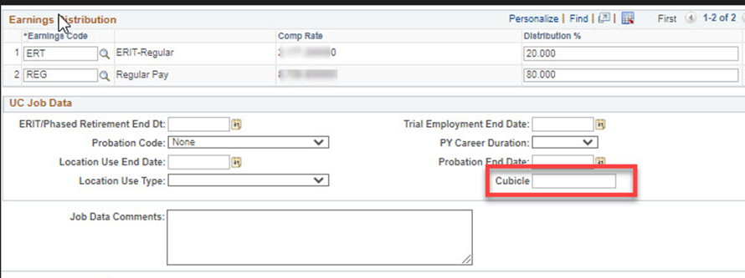
Quick Reminders III
UPDATE: The new action reason code for updating cubicle, room, or suite numbers for employees in PayPath has been deployed.
In the past you were using DTA/COR
Now begin to use:
  New DTA/CRS
  Used to updated employee’s cubicle room or suite assignment
  Use when the only field being updated is the cubicle field in the Job data section. Job aids in UCPath have been updated.

Slide 7
Quick Reminder IV
Changes to FTE for Grad Students
If you are needing to update an FTE effective 4/1/23 the date was used as part of the pay and step change processed by UCPath
This will now require a case and position update form.
We currently have a case to do large volume via spreadsheet
If you have a large number of changes, please contact Debbie today to see if we can add to our open case.

Slide 8
Future BW Training Tips Meetings
May 2
May 16
May 30
June 13
June 27

Slide 9

Agenda
Ask UCPath Enhancements
Budget Calendar
Updating Extended Absence Process
Security Update
Summer Salary Training
Q&A

Slide 10

Ask UCPath Enhancements

Slide 11
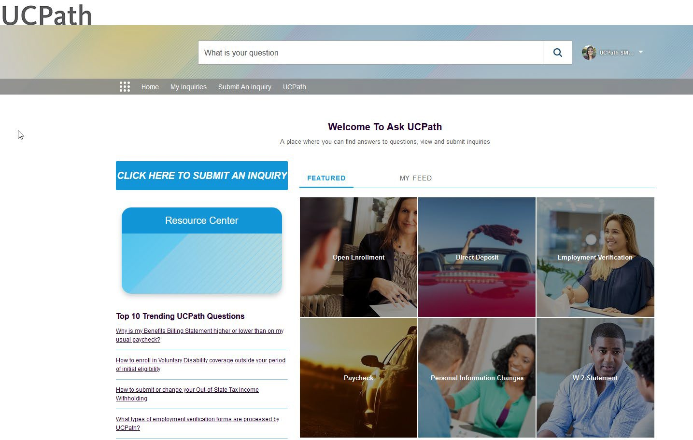
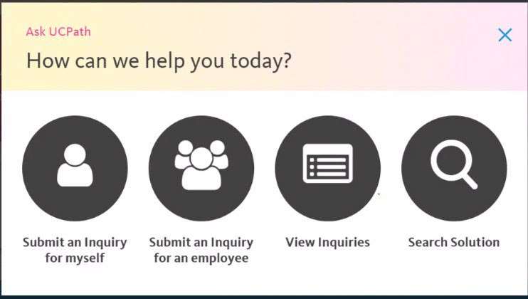
Enhanced Ask UCPath
Key Changes
Search bar returns case information and knowledge resources
A collection of trending topics relevant to seasonal activities and the current time of year.
Enhanced “Quick Search” for fast access to frequently requested content
FAQ automatically updated
Additional resources easily accessible: Resource Center, Former Employee Portal, etc.
New “Ask UCPath” web page for “Submit an Inquiry on Behalf of” (SOBO) Transactors
Current Employee View
Training Resources:
UCPath Help site updated and
Ask UCPath Overview video : https://youtu.be/AskUCPath
11
Current SOBO View
Notes:
Debbie presents

Slide 12
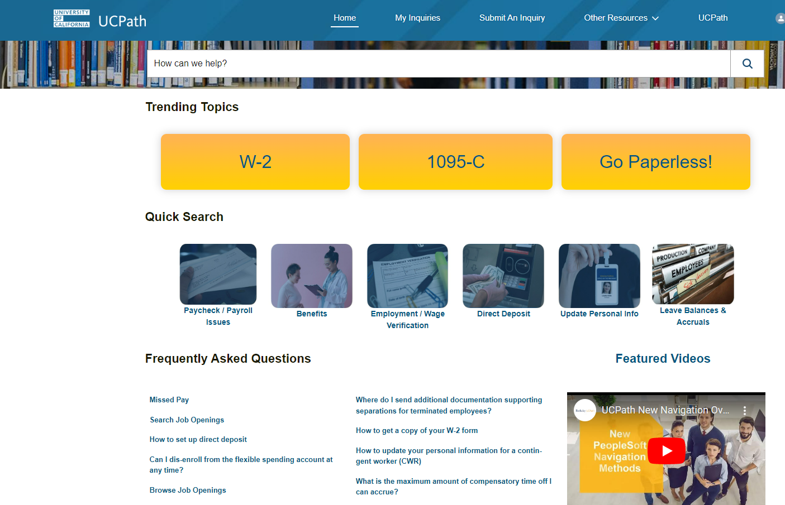
Enhanced ‘Ask UCPath’ Landing page available April 17

Slide 13
Budget Distribution Calendar

Slide 14
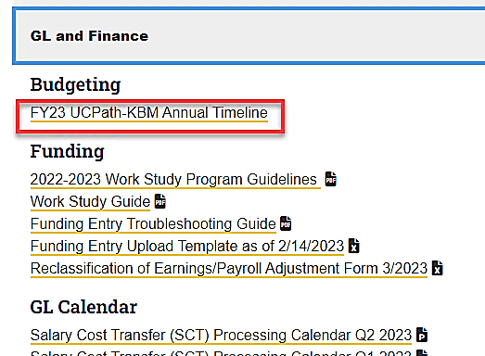
Budget Distribution Calendar
Transactional User page > GL and Finance section > Budgeting

Slide 15
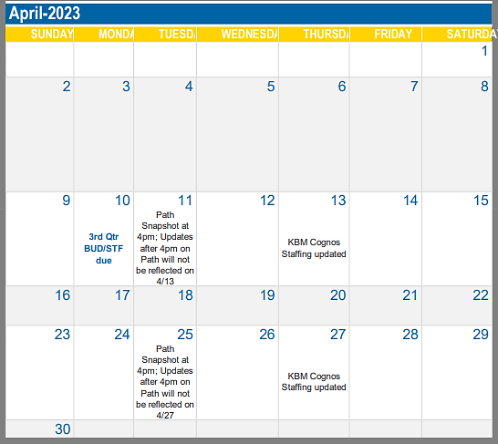
Budget Distribution Calendar Cont’d
Identifies deadlines for updating the BDP page
Shows when Staffing List will be updated in Cognos

Slide 16
Extended Absence Process

Slide 17
Ways to Edit Extended Absences
There are 2 (two) ways to edit / update extend absences in UCPath.
VS.
Administer Extended Absence Page
Request Extended Absence Page

Slide 18
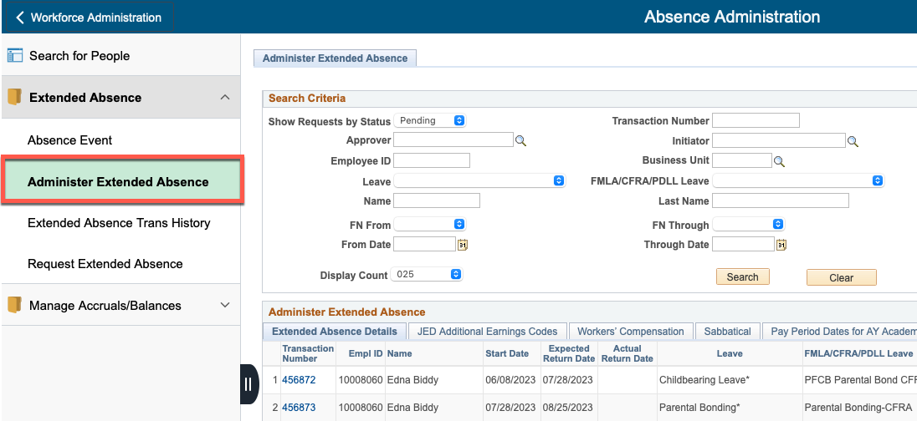
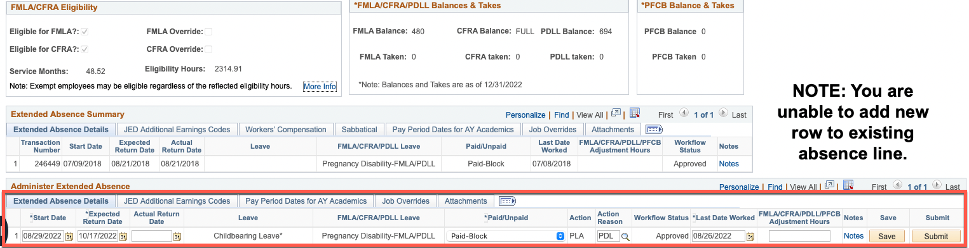
Method 1 – Administer Extended Absence Page
When to Use:
Updating the ”Expected Return Date” for an existing absence.
Entering the “Actual Return Date” for a returning STAFF employee.
Changing the “Paid/Unpaid” status on the existing absence.
  i.e., Changing from ”Paid-Block” to “Unpaid-Block” or vice-versa.
Cancelling existing absence due to incorrect Leave or FMLA/CFRA code.
Updating Notes on existing absence.

Slide 19
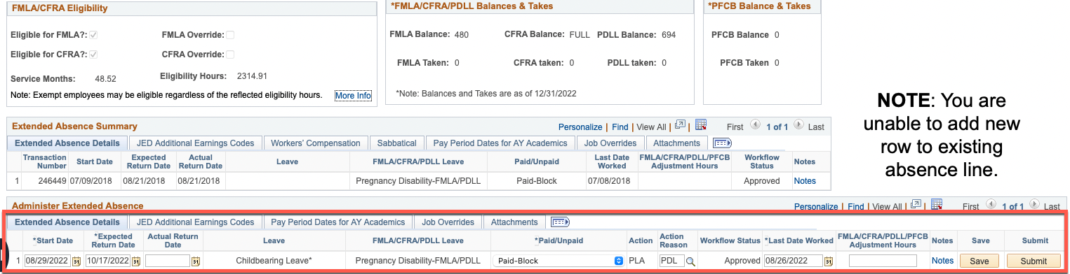
Common Mistakes – Not Saving & Submitting!
If you do not click SAVE and SUBMIT after making changes/updates to an existing absence, the transaction will revert to a “Saved” (draft) state and will no longer appear on the Administer Extended Absence page.
Unsubmitted extended absence transactions will appear in the Request Extended Absence page and can be submitted from there.

Slide 20
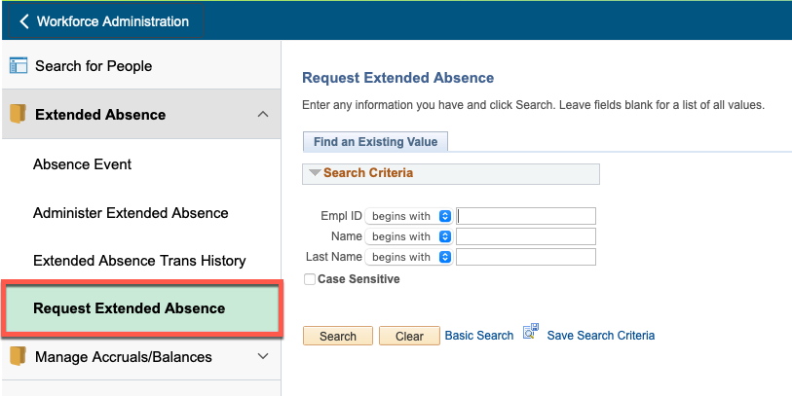
Method 2 – Request Extended Absence Page
When to Use:
Extending existing absence using a different Leave type.
  Extend Absence w/ New Leave Type: Use the Request Extended Absence page to add (+) a new row, indicating the Start Date & Expected Return Date for the new leave type.
    Start Date of new leave row must be the next day after the “Expected Return Date” of prior row.
  Changing Existing Absence w/ New Leave Type: Request to cancel the existing absence transaction. After cancellation is processed at UCPC, enter a new absence request with correct Leave type.
Extending existing leave with a different “Paid/Unpaid” status.
Adding / Extending leave to use PFCB.
NOTE: Unable to add new rows to existing absences with an “Actual Return Date” already entered.
  Mostly impacts Academic employees.
  Must enter as new request.
  STAFF - If a change is necessary, it is recommended to cancel the existing absence request and enter a new transaction with correct leave data.
    UCPC must process cancellation before new entry.

Slide 21
UCPath Security Access Reminders

Slide 22



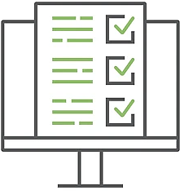


User Access Approval Process
UCPath Access Request Online Form
Supervisor
HR DSA
Training Check
Old Access Check
Fills & Signs Form
Reviews Form
Submits KSAMS request
User
CPO/MAABO/HRBP
UCPath Security
New Hire, or change in Responsibility
Complete training
Reviews Form with KSAMS request
Approve KSAMS
Appropriateness Check
Signs Form to Approve
Notes:
Just to illustrate the process.
01- User need for access is arisen by hire, transfer or promotion action
02-Supervisor when assigning work to user, determines UCPath access requirements using Roles Wiki
03-Supervisor assigns training when required for a role and follows up in UCLC once the training is completed.
04-DSA ensures that there was previously approved UCPath access for the users, gets it removed. Confirms with supervisors if the training has been completed.
05- The UCPath security administrator verifies in the DSA conducted the checks before submitting the request and reviews supporting information.

Slide 23
UCPath Security Access Form-FAQ
 | Question | Answer
1 | Do I need to submit the form each time? | Yes. The form covers information not in KSAMS.
2 | How many people need to sign the form? | Two are required. Supervisor (requestor) and one other officer in user’s department hierarchy. Without 2 signatures, the form does not go anywhere.
3 | Do I need to specify HR DSA? | Yes. The forms provides information for the DSA to create a KSAMS request for access.
4 | Does the DSA sign? | No. DSA approves the KSAMS request, not the form.
5 | Selected roles require training, can I submit form a) without checking box that training was completed or, b) I check the box if employee plans to get trained? | No. The form is submitted after all required training has been completed by employee when selected role requires training.
6 | What if I am the CPO or MAABO and/or the Supervisor of the employee, who would be the second signatory? | A CPO or CAO can be the second signatory, or even HR Business Partner, for example.
7 | How do I know where the courses for roles requiring training are listed? | UCPath Roles Wiki or Training Curriculum both located on UCPath.uci.edu website
8 | Can the form be used for DSS (Cognos) reports? | No. The form is designed only for UCPath Online elevated access.
9 | Do I need to save the PDF version of the completed form? | If your unit’s process to maintain such records. For approvals, you do not.
10 | Where is the form? | Here in DocuSign. A link is also on the UCPath System Access (Security) page.

Slide 24
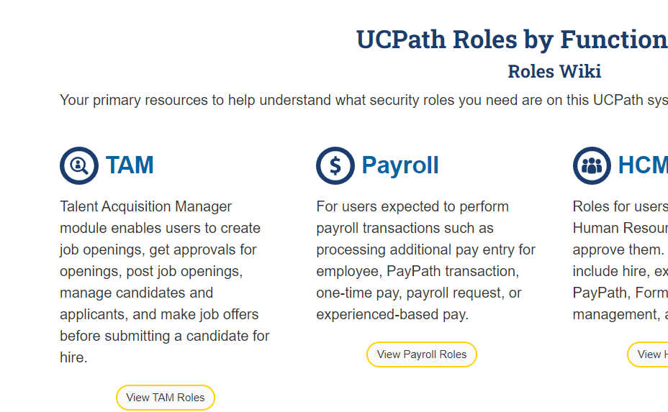
Roles Wiki
Due to cloud migration, these links broke and are being fixed.
Workarounds:
Request KSAMS role
ITSVC - Confluence - General Users
2) Leverage new Roles Summary
3) Training Curriculum

Slide 25
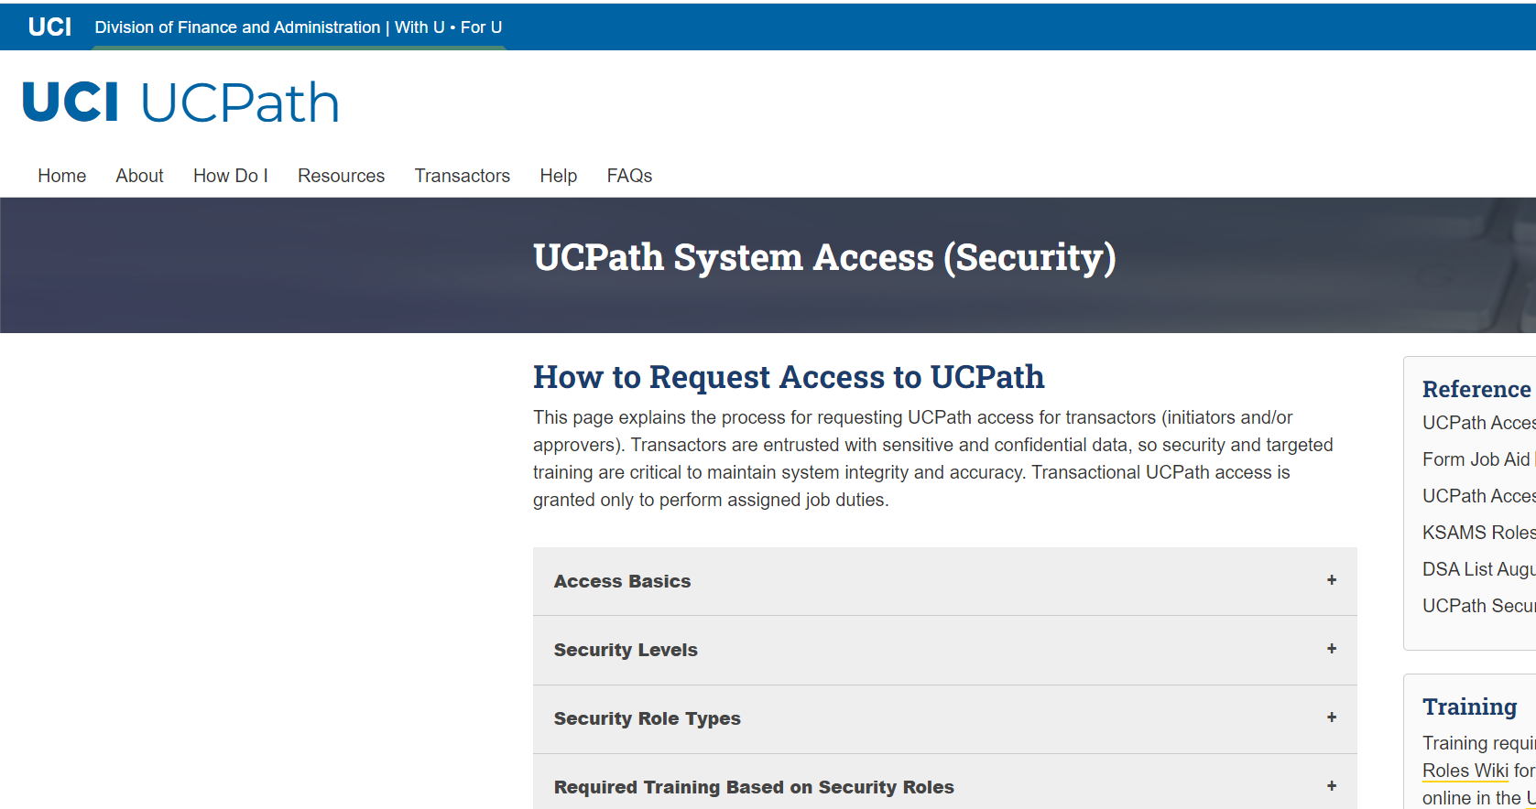
Security Website Updates
https://ucpath.uci.edu/security/
https://ucpath.uci.edu/security/
Training for Roles Matrix

Slide 26
Training for Roles Matrix
1 Complete the Pre-Reqs
To gain access to UCPath, required training courses must be completed through UCLC, courses on website are for reference and review only
UCPath Pre-Requisite Online Courses
Security Role | UCP101 | POS101 | FIN101 | TEM101 | PPA101
 | Intro to UCPath | Intro to Position Mgmt. | Intro to Position Funding | Intro to Smart HR Templates | Intro to PayPath Actions
UCP – Campus HCM Initiator | R | R | R | R | R
UCP – Campus HR Approver | R | R | R | R | R
UCP – Campus HCM Inquiry | R | R | R | R | R
UCP - Campus Funding Initiator | R | R | R | R | R
UCP - Campus Budget Entry | R | R | R | O | O
UCP - Campus Cost Transfer Initiator | R | R | R | O | O
UCP – Campus GL Approver | R | R | R | R | R
UCP – Campus GL Inquiry | R | R | R | O | O
*NOTE: All UCPath pre-requisite courses must be completed in UCLC prior to registering or attending any Instructor led training course marked with an asterisk (*).

Slide 27
Training for Roles Matrix
2 Complete the Courses
UCPath Instructor Led Virtual Bootcamp Courses
Security Role | POS201 | FIN201 | TEM301 | TEM302 | PPA310 | PPA320 | PRQ301 | ABM320 | DRD301 | BDP100
 | UCPath Nav & Position Control | Position Funding Entry | Template Transactions Pt. I | Template Transactions Pt. II | PayPath Actions Pt. I | PayPath Actions Pt. II | Payroll Requests | Absence Mgmt. | Direct Retro | Budget Distribution
UCP – Campus HCM Initiator | R | R | R | R | R | R | R | R | O | O
UCP – Campus HCM Approver | R | R | R | R | R | R | R | R | O | O
UCP – Campus HCM Inquiry | R | O | O | O | R | O | O | O | O | O
UCP - Campus Funding Initiator | R | R | O | O | R | O | R | O | O | R
UCP - Campus Budget Entry | O | R | O | O | O | O | O | O | O | R
UCP - Campus Cost Transfer Initiator | R | R | O | O | O | O | O | O | R | O
UCP – Campus GL Approver | R | R | O | O | R | R | R | O | R | R
UCP – Campus GL Inquiry | O | R | O | O | O | O | O | O | O | R
*NOTE: All UCPath pre-requisite courses must be completed in UCLC prior to registering or attending any Instructor led training course marked with an asterisk (*).

Slide 28
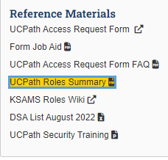
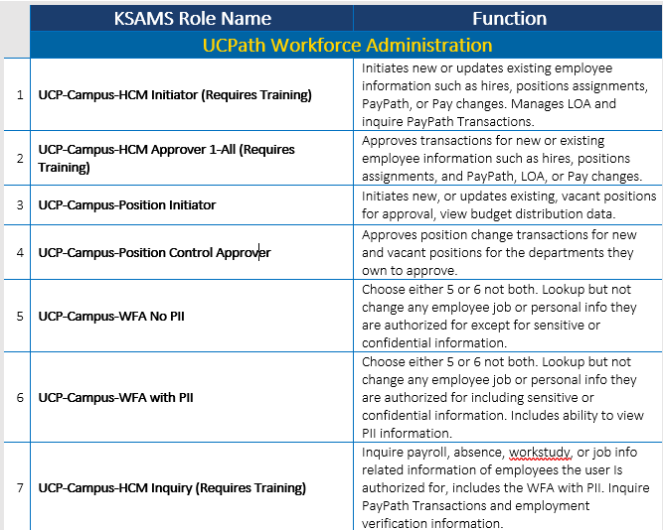
UCPath Roles Summary

Slide 29
Training Reminders

Slide 30
Upcoming Training
*Last Refresher Training*:
  April 25: 1p -2p Budget Distribution Updates
    Sign-up link
Summer Salary Training:
  Two sessions for Campus:
    May 3: 10a-12p
    May 10: 1p -3p
    Campus Sign-up
Lived Name Training:
  Mandatory 90 min. Zoom sessions to come late May / early June.
  Schedule to be announced soon

Slide 31
Lived Name & Other Training
Training will be required for those people who will have access to Legal Name. This includes these roles:
  HCM Initiator, HCM Approver, HCM Inquiry, People Services, WFA No PII, HCF
Training for Inquiry Only roles will be available via e-learning on UCLC in late May.
Training for Initiator and Approver roles will be conducted in 90-minute Zoom sessions starting the week of May 22 through June 16
Go-Live will be June 20th.
Detailed dates, times, and sign-up information will be available first week of May.

Slide 32

Did You Know?
UCPath updated the effective date calendar for enrollments and changes to the Voluntary Retirement Savings plans.
  Employees and location administrators can access the updated calendars for 2023 and view when their updated deductions will take effect.
  Navigate to UCPath > Quicklinks > Benefit Resources > Savings Plans Enrollment/Change Effective Dates
The forms library is updated with the Payroll Adjustment Form template. Access the template by navigating to UCPath > Forms Library > Payroll
UCPath works differently for future dated hires! Employees with a future dated hire cannot use UCPath to set up direct deposit until their start date Future dated hires are not visible in Person Org summary

Slide 33
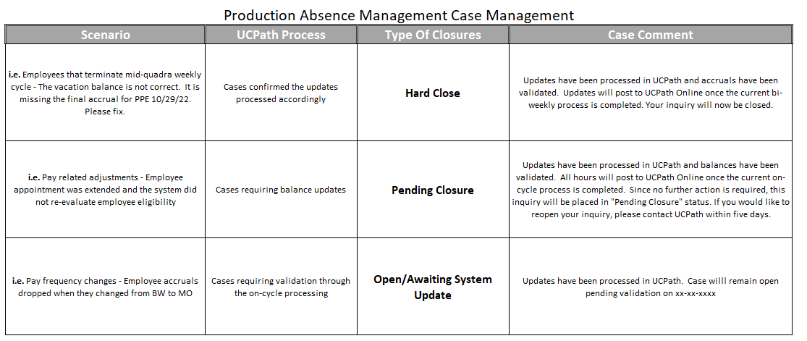
Did You Know?
UCPath added a new note to the payroll processing schedule Employee Data change section, this includes:
  Recurring Additional Pay entered via PayPath,
  Self-Service Transactions Links for One-Time Pay
UCPath will disposition accrual balance management cases, depending on case type and resolution

Slide 34
Questions?

