Slide 1
UCPath Training Updates
Tips & Lessons Learned
8/18/20

Slide 2
Important Reminders
Training has started!
- Please visit UCLC if you have not registered.
Deadlines for Bi-Weekly transactions are due this week!
If possible, do not wait to submit transactions
Retro pay transactions (addt’l pay, merits, promotions, etc.) PLEASE RE-REVIEW transactions before submitting.

Slide 3
Quick Announcements
Training Documents - Updated.
Some documents updated and renamed.
Look for NEW Support Documents this week.
Finding Transactions
Job Data Page
PayPath Entries
Position Control Mandatory Fields
UCPath Off-Cycle Dashboard
WOS (Without Salary)

Slide 4
Quick Announcements II
Summer Salary
Positions: Should be created at the true FTE value for the first summer month.
FTE: Positions will only go to 4 decimal values & will round up. Summer Salary Worksheet has been updated to reflect this change.
Continue to Manage FTE on the position data tab for preceding Summer Salary Months.
There is a defect with Salary Cost Transfers
Notice to be sent out to all initiators in each division.

Slide 5
Agenda
Earn Code Change Form
Using JED Values
Summer Salary MCOP

Slide 6
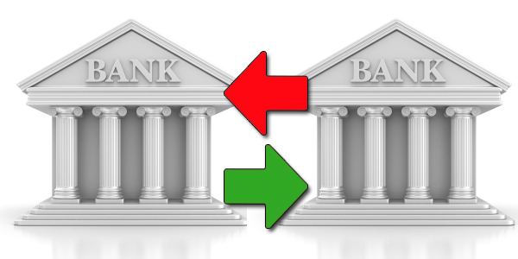
1. Earn Code Changes
The Earn Code Change form needs to be used whenever there is a need to retroactively change an earn code that was charged on an employee paycheck.
The form can be located on our UCPath website, and can also be requested via a case to the UCPath Center (Ask UCPath).
REG
ACR

Slide 7
Process to Change Earn Code
REG ➔ ACR

Slide 8
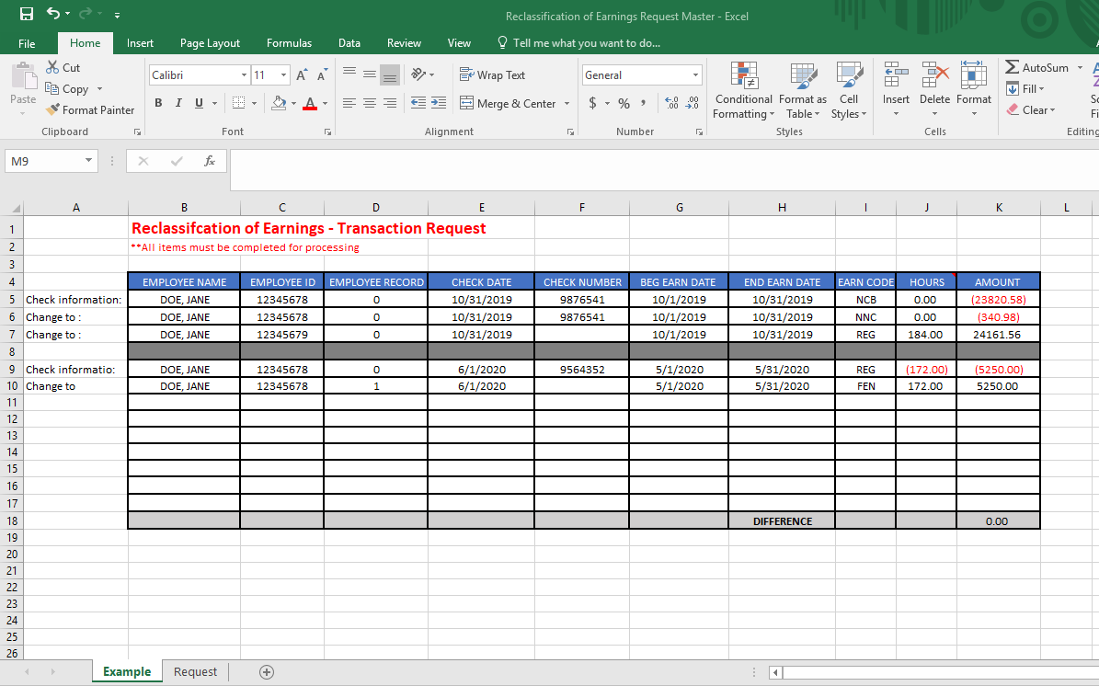
Reclassification of Earning Request
Direct Retro cannot be used to reclassify Earn Codes.
This spreadsheet must be completed and submitted using the yellow Ask UCPath button.

Slide 9
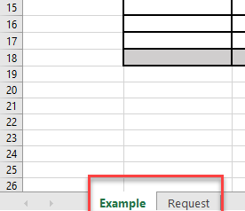
Tabs at the Bottom of the File
There are two tabs at the bottom
Example – shows how to complete the file with mock data
Request – is where you enter data to be changed

Slide 10
Completing the Request Form
All items must be completed for processing
Check Information - is how the expense was charged on the paycheck
Change to - is what it should be changed to; can be multiple rows if needed
Multiple checks should be separated by gray filled row

Slide 11
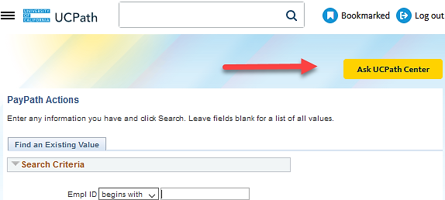
Ask UCPath Center – UCPC Case
UCPC cases are entered via the yellow Ask UCPath Center button in UCPath
This button is located at the top of all pages in UCPath
These cases are reviewed and resolved via the UCPC team and not the UCI UCPath team

Slide 12
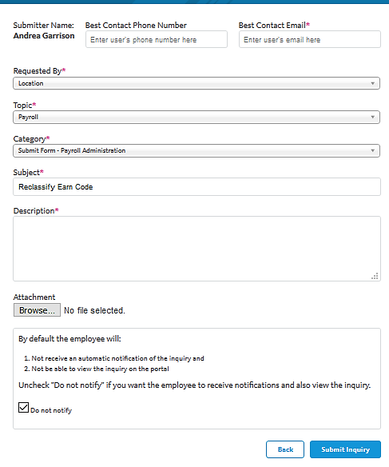
UCPC Case Entry
Use the information below to complete the UCPC Case:
Enter your phone number and email address
Requested by: Location
Topic: Payroll
Category: Submit Form – Payroll Administration
Subject: Reclassify Earn Code
Description: Enter an explanation of the change you want to make
Attach the spreadsheet
Click the Submit Inquiry button

Slide 13
What We Know So Far
This does not happen overnight; it will take several days or weeks for this correction to be finalized.
Payroll has to reverse this entry and rerun it.
This may result in an overpayment, underpayment or same pay due to the difference in eligibility for retirement contribution or other factors, as applicable.
The update to the CBR, GL and KFS will not occur until the Post GL Confirm process runs.
This process may have to run for the specific pay cycle, such as BW or Monthly.

Slide 14
2. Using JED in UCPath
Job Earnings Distribution information only needs to be identified when earnings are being distributed to an Earn Code other than REG.
JED percentages can be entered as partial percentages that equal to 100.00, entered in a specific format. For example, 20.5 and 79.5 can be entered as percentages equaling 100.
UCPath cannot accept 0.205 and 0.795 because adding those numbers equal 1.0 they must equal 100.00.

Slide 15
Summer Salary & JED
KEY NOTES !!!!
JED MUST be distributed By Percent
Summer Salary: GAP Earn code should be entered in the Earnings Distribution section ONLY IF the department is NOT Paying for the cap gap amount.
If the cap gap will be paid, identify the KFS account that will pay the gap on the MCOP Worksheet.
If ALL earnings, irrespective of capped funds, are being charged to a specific EARN CODE, distribute accordingly.

Slide 16
3. Multiple Components of Pay & Summer Salary
The Salary Cap/ MCOP Funding Worksheet is required when an employee is compensated with funds that have a salary cap and their compensation exceeds the amount allowed for the capped fund.
If the department is using a capped fund to pay for an employee’s summer salary appointment, use Salary/MCOP Funding Worksheet.
Vacant positions cannot have Multiple Components of Pay entered because employee compensation has not been identified in the system yet.
Compensation is determined on the Smart HR Hire Template.

Slide 17
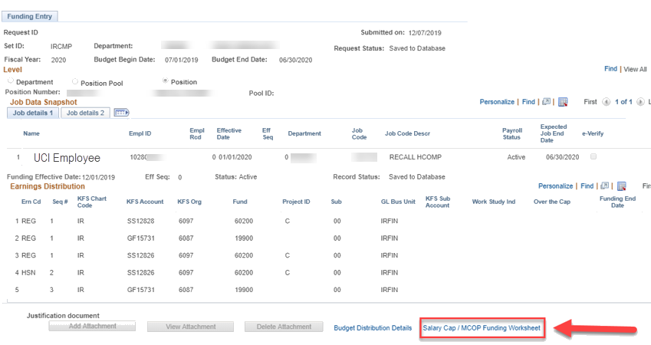
Salary/MCOP Worksheet
The Salary Cap/MCOP Funding Worksheet link is located at the bottom of the Funding Entry page.
In order to access the worksheet, an incumbent must be hired into the position. Incumbent information is located within the Job Data Snapshot.

Slide 18
Default Funding Profiles
Default Funding Profile section is set up to ensure that payroll expenses are charged to the correct KFS account/fund. Initiators have to indicate which account and fund will pay up to the cap and which will pay over the cap.
Effective Date – indicates when the use of this funding should begin.
These dates can be in the future, though it is recommended to not plan too far in the future should the funding need to change.
The Distribution % shows the percentage paid by earn code.
The OTC Indicator displays which accounts will/won’t cover the over the cap amount.

Slide 19
Funding Distribution Worksheet
The Funding Distribution Worksheet section allows the initiator to identify the desired funding sources for employee payroll expenses.
The Begin Dates and End Dates are specified to inform UCPath when the KFS Account should begin and end paying from the distribution line.
Begin Date should match the Effective Date in the Default Funding Profile section.
End Date should not go past the fiscal year end date of 6/30/YYYY.
The Percent of Pay and Percent of Effort fields must sum to 100% for each line entered.
Click the Funding Distribution Preview button to validate entry for errors.
Notes:
Please enter data on this page from left to right. You will encounter errors if you start entering information out of order.
Ensure you’re entering the correct account/fund. UCPath doesn’t validate the correct usage of funds. However the system will inform the initiator if the incorrect account combination is entered. The system will allow users to enter any chartfield combination that lives in KFS. Incorrect accounts/funds can be denied within the Funding Entry AWE process and may impact employee’s pay.
If there are errors, when the Funding Distribution Preview button is clicked the system will identify items that need to be addressed.

Slide 20
5. Q&A

