Slide 1
UCPath Training Updates
Tips & Lessons Learned
8/25/20

Slide 2
Quick Announcements
Training Documents - Updated.
Some documents updated and renamed.
Sponsored IDs
Sponsored ID can no longer be requested for employees that are going to be hired at UCI.
Please submit the appropriate Smart HR template to hire the employee.
Do not wait until last minute to submit transaction.

Slide 3
Quick Announcements II
UCPath Center Tickets/Cases
When submitting an “Ask UCPath” ticket, please be patient as the service level agreement for responses is 3-5 days.
Submitting multiple inquiries into the same transaction can cause unwanted delays and confusion.
Please escalate the matter if 5 or more days have passed without a response from the UCPath Center.

Slide 4
Agenda
Mass Hire Process Support
Personal Data Changes
Summer Salary

Slide 5
1. Mass Hire Process
Mass Hire transactions are being prepared for entry for the fall.
Individuals have been identified to enter transactions.
Mass Hire process is ONLY for Concurrent Hires & CWR.
Newly created positions should have an effective date of 7/1.
Graduate Students that need a WOS appointment, should be entered now – DO NOT WAIT.
Hires without SSN due to COVID-19 need to have comments entered on the template addressing this situation.

Slide 6
Mass Hire Support
Philip Nguyen will be supporting individuals entering Mass Hire Transactions from 3pm – 5pm daily (M-F) until further notice.
Please use the drop-in support center call information to access support from 3pm – 5pm
Zoom link: https://zoom.us/j/8519035805

Slide 7
2. Personal Data Change Methods
There are 3 methods to update personal / employee data in UCPath.
UCPath Employee Self-Service
In most cases, employees enter their own personal data changes using the UCPath Employee Actions.
Updates that can be made includes: Legal/Preferred name, SSN, personal email, emergency contacts, home and mailing address, employee disclosures, phone number, ethnic groups, military status and disability status.
UCPath “Person Data Change” Template Transaction
This method can be used to update the personal data mentioned above.
Notes:
Business e-mail and business address are updated through the UCI Identify management system.
Paperwork has to be submitted to legally update an employee’s gender. If your department or school is participating in the Onboarding Pilot you do not do the Social Security Number Verification (SSNVS) anymore.

Slide 8
Personal Data Change Methods (cont’d)
Submit “Ask UCPath” ticket on Behalf of Employee*
This method is used when the Initiator is requested to update certain personal information or submit a UCPC ticket “on behalf of” an employee. Examples include Legal Name, Date of Birth, Address, Phone number, gender, etc..
Initiator opens a case with the request, and UCPC WFA team enters the update directly in UCPath.
For example: For a gender marker change, the employee must submit a copy of a government issued ID, which indicates gender, to substantiate the request.
* A special security role (SOBO) must be granted in order to enter transactions on behalf of an employee
Notes:
This training covers the following methods that can be performed by a Template Initiator:
UCPath Template Transaction
AWE is not used when a personal data change is requested using Case Management.
Refer to the PHCMPOR110 course folder (in the Portal and Self Service folder) for additional information on submitting a case/inquiry.

Slide 9
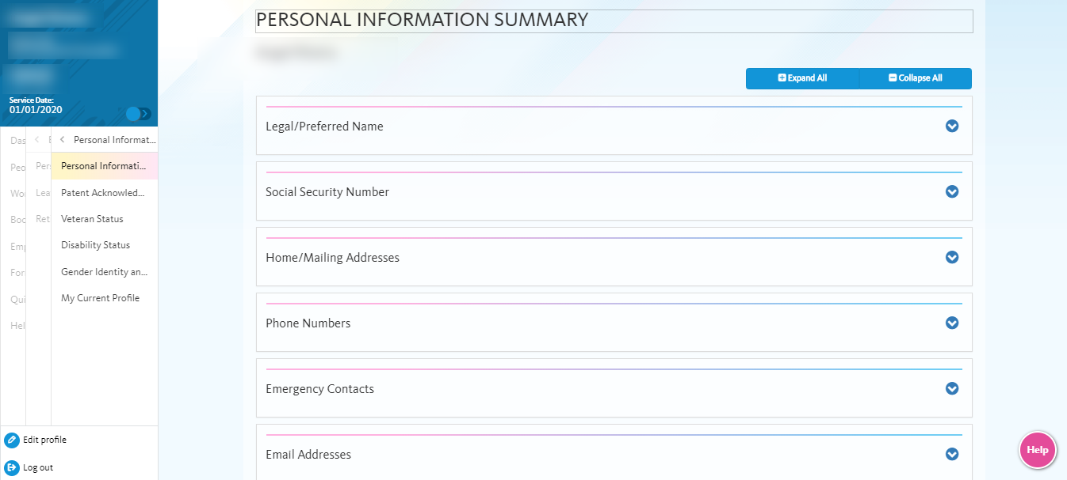
Employee Self Service Updates
Employees can update much of their personal information using Employee Self Service via the UCPath Portal.
Navigation: Employee Actions > Personal Information
Notes:
The sections available for employees to go in and make updates are:
Legal/Preferred Name
Home/Mailing Address
Phones Numbers
Emergency Contacts
Email Addresses
Ethnic Groups
Other Personal Information

Slide 10
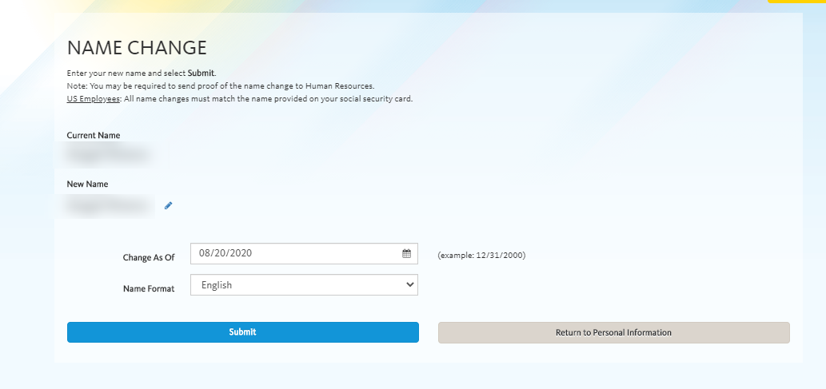
Legal/Preferred Name Updates
Update preferred name in UCPath with no required documentation
Notes:
The update for the preferred name happens as soon as the transaction is saved. Changes to the legal name will approve documentation and approval. When an employee changes their preferred name, unfortunately no notification is provided to their manager/supervisor. The new name will start appearing on the employee roster.
Click animation to display the Edit Name page.

Slide 11
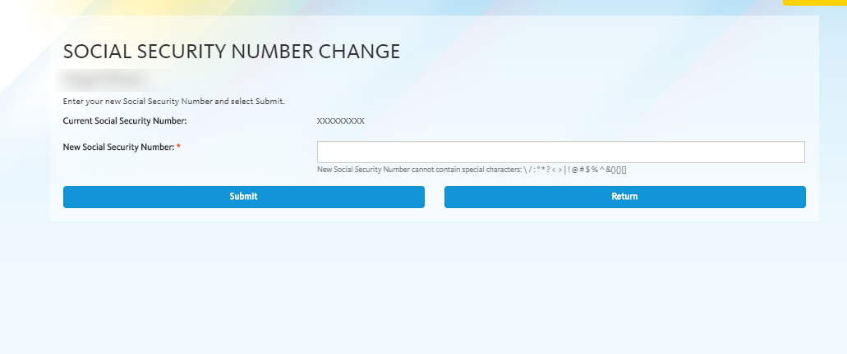
Social Security Updates
Employees are now able to update their Social Security numbers in UCPath via Self-Service.

Slide 12
3. Summer Salary Reminders
Please update the position FTE via PayPath Actions for any Faculty Summer Salary coming up in September.
For new Summer Salary entries, please ensure the position information is correct prior to submitting the hire template.
For departments using capped funds, the Salary/MCOP Worksheet is only available once an employee is active in the position.
JED Must be identified AFTER the hire has been processed by UCPC.
JED will be entered in PayPath Actions

Slide 13
Retro Dated Concurrent Hires
Retro Effective Dated concurrent hire entries that are submitted and approved AFTER a pay period has closed, will required an off-cycle payroll request if they miss pay.
The system will NOT automatically pay these employees for missed pay-periods once the hire transaction has been completed.
Please submit an EEC ticket if additional assistance is required.

Slide 14
Summer Salary & JED
KEY NOTES !!!!
JED MUST be distributed By Percent
Summer Salary: GAP Earn code should be entered in the Earnings Distribution section ONLY IF the department is NOT Paying for the cap gap amount.
If the cap gap will be paid, identify the KFS account that will pay the gap on the MCOP Worksheet.
If ALL earnings, irrespective of capped funds, are being charged to a specific EARN CODE, distribute accordingly.

Slide 15
Multiple Components of Pay & Summer Salary
The Salary Cap/ MCOP Funding Worksheet is required when an employee is compensated with funds that have a salary cap and their compensation exceeds the amount allowed for the capped fund.
If the department is using a capped fund to pay for an employee’s summer salary appointment, use Salary/MCOP Funding Worksheet.
Vacant positions cannot have Multiple Components of Pay entered because employee compensation has not been identified in the system yet.
Compensation is determined on the Smart HR Hire Template.

Slide 16
5. Q&A

