Slide 1
UCPath Training Updates
Tips & Lessons Learned
8/4/20

Slide 2
Important Reminders
Training Scheduled to begin August 17th
Classes held via Zoom
Please bring your questions to class.
If you’re still having trouble with the Position Control class registration, please email Angel Rivera (arriver2@uci.edu)

Slide 3
Quick Announcements
Reports
All Cognos reports are available
Pay Statements for 8/5 paychecks are available
Benefit/Salary Cost Transfers
Please only process ONE (1) salary or benefit cost transfer at a time.
Do NOT select multiple checks in one transaction.
Selecting multiple checks will cause an error.
Initiators will NOT get an error message. This issue impacts finance reports.
Overpayments
Please continue to report any overpayments over 1 month

Slide 4
* Virtual Drop-In Center *
To better serve you, please try to have the following information available, prior to calling or scheduling an appointment via the Drop-In Support center
Employee ID
Description of Issue
Screenshots (if applicable)
Any/All relevant transaction details

Slide 5
Agenda
EEC vs. UCPath Tickets
Summer Salary Changes
Position Data Update Form
Job Data Update Form

Slide 6
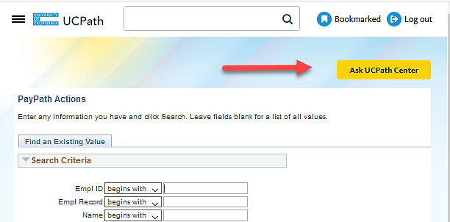
EEC Ticket vs UCPC Case
When to submit one versus the other?

Slide 7
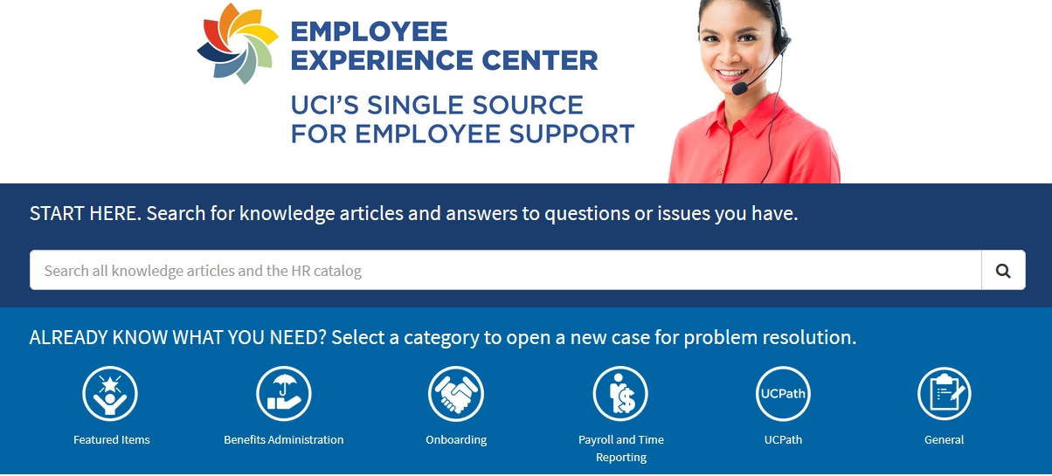
UCI UCPath Homepage - EEC
EEC is accessed via the UCI UCPath homepage
https://uci.service-now.com/eec
Tickets are routed only to UCI UCPath teams for review and resolution
EEC tickets are not viewed by UCPath Center teams
If escalation is required, then a separate UCPath Center case must be opened to get the UCPath Center involved

Slide 8
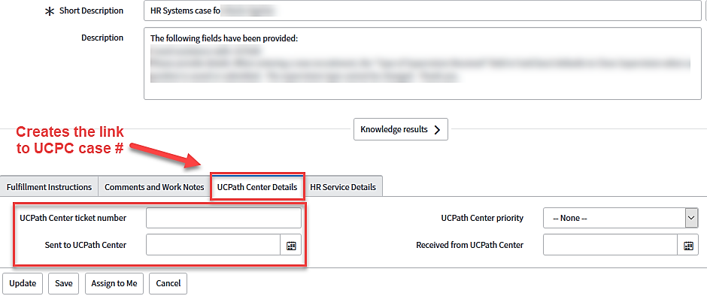
Linking a EEC ticket to UCPC Case
If you are instructed to open a UCPC case, please link the EEC ticket and UCPC case by entering the UCPC case number in the EEC ticket for tracking
Notes:
Communication with the UCI UCPath team is handled through the Comments and Work Notes tab so that history of the issue is built.

Slide 9
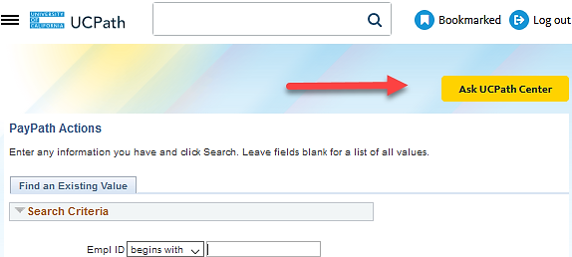
Ask UCPath Center – UCPC Case
UCPC cases are entered via the yellow Ask UCPath Center button in UCPath
This button is located at the top of all pages in UCPath
These cases are reviewed and resolved via the UCPC team and not the UCI UCPath team

Slide 10
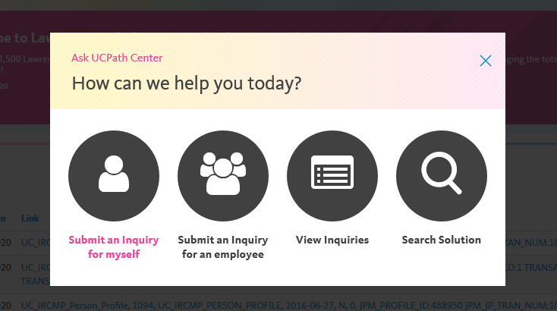
Ask UCPath Center – Options
Four options are available after clicking the yellow Ask UCPath Center button:
Submit an Inquiry for myself – choose this option if you are asking a question about your own ticket or unable to indicate who the ticket is for. UCPC prefers the SOBO (submit on behalf of) as there can be confusion on who the ticket is about
Submit an Inquiry for an employee – choose this option if you are submitting a case on behalf of an employee. Be sure to uncheck the box if you want the employee to receive updates.

Slide 11
Ask UCPath Center – Options Cont’d
View Inquiries – choose this option to view the status of inquiries you have previously submitted.
Search Solution – choose this option to search for published answers to questions you may have.

Slide 12
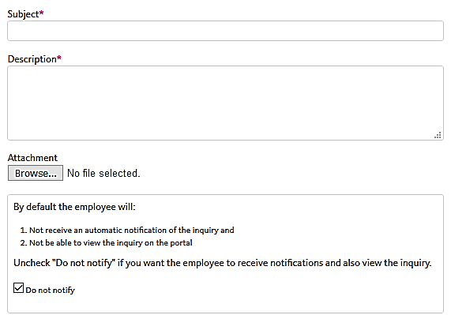
Attachments and Comments
Attachments – be sure to send screenshots of issues encountered including error messages. Try to capture as much of the screen as possible.
Comments – be very detailed with your comments; always include the employee ID, employee record, effective date, etc. Do not make the UCPath Center have to guess any of this information.

Slide 13
2. Summer Salary Changes
Prior to the start of Summer, the AP Office & Training team designed a process to enter Summer Salary appointments into UCPath.
The initial decision involved
Decoupling the Position FTE from Job data,
Entering a different value for each varying month.
That process did not work due to the fact that there was a system auto-generated effective dated row entered on the position based on the effective date the HIRE transaction took place.
Notes:
Once the next Funding Entry transaction that affects the MCOP Worksheet is entered, the new compensation data is updated. Because this particular employee’s compensation is paid from one fund source, there is no urgency to take action. If the compensation was being paid from multiple fund sources and the increase in pay changed the distribution percentages, then the urgency to make the update to the MCOP worksheet would be necessary. In this example, the compensation will continue to pull from the same account but at a higher rate.

Slide 14
Summer Salary Woes
The system generated entry prevented users from being able to use the faculty start date as the effective date of the FTE decoupling. This caused records/FTE to be off by 1 day.
Overpayments
Corrections
Job Data Forms
Etc.
Additionally, JED doesn't apply correctly when entered on the Smart HR template. Many faculty members have had the JED default to a DEF earn code. This is a timing issue. We learned that UCPath has to assign the pay group first, prior to JED being defined.

Slide 15
Summer Salary Fundamentals
Continue to:
Utilize the summer salary worksheet to identify the type of summer salary appointment to be entered In UCPath:
Effort Bearing - Concurrent Hire
Non-Effort Bearing – Enter Additional Pay on Current job / Or - Concurrent Hire
All Summer Salary FTE is calculated based on a 19 day month (June, July, August, September)
Exception: Law School (May, June, July, August)

Slide 16
NEW – Summer Salary Processing
Positions should be set to the actual FTE value for the Summer Salary month - NO MORE DECOUPLING.
2. Smart HR Template to be submitted without JED.
*DO NOT:
Create positions with 1.0 FTE, if it’s not the actual FTE for the Summer Salary month.
Enter a Summer Salary Earn Code in the Earnings Distribution tab on the Smart HR Template for Concurrent Hire.

Slide 17
Summer Salary – Example A
Professor Smith will begin his Summer Salary appointment on June 1st, based on the summer salary worksheet, his appointment is effort bearing and his FTE for the month June is .2632
The Summer Salary Position should be created with an FTE of .2632
Create a Concurrent Hire Smart HR Template to hire the faculty member into the new position. DO NOT ENTER ANYTHING on Earnings Distribution tab (JED)
After hire is processed by UCPC, submit a PayPath Action to enter JED on the Job Data tab.

Slide 18
Summer Salary – Example B
In July, Professor Smith's FTE increases to 1.0:
In PayPath Actions, on the Position tab, enter the effective date of the FTE change (July 1st)
Enter the Position Change Reason: TIT (Temporary Increase in Time)
In the FTE field, enter the new FTE value (1.0)
Submit from the Additional Pay Tab.

Slide 19
3. Position Data Update Form
Location of Document: UCI UCPath Website OR UCPath Forms Library
Purpose: After the position has been created and approved, this form is used to make position corrections that UC Locations are unable to perform.
Examples:
Correction to Position Effective Date (creation date)
ANY correction dating back to original position efft. Date
FTE Corrections
Salary Admin Plans
Head Count
Special Training / Verification requirements
NOTE: All data update forms are to be submitted as a CASE to the UCPath Center.

Slide 20
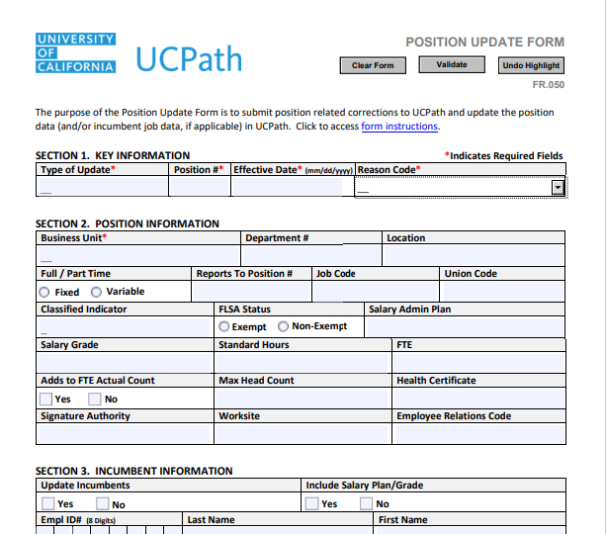
Filling out Pos. Data Update Form
It is strongly recommended to download and save the document to your computer in order to activate values for each required field.
Please make sure to fill out the areas with red asterisks. Those fields are required.
If the position change affects the Employee, please include employee’s ID number in the required section.
Please ensure to enter detailed comments so the UCPath Center understands the change you’re looking to make

Slide 21
4. Job Data Update Form
Location of Document: UCI UCPath Website OR UCPath Forms Library
Purpose: This form is utilized to make corrections to Employee Job data that UC Locations are unable to fix or enter in UCPath.
Examples:
Correction to Hire/Termination Effective Dates
Employee Class
Position Changes (not original pos. efft. date)
Pay Group
Benefit Eligibility Group
Pay Components change
Probation / Anniversary dates
NOTE: Job Data Update forms can only be submitted to fix JOB RECORD information, not vacant positions.

Slide 22
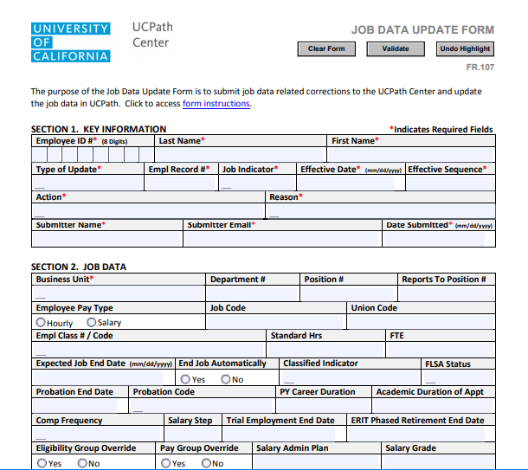
Filling out Job Data Update Form
It is strongly recommended to download and save the document to your computer in order to activate values for each required field.
Please make sure to fill out the areas with red asterisks. Those fields are required.
Please be detailed in the comments section of the form. Provide as much detail to what is changing as possible.
Please ensure that changes to employee job data are not able to be entered in PayPath Actions first, before submitting a Job Data Update form.

Slide 23
5. Q&A

