Slide 1
UCPath Training Updates
Tips & Lessons Learned
9/8/20

Slide 2
Quick Announcements I
Inter-location One Time Payments
HOST location is responsible for entering the additional pay request in UCPath.
Employee will need to be hired into a position/job at the host location first.
Sponsored IDs
Sponsored ID can no longer be requested for employees that are going to be hired at UCI.
Please submit the appropriate Smart HR template to hire the employee.
Do not wait until last minute to submit transaction.

Slide 3
Quick Announcements II
September – 3 Bi-weekly Pay Checks
For EE’s receiving additional pay, please check the appropriate “Applies- to Pay Periods” that should be paid.

Slide 4
Quick Announcements III
Pre-Hire Process
The Pre-Hire process can be used to grant future UC Employees early access to the UCPath System.
Smart HR Hire Template should be submitted at least 3 weeks prior to employee’s start date.
The Pre-hire process allows the minimum amount of an employee’s information to be entered prior to their start date in order to have an Employee ID generated.
The following items should be entered on Template before submitting a Pre-hire:
Full name (First, Middle or Initial, Last)
Address
DOB or SSN
Email
Position/Job Title

Slide 5
Agenda
Employee Relation Codes
Earn Code List: Uses & Demo
HR Worksite ID Requirement

Slide 6
1. Employee Relation Codes
Online Resources:
Definitions under Higher Education Employer-Employee Relations Act (HEERA)
UCI Employee Relation Codes
Job Classification: Contact Campus/HS/MC Compensation consultants

Slide 7
Position Control: Employee Relation Code
Rule 1: always choose the non-confidential options.
Confidential* options are only available for certain employees in Central HR and Chancellor’s office.
Confidential: An employee required to develop or present management positions for collective bargaining, and/or an employee whose duties normally require access to information which contributes significantly to the development of such management positions.
Rule 2: Click on Specific Information tab.
If Classified Indicator is “Management & Sr Professional” (MSP), on the UC Position Data tab choose “Manager – Not Confidential”
If Classified Indicator is “Professional & Support Staff” (PSS) and the Job Code on the Description tab has a supervisory title (Admin Analyst Supv), choose “Supervisor – Not Confidential” on the UC Position Data tab.
If Classified Indicator is “Professional & Support Staff” (PSS) and the Job Code on the Description tab does not have a supervisory title (Admin Analyst), choose “All others – Not Confidential” on the UC Position Data tab. (most common value)

Slide 8
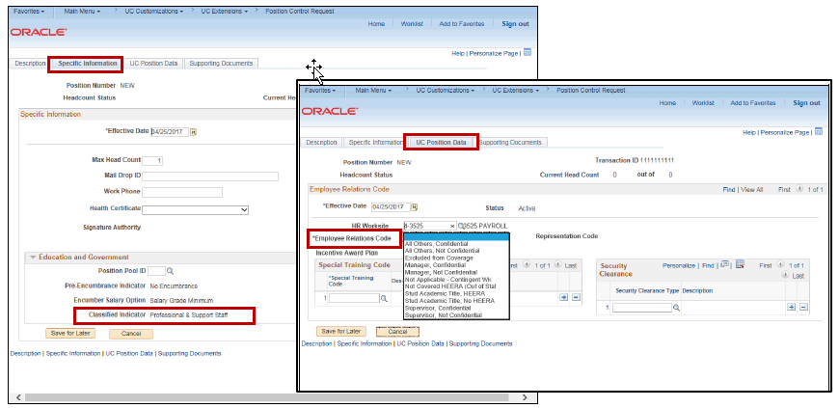
Position Control: Employee Relation Code – (Cont’d)

Slide 9
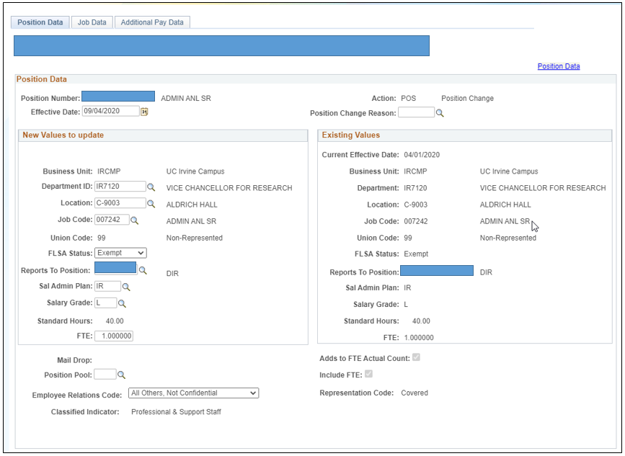
PayPath Actions: Employee Relation Code Apply the same rules as for Position Control
PayPath: Employee Relation Code

Slide 10
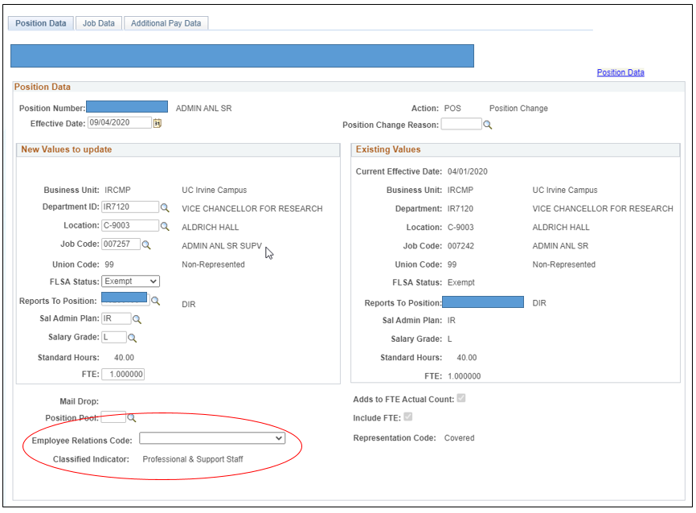
PayPath Actions: Employee Relation Code Apply the same rules as for Position Control
PayPath: Employee Relation Code – (Cont’d)

Slide 11
PayPath Actions: Employee Relation Code Apply the same rules as for Position Control
Employee Relation Code Selection

Slide 12
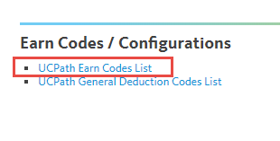
2. Earn Code List
Understanding the Earn Code List
This document lists all UCPath related earn codes, what they’re used for, and whether the earn code triggers retro pay or not.
Navigation: Dashboard Quicklinks > Payroll Resources > Payroll Configuration Codes > UCPath Earn Codes List
Notes:
Business e-mail and business address are updated through the UCI Identify management system.
Paperwork has to be submitted to legally update an employee’s gender. If your department or school is participating in the Onboarding Pilot you do not do the Social Security Number Verification (SSNVS) anymore.

Slide 13
Using the Earn Code Spreadsheet
Within the Earn Code Configuration spreadsheet, there are various columns with additional information relevant to the use of that specific earn code.
UCI DOES NOT USE ALL OF THE EARN CODES on the list.
This document references all EARN Codes that may be used at various locations, not just UCI. Please use as a research tool, not as a means of guidance.

Slide 14
3. HR Worksite ID Requirements
Effective Saturday, August 29, 2020, the HR Worksite ID field will be required when creating new positions or updating vacant positions through the Position Control Request pages in UCPath.
Old Options:
UCI No-Everify = manual i-9/onboarding process
UCI Everify = system auto-generated i9 communication for employee to initiate.
New Values in UCPath
N – No I9 Integration required:
Using “N” in the position HR Worksite ID field will ensure new I-9’s and E-Verify functionality will not be initiated for an employee hired into the position.
“U” (U – Unknown) value, as it is only for administrator use and is not a valid HR Worksite ID. - DO NOT USE

Slide 15
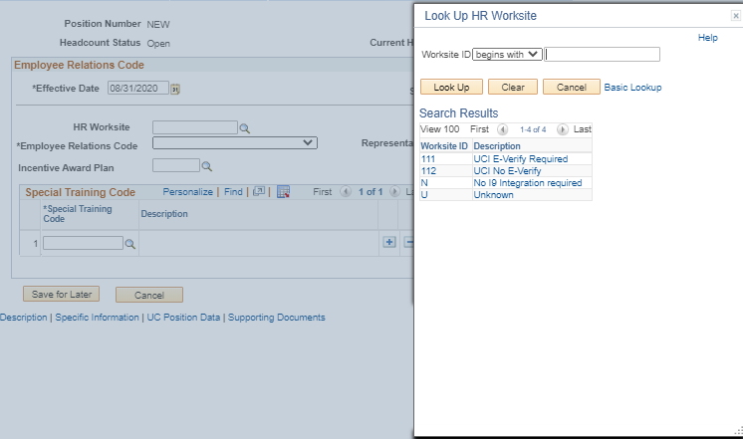
HR Worksite ID

Slide 16
5. Q&A

