Slide 1
Benefit Cost Transfer(BCT) Issue
Only triggered if there is a prior Salary Cost Transfer(SCT) which transferred the benefits along with the costs

Slide 2
How to determine if the Salary Cost Transfer was processed?
Negative amounts in OLD Data section indicate the benefits did transfer, although may not be in same period.
Navigate to Process Benefit Cost Transfer page:
PeopleSoft Menu > Payroll for North America > Payroll Distribution > UC Customization > Process Benefit Cost Transfer
Old Data section
Negative amounts indicate the benefit costs have already moved with the previous Salary Cost Transfer.

Slide 3
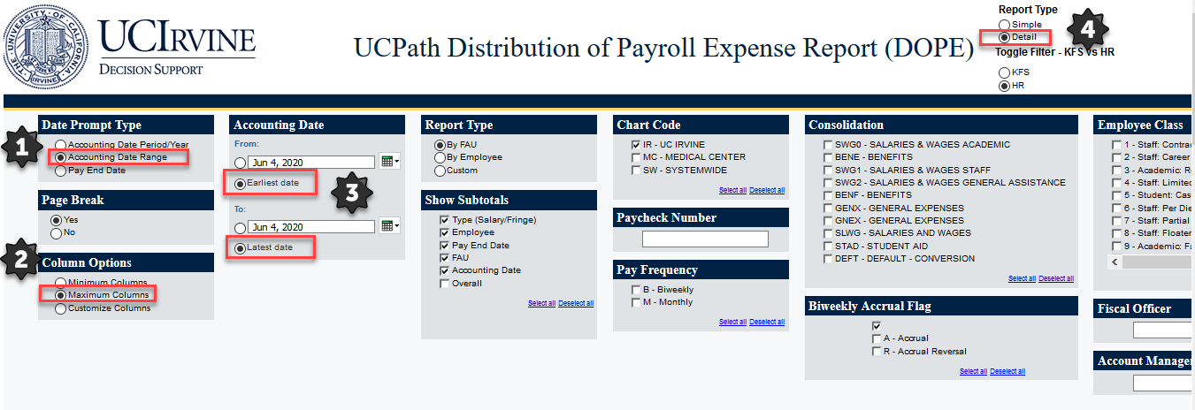
Run the DOPE Report
Ensure you use a wider date range to ensure the transaction did not process in a different period and validate all the pieces of the transaction are in the UCPath Labor Ledger
Notes:
Run DOPE report using new missing transaction in period feature and validate that all pieces of transaction are in UCPath Labor Ledger

Slide 4
If Benefits Did not Transfer and Cost Transfer is Needed
Fill out an EEC ticket and UCI UCPath Support team will get back to you for assistance
This process will require a UCPC ticket for a custom SQL, so it will not be a quick turnaround

