Slide 1
UCPath Training Updates
Tips & Lessons Learned
7/14/20

Slide 2
Important Reminders
TRAINING STARTS 8/17
Registration for schedule 4A is now available in UCLC!
Click here for training schedule
Training Materials are being updated!!
Please visit the Transactional Users section on the UCI UCPath Website for all the latest training materials.

Slide 3
New Training Schedule
There will be 2 (two) training schedule options available in August.
Accelerated Pace (4A)
2 weeks
Last Summer Salary training before summer ends.
Most trainings last a full day
Customary Pace (4B)
4 weeks
No Summer Salary course
Most training classes are half days.
Instructor Led classes are scheduled intermittently.
Training must be completed and validated by DSA before Security access is granted in UCPath. No exceptions.

Slide 4
Quick Announcements
System Outage
Friday July 17th @ 10:00pm – Monday July 20 by 6:00am
Migration Activity for LBNL
Union Dues & SWB
Union Dues for employees on an ACTIVE Short Work Break are placed on HOLD and will not be billed.
UCPC Service Levels
Service level from UCPC should return to normal
VLA Assessments
Transactions are being still being worked on / updated.

Slide 5
Agenda
New Transaction Requirements for BX Employees
Distributions – UCPath vs. PPS
Transferring Positions to another Department

Slide 6
1. “BX” Employees
Changes were recently implemented for the BX bargaining unit to ensure compliance with the labor agreement.
Previous State:
The Employee Relations Code was required on every position entry. (i.e. all other, non-confidential)
There was no validation to ensure that the Employee Relations Code was correctly entered for the Job Code.
When the Job Code was changed the Employee Relations Code was not required to be updated resulting in inaccurate employee relations code entries that caused several downstream issues.
Notes:
Depending on the circumstances, which option to use and when, can vary.

Slide 7
Bx Employee – New Changes
Current State:
The Employee Relations Code is now required for all job code changes in order to validate against the Union Code.
All positions with a Job Code tied to the BX union code will require that the Employee Relations Code equals “H” (H = Stud Academic Title, HEERA).
All positions with a Job Code tied to a Union Code that is not BX cannot have “H” as the Employee Relations Code.
When the Job Code is changed for any position, the existing Employee Relations Code will be removed and the transactor will need to enter the correct Employee Relations Code based on the change in Job Code and possibly the Union Code.
This will apply to position updates made in PayPath Actions, Mass Update of PayPath, Add/Update Position Info, and Position Control Request.
The Employee Relations Code should also be included on the Position Update Form when corrections are submitted to UCPath.
The message below appears when the Job Code is changed in the PayPath Actions page as a reminder to update the Employee Relations Code:

Slide 8
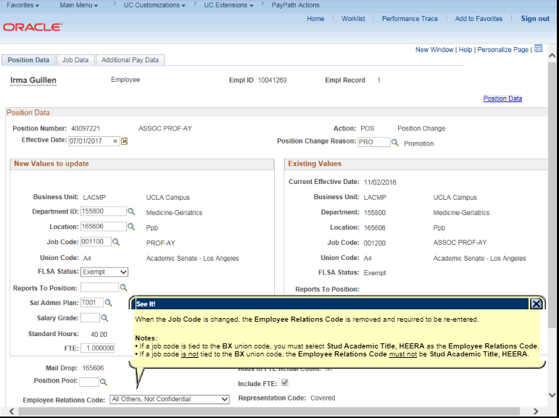
PayPath Actions: Employee Relations Code

Slide 9
2. Distributions
Distribution information has taken a different meaning in UCPath.
It is recommended to not look for comparisons between PPS distribution lines, and UCPath funding entries.
In Funding, Pay Distribution Percentage in UCPath IS NOT reflective of the FTE in Job Data.
The Pay Distribution % represents which funding sources will pay the person’s salary. All sources must equal 100%, if funding is coming from more than 1 source.

Slide 10
Distributions: Example A
Employee FTE = .60 = $60,000.00 / Year
Employee’s Salary is Split between 2 sources ($60k = 60/40 split)
Funding from Source A & B must equal 100% (Source A 60%, Source B 40%) to pay out the employee’s 60% ($60k) appointment.

Slide 11
Distributions: Example B
Employee FTE: 22.5% (.225)
Finance says to fund the positions from Fund Source A @ 10% and from Source B @ 12.5%
Fund Source A:
10% divided by 22.5 = 44% on Funding Pay Dist %
Fund Source B:
12% divided by 22.5 = 56% on Funding Pay Dist %

Slide 12
3. Transferring Positions
Transferring positions should occur in instances where the POSITION & FUNDING are moving over to the receiving department.
Current State:
Department changes were entered as a change in the Position Data tab in PayPath Actions. The receiving department would then have to setup the appropriate funding for the position they received.
Issue: Department changes, although approved, were not happening in the system, triggering many issues/delays, including wrong departments to be charged, in some cases.
Future State:
When a complete transfer of a position occurs, submit an EEC ticket to request the Position Administrator to make the changes.
Whether the position is vacant or filled, the Position Administrator has access to make changes on behalf of a department if unsuccessful attempts have been made.

Slide 13
5. Transactor Q&A

